Slide 1
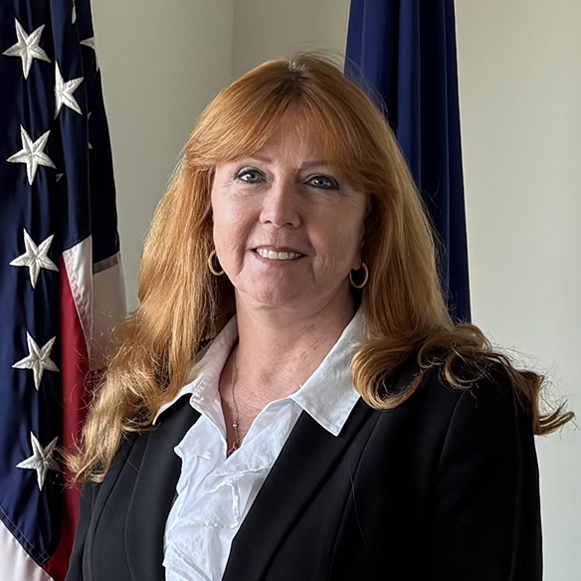

Ms. Dianna Seaborn
Made in America Manufacturing
Deputy Associate Administrator
Office of Capital Access Small Business Administration

Slide 2
U.S. Small Business Administration Office of Capital Access Business Loan Program Overview Army Small Business Seminar
January 22, 2026

Slide 3
SBA Initiatives
Access to Capital
Manufacturing
Strengthen Supply Chains
Rural Business
Critical Minerals
Veterans
Red Tape Hotline

Slide 4




SBA Loan and Surety Programs
504 Loan
7(a) Loan
Microloan
Surety Bond Guarantees

Slide 5
Am I Eligible?
Be an operating business
Be organized for profit
Be located in the United States
Be “small” based on regulatory size requirements
Demonstrate a need for the desired credit
Demonstrate the ability to repay the debt from the cash flows of the Applicant business

Slide 6
504 Loan Program
for Small Businesses

Slide 7
How the 504 Loan Program Works
Provides funding for fixed assets:
Real estate acquisition, improvements, and ground–up construction
Machinery and equipment acquisition and installation
Refinancing of equipment term loans and deeds of trust or mortgages
Typical structure is 50% from conventional lender, 40% from SBA through our Certified Development Companies (CDC's), and 10% borrower equity
10-, 20-, and 25-year maturity terms available
Low, fixed-rate of interest for the SBA portion for life of the SBA portion
SBA loan maximum is $5,000,000 for most loans, and $5,500,000 for manufacturing

Slide 8
504 Eligible Uses of Proceeds
Acquire land (by purchase or lease) as part of an eligible project
Improve a site
Purchase one or more existing buildings
Convert, expand, or renovate one or more existing buildings
Construct one or more new buildings
Acquire (by purchase or lease) and install fixed assets

Slide 9
7(a) Loan Program
for Small Businesses

Slide 10
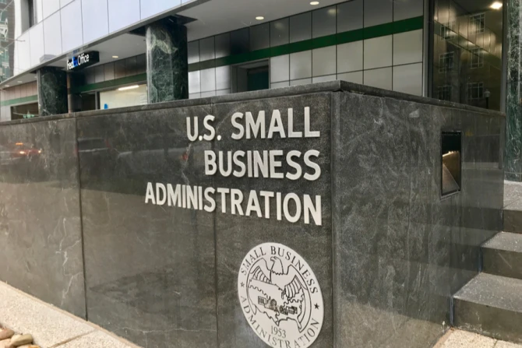


How the 7(a) Loan Program Works
SBA - Partners with financial institutions such as banks, Credit Unions, CDFIs, and other mission-based lenders to offer private dollars leveraged by an SBA guaranty
Lenders - Make, close, and service loans to provide capital to Applicants
Applicant - Receives credit that would not have been available elsewhere. Applicants only interact with their lender

Slide 11
7(a) What can I use the loan for?
Long- and short-term working capital
The purchase of equipment, machinery, furniture, fixtures, inventory, supplies, or materials
The purchase of real estate, including land and buildings
The construction a new building or renovation of an existing building
Establishing a new business or assisting in the acquisition, operation or expansion of an existing business
Refinancing existing business debt, under certain conditions
Lines of credit - Revolving funds based on the value of existing inventory and receivables

Slide 12
7(a) Loan Terms
Working capital and inventory loans must not exceed 10 years
Equipment, fixtures, or furniture loans should not exceed 10 years
Real estate loans may be up to 25 years
General Policy on Interest Rates
A 7(a) loan may have a fixed or variable interest rate
Maximum Variable Interest Rates are based on the loan amount:
$50,000 and less = Prime + 6.5%
$50,001 to $250,000 = Prime + 6.0%
$250,001 to $350,000 = Prime + 4.5%
$350,001 and greater = Prime + 3.0%

Slide 13
Microloan Program
for Small Businesses
sba.gov/microloans

Slide 14
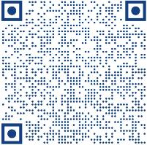
Microloan Program
The microloan program provides loans up to $50,000 to help small businesses and certain not-for-profit childcare centers start up and expand. The average microloan is about $13,000.
SBA provides funds to specially designated intermediary lenders, which are nonprofit community-based organizations with experience in lending as well as management and technical assistance. These intermediaries administer the Microloan program for eligible borrowers.
Scan the QR code to find authorized intermediary lenders

Slide 15
Surety Bond Guarantee Program for Small Businesses
sba.gov/osg

Slide 16
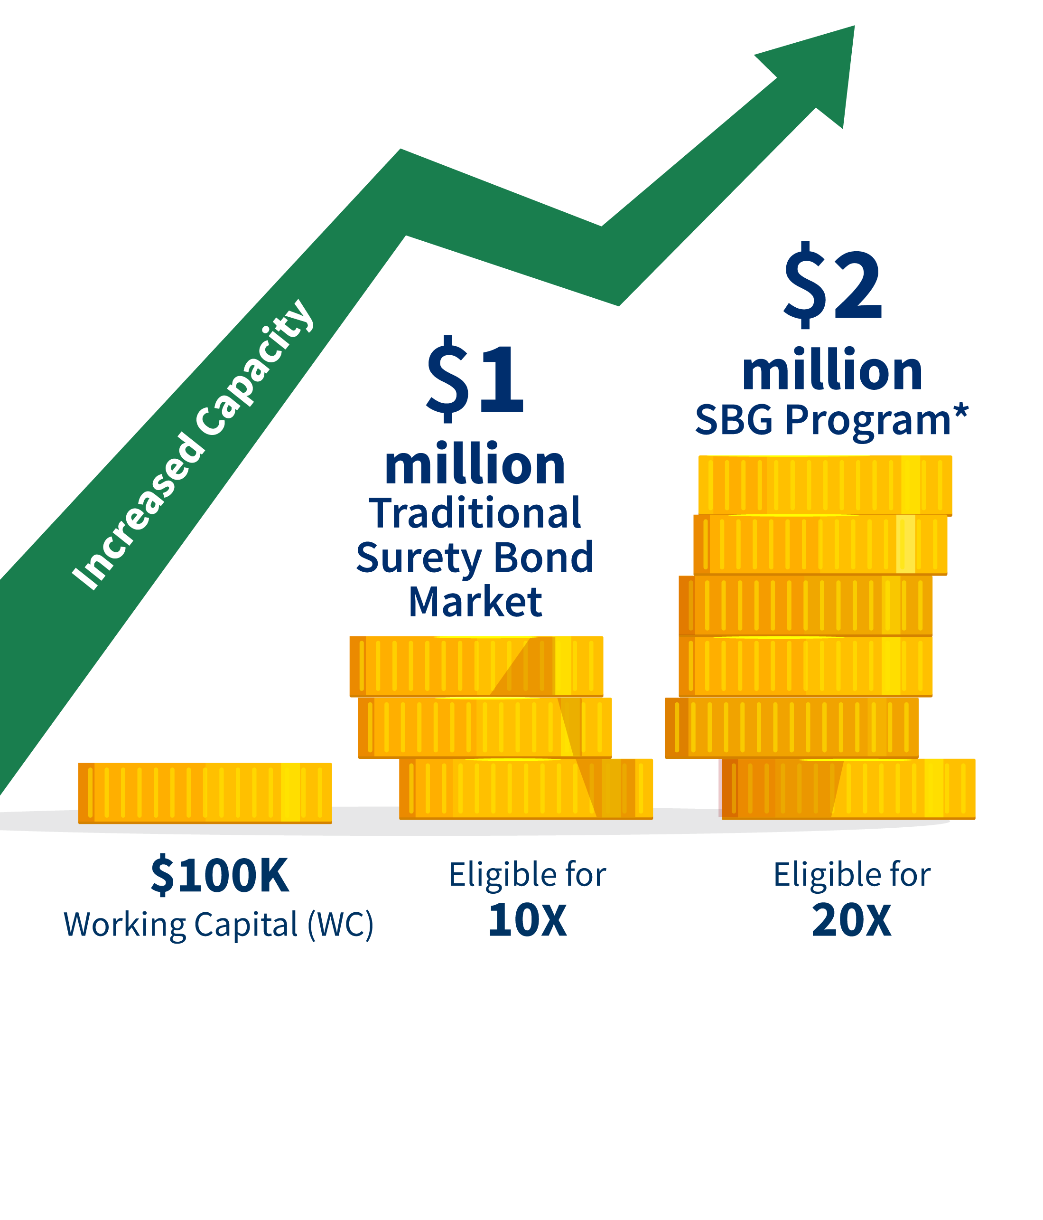
Benefits of SBA Guaranteed Bonds

Slide 17
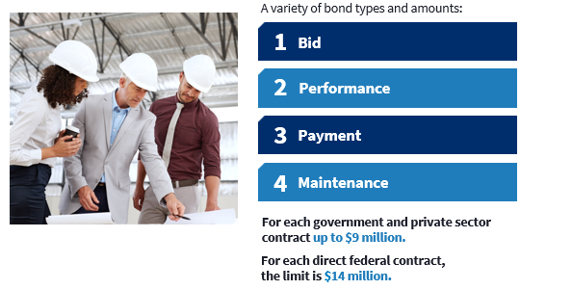
Types of Bonds SBA Guarantees

Slide 18

Find an SBA-authorized surety agent
Visit
sba.gov/osg
Visit
sba.gov/osg

Slide 19

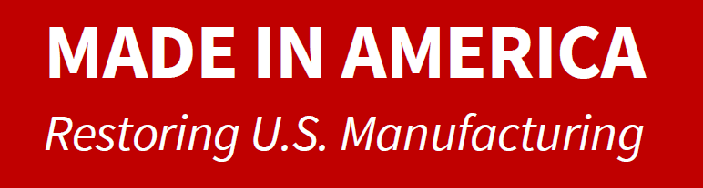

Slide 20
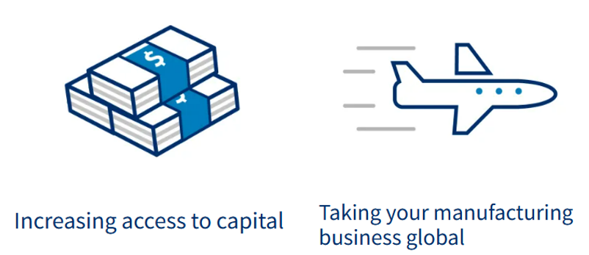
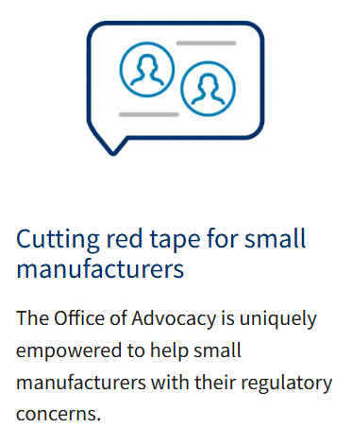
Made in America Manufacturing Initiative
Reduce barriers to access the SBA 504 loan program and Expand the use of the 7(a) Working Capital Pilot program.
Help small businesses export their products on a global scale.

Slide 21
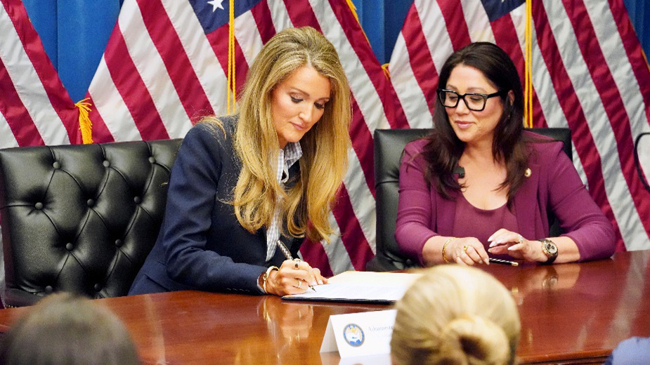
July 16, 2025 - The U.S. Small Business Administration and Department of Labor signed a memorandum of understanding (MOU) in support of domestic manufacturing. These agreements promote a skilled manufacturing workforce by partnering with agencies, trade schools and private sector stakeholders to create a pipeline of skilled workers to support manufacturing.
The agreement

Slide 22
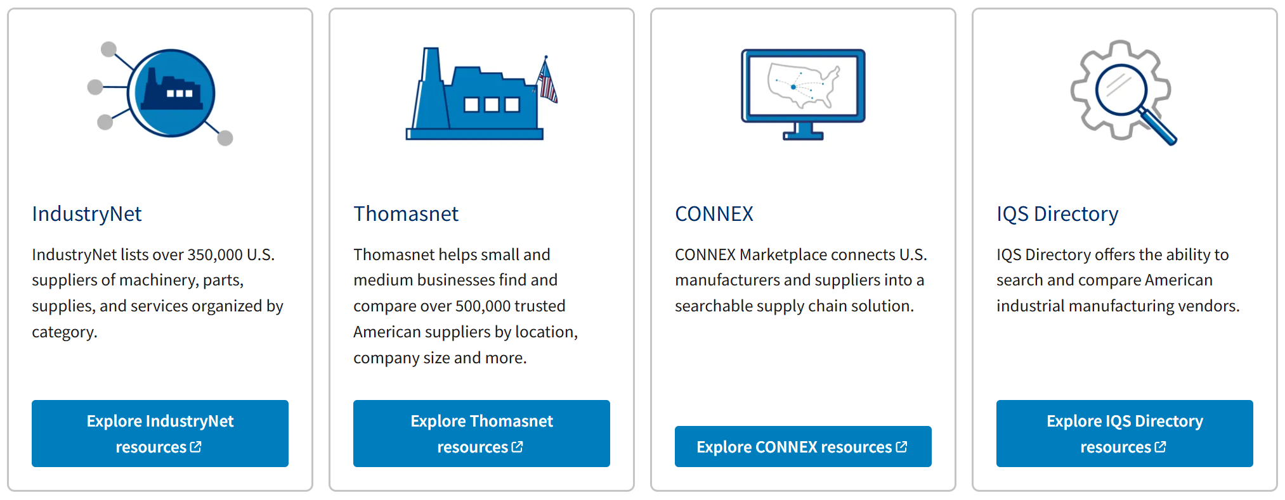
Make Onshoring Great Again
Discover a network of more than 1 Million Domestic Suppliers
Get your search started at www.SBA.gov/Manufacturing

Slide 23
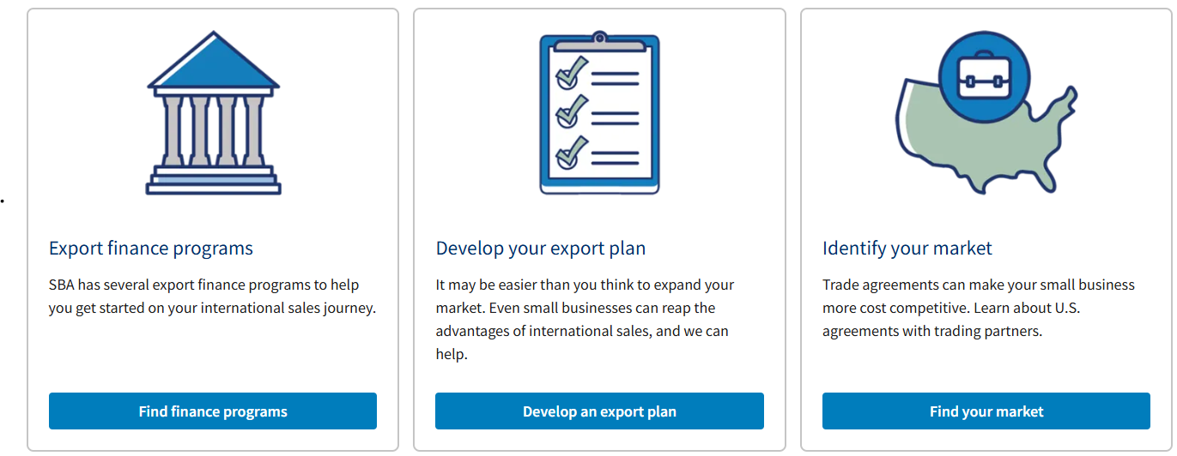
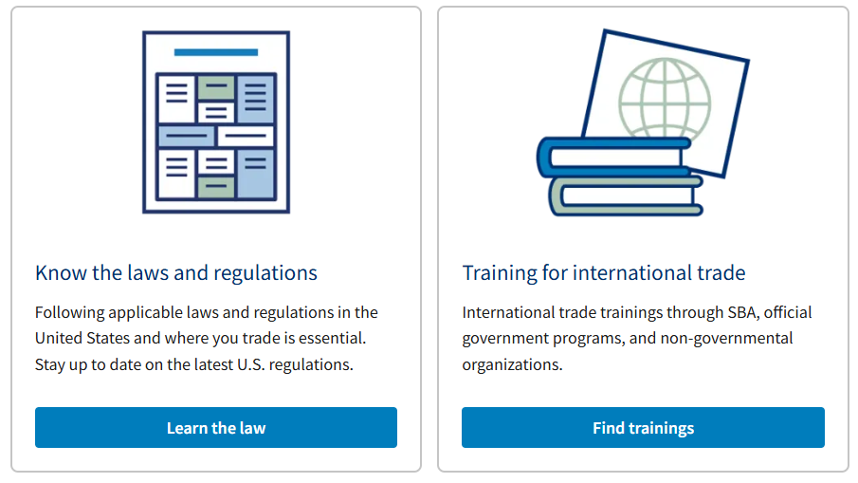
SBA Trade Tools
Unlocking information and expertise for U.S. small business exporters
Learn more at www.sba.gov/tradetools
Contact Email: International@sba.gov

Slide 24
SBA Supports U.S. Manufacturers
Sept 4, 2025 - SBA Announces the Manufacturers’ Access to Revolving Credit Loan Program (MARC)
Sept 18, 2025 - SBA Waives Loan Fees for Small Manufacturers in Fiscal Year 2026
Zero upfront fees for 7(a) Manufacturing loans up to $950,000
Zero upfront and annual service fees for all 504 manufacturing loans
Sept 23, 2025 – SBA awards $1.1 Million in Empower to Grow grants to fund training for small manufacturers in critical industries

Slide 25
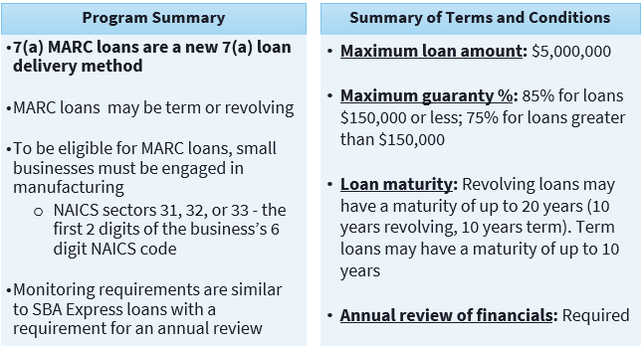
7(a) Manufacturer’s Revolving Credit Loans (MARC) At-A-Glance

Slide 26
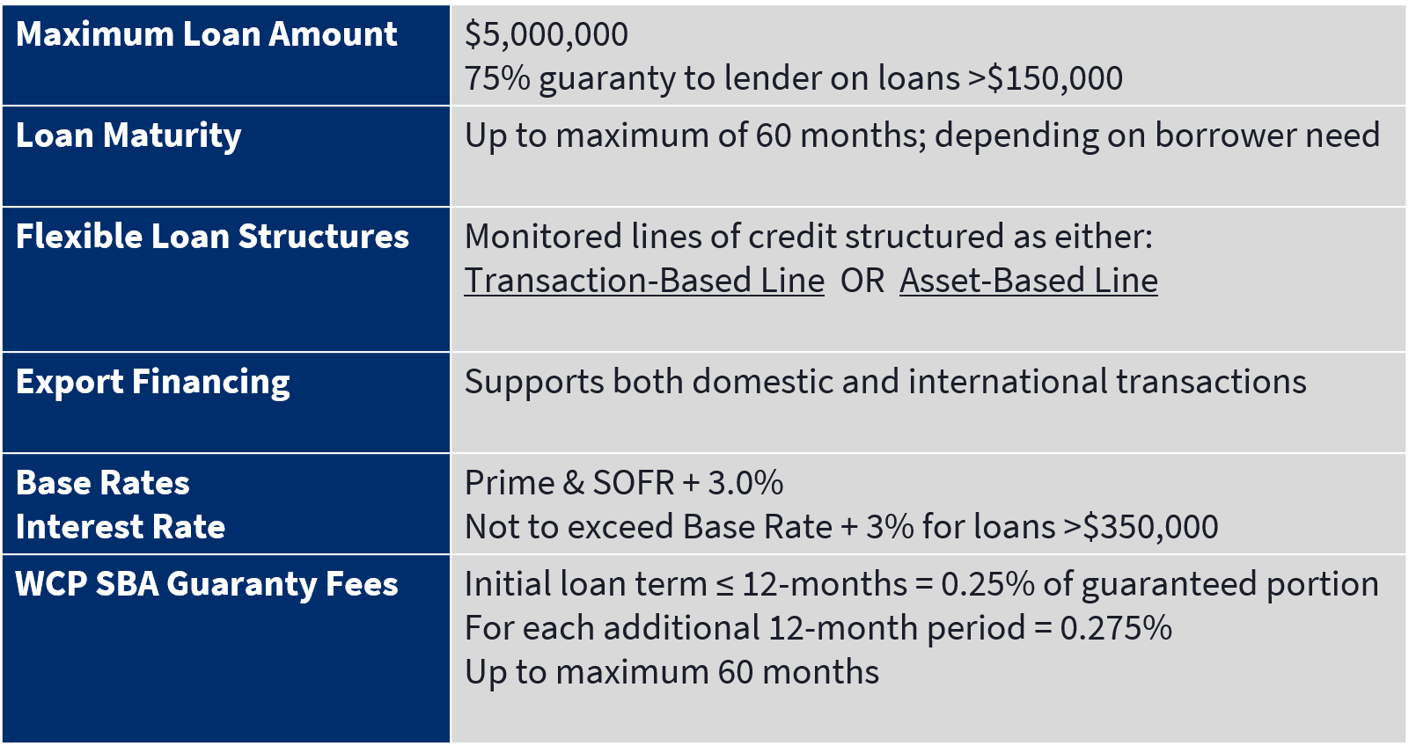
7(a) Working Capital Pilot (WCP) Program At-A-Glance

Slide 27
WCP: Transaction-Based Example
Example highlights two challenges facing a small business engaged in a large contract that the Transaction-Based WCP can help solve:
Need to access funding before billing revenue is received
A small business that has a large concentration of revenues from a single buyer
Business Need:
XYZ Engineering won a large government contract in which they will provide custom-fabricated components for a multi-stage infrastructure project
XYZ is having some components produced by a U.S. contract manufacturer but needs funding to begin production
Solution:
Using a Transaction-Based WCP line of credit, XYZ can draw on the line to fund payments to their U.S. contract manufacturing partner and cover the direct labor involved with the project before installment payments begin to be received from customer.

Slide 28
WCP: Asset-Based Example
Business Need:
ABC Company manufactures and distributes medical devices throughout the US and Latin America
Due to occasional shortages in surgical-grade stainless steel, management has been increasing their purchases of raw materials to ensure they have enough stockpiled
ABC is carrying more inventory on its balance sheet, which has strained their cash position
Solution:
An Asset-Based WCP line of credit allows ABC to access liquidity against their A/R and inventory
Without the assistance of the WCP, ABC would not be able to borrow as much against their accounts receivable and inventory, due to collateral requirements
Lender can advance more funds against ABC’s larger inventory position with the support of the SBA’s guaranty, allowing
the business to access the working capital

Slide 29
WCP & MARC Loan Example
Business Need:
Metal stamping manufacturer serving the telecom and defense sectors. Their largest customer represents approximately 50% of sales. To diversify customers, the company plans to invest $1MM to develop a new product for the medical sector. Additional working capital is needed to fund the new opportunity.
The business requires $1MM in working capital to support product development and to increase their existing $1MM line of credit to $2.5MM support the addition of new customers.
Solution:
Loan 1: $1mn MARC term loan (10-year term)
Loan 2: $2.5mn WCP revolving line of credit (annual reviews)
Without the assistance of the SBA lender would face customer concentration issues with their lender.

Slide 30
SBA Contacts
Office of Financial Assistance
Dan Pische, Director OFA
daniel.pische@sba.gov
7a Loan Program
Bob Carpenter
Acting Chief, 7(a) Loan Division
robert.carpenter@sba.gov
504 Loan Program
Linda Reilly
Chief, 504 Loan Division
linda.reilly@sba.gov
Manufacturing & Trade
Gayle Roenbaugh
Director
gayle.roenbaugh@sba.gov
Microloan Program
Chris Webb
Acting Chief, Microloan Division
james.webb@sba.gov
Office of Surety Guarantees (OSG)
Jermaine Perry, Director
Kevin Valdes, Management Analyst
kevin.valdes@sba.gov

Slide 31
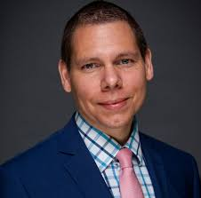
Moderator: Dr. Matthew Willis
Idea to Impact: How Army FUZE Accelerates Small Business Innovation
Director, Army Innovation Programs

Slide 32




www.fuze.army.mil
usarmy.pentagon.mbx.fuze@army.mil
Army FUZE
www.fuze.army.mil
usarmy.pentagon.mbx.fuze@army.mil
Army FUZE

Slide 33

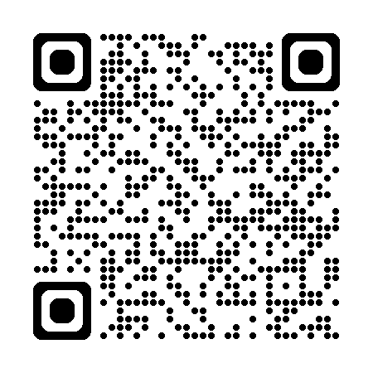
ARMY SMALL BUSINESS SEMINAR
Thank You!
For more information, visit Army.mil/OSBP

