Slide 1





ARMY SMALL BUSINESS
Seminar

Slide 2
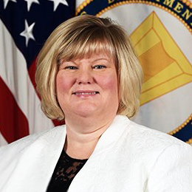

Ms. Kimberly Buehler
Army Office of Small Business Programs Welcome
Director
Army Office of Small Business Programs

Slide 3

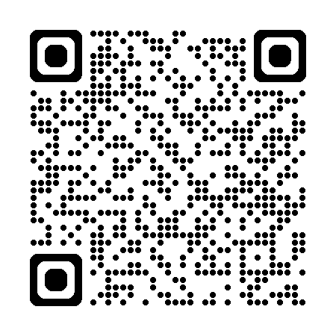
WELCOME TO THE
ARMY SMALL BUSINESS SEMINAR
Ms. Kimberly D. Buehler, Director | 22 January 2026
LinkedIn / Facebook: @ArmySmallBiz

Slide 4
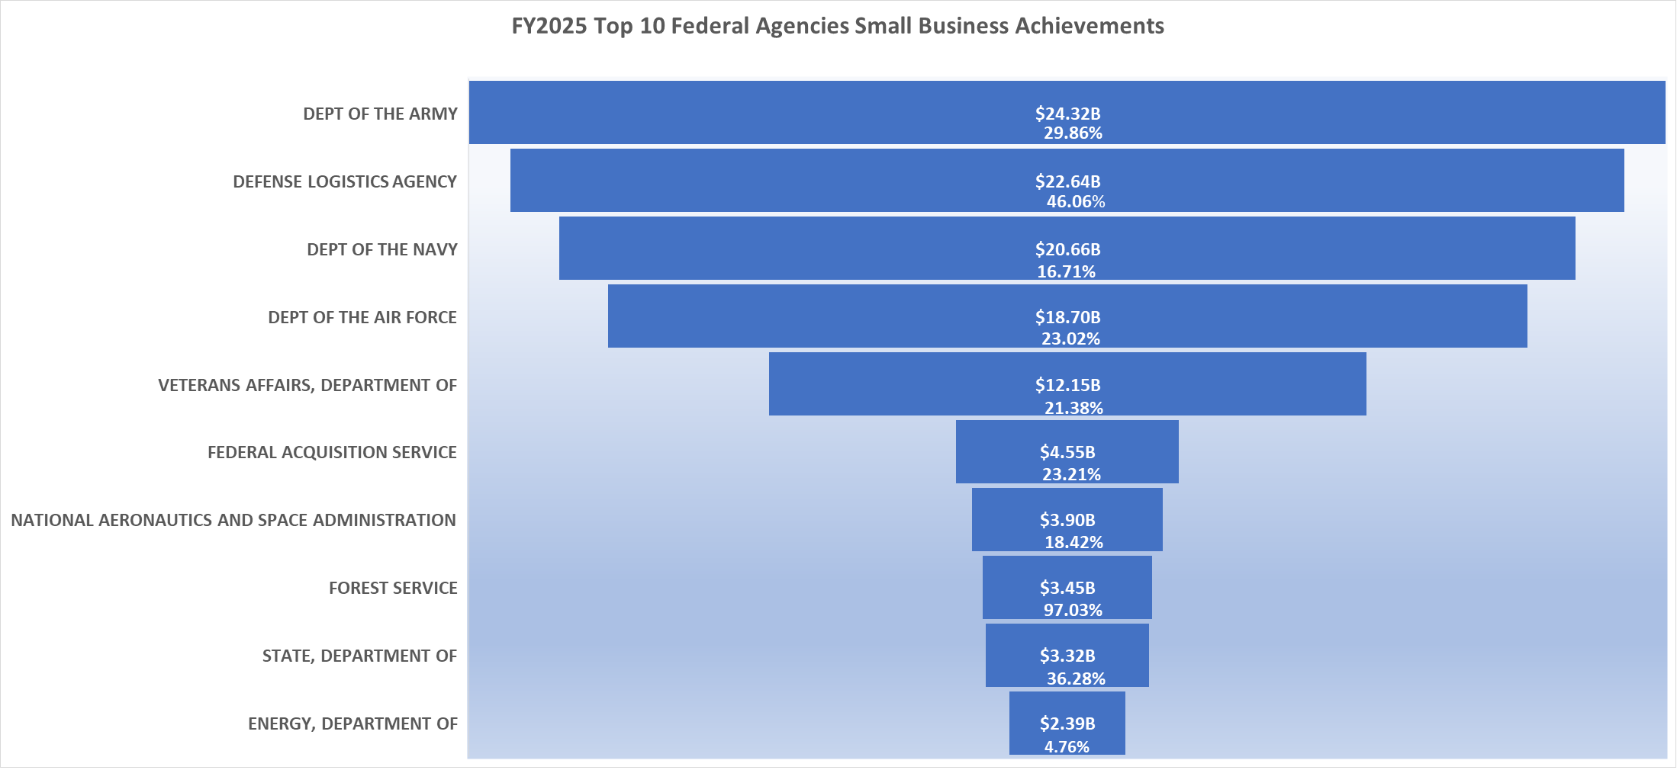
FY2025 Federal Agency Small Business Achievement (Preliminary)
Source: SAM.gov as of 17 Nov 2025

Slide 5
https://www.army.mil/osbp#org-programs
Phone: 703-697-2868 | LinkedIn / Facebook: @ArmySmallBiz

Slide 6
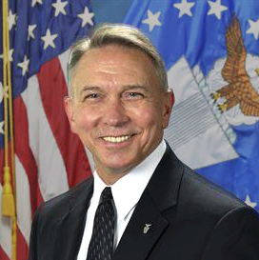
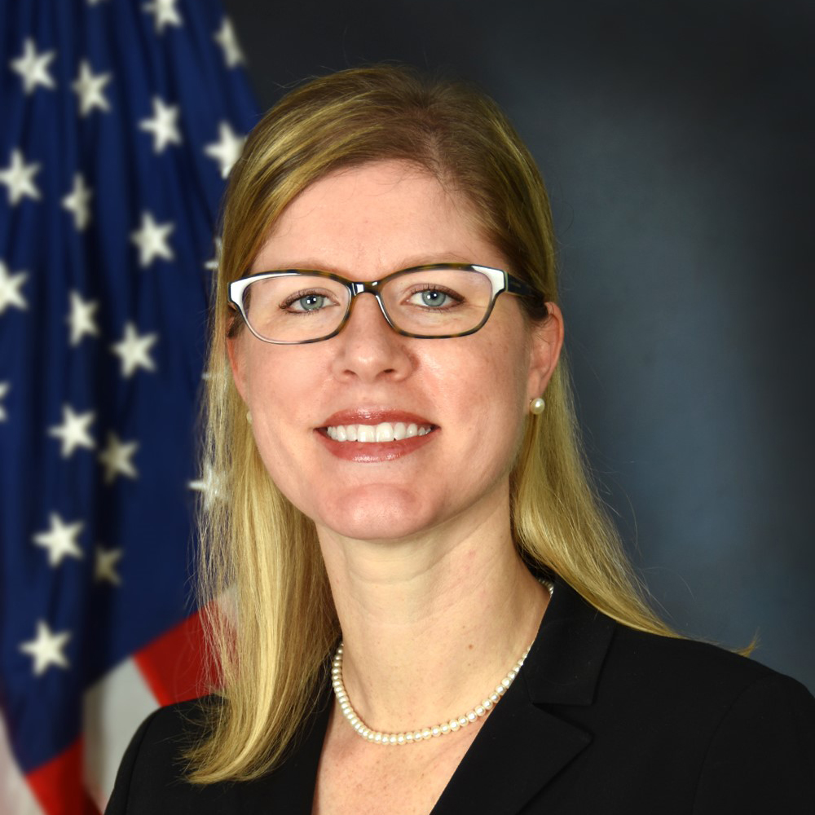
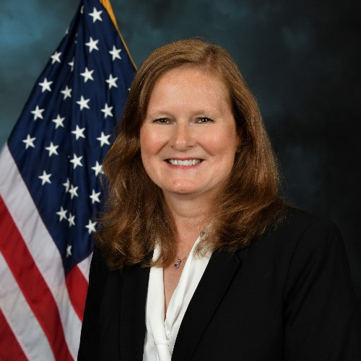
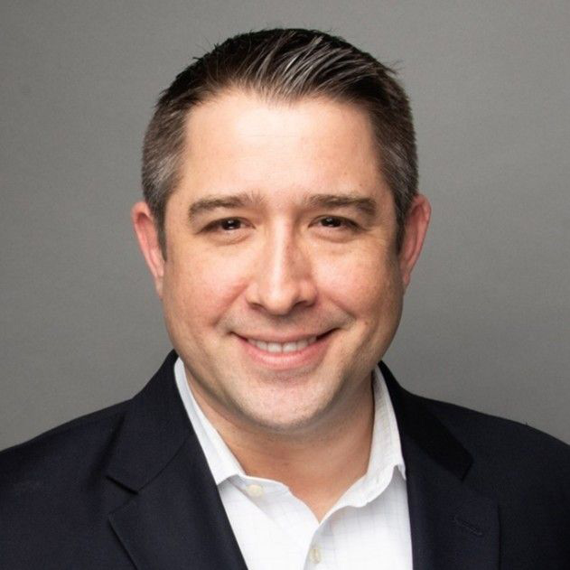
OFFICE OF SMALL BUSINESS PROGRAMS
DIRECTORS PANEL
MODERATOR
Ms. Kimberly Buehler
Director, Army OSBP
Mr. Scott Kiser
Director, Air Force OSBP
Ms. Daniele Kurze
Director, Defense Logistics Agency OSBP
Ms. Carlen Capenos
Director, DISA OSBP
Mr. Andrew Magliochetti
Director, Navy OSBP

Slide 7
ARMY SMALL BUSINESS SEMINAR
Break Until 1:45pm

Slide 8
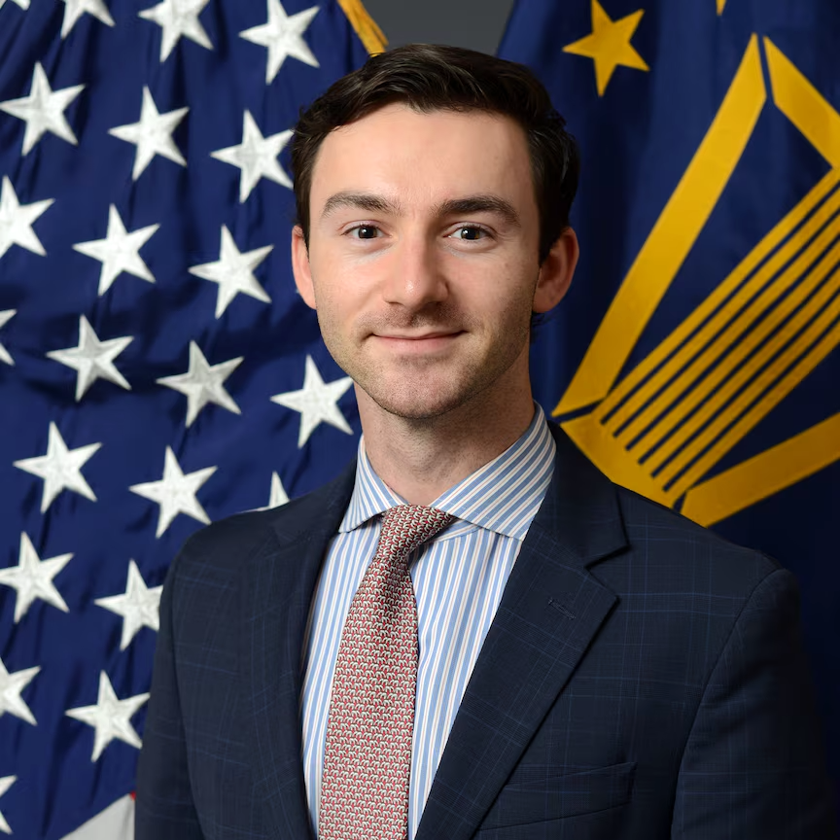

Mr. James R. Mismash
Director’s Remarks
Director of Small Business Programs (OSBP)
Office of the Secretary of War

Slide 9
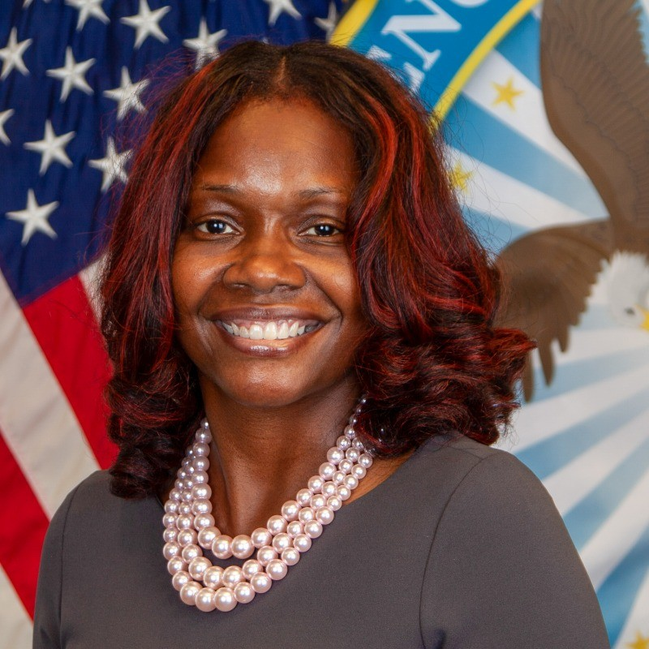

Dr. Ruby Crenshaw-Lawrence
How Small Businesses Can Obtain Facility Clearance to Work with the Department of War
Chief, Office of Small Business Programs
and Industry Engagements
Defense Counterintelligence and
Security Agency (DCSA)

Slide 10
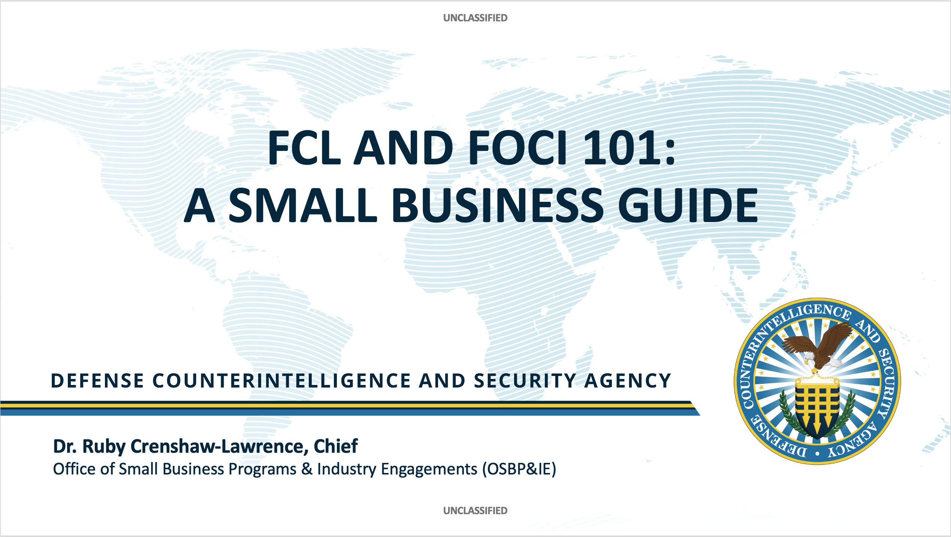

Slide 11
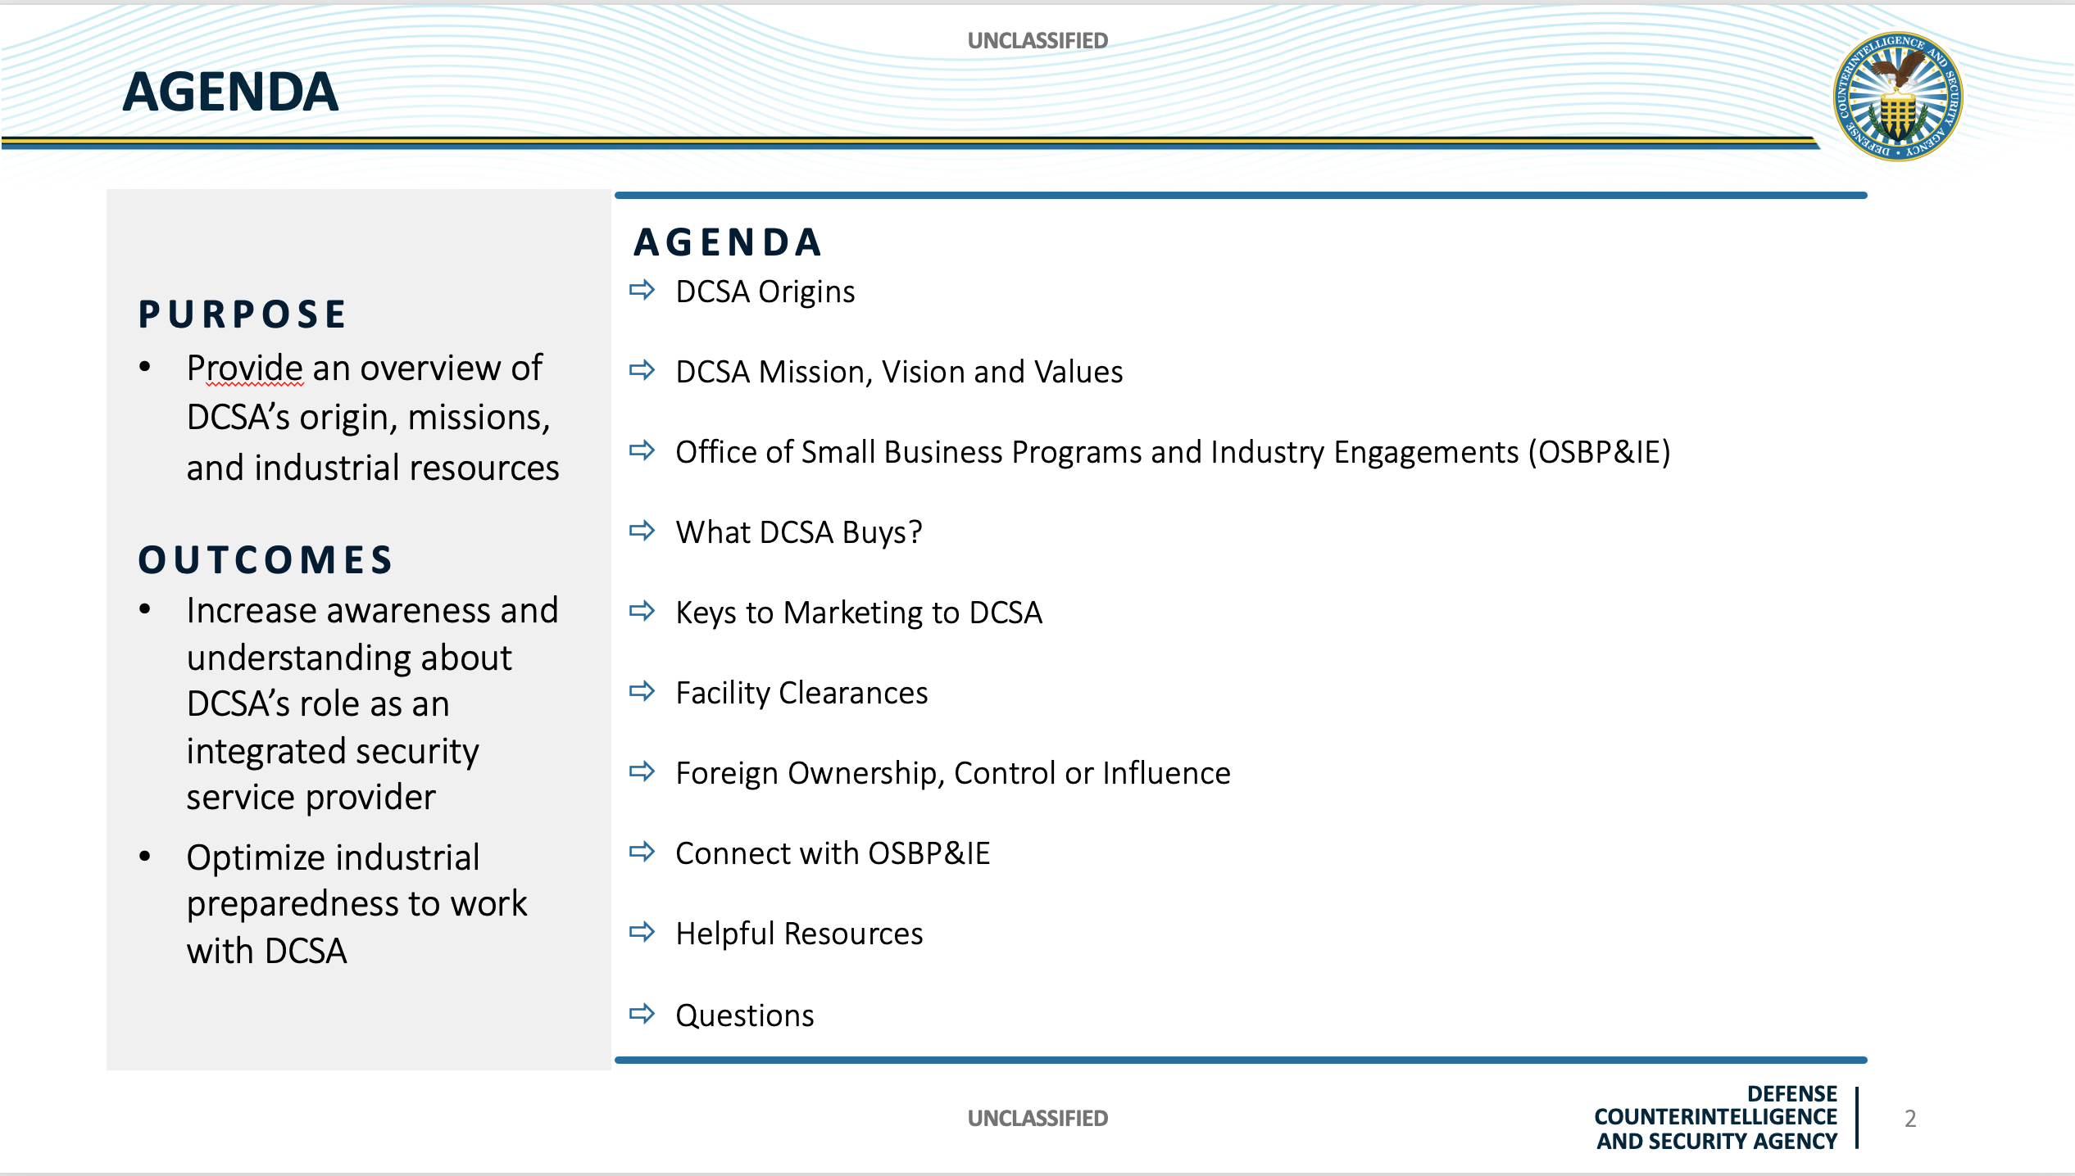

Slide 12
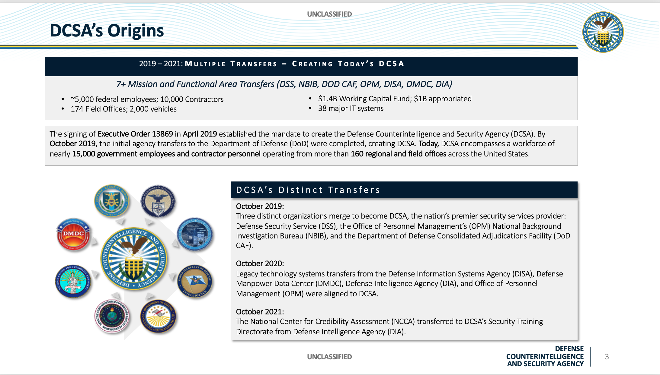

Slide 13
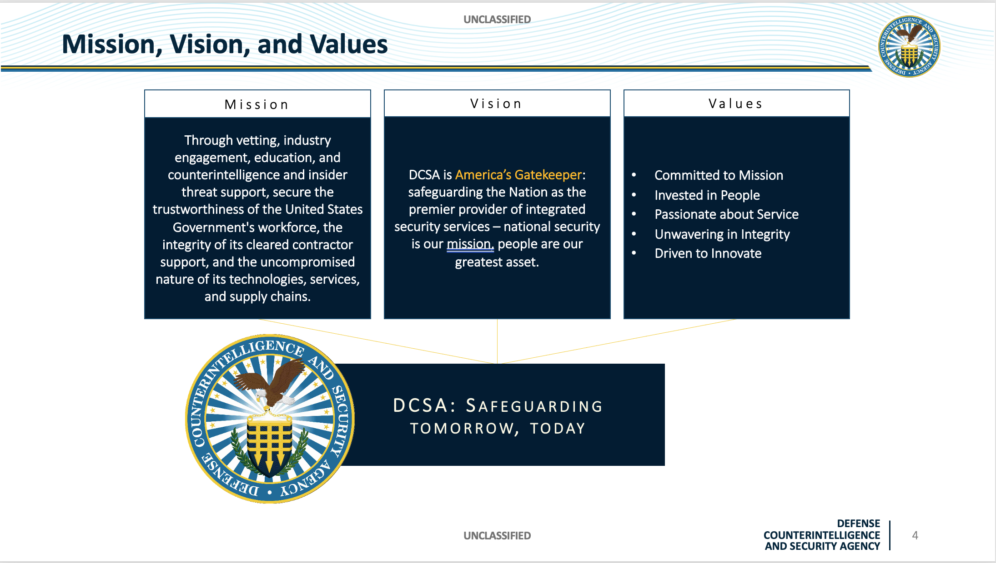

Slide 14
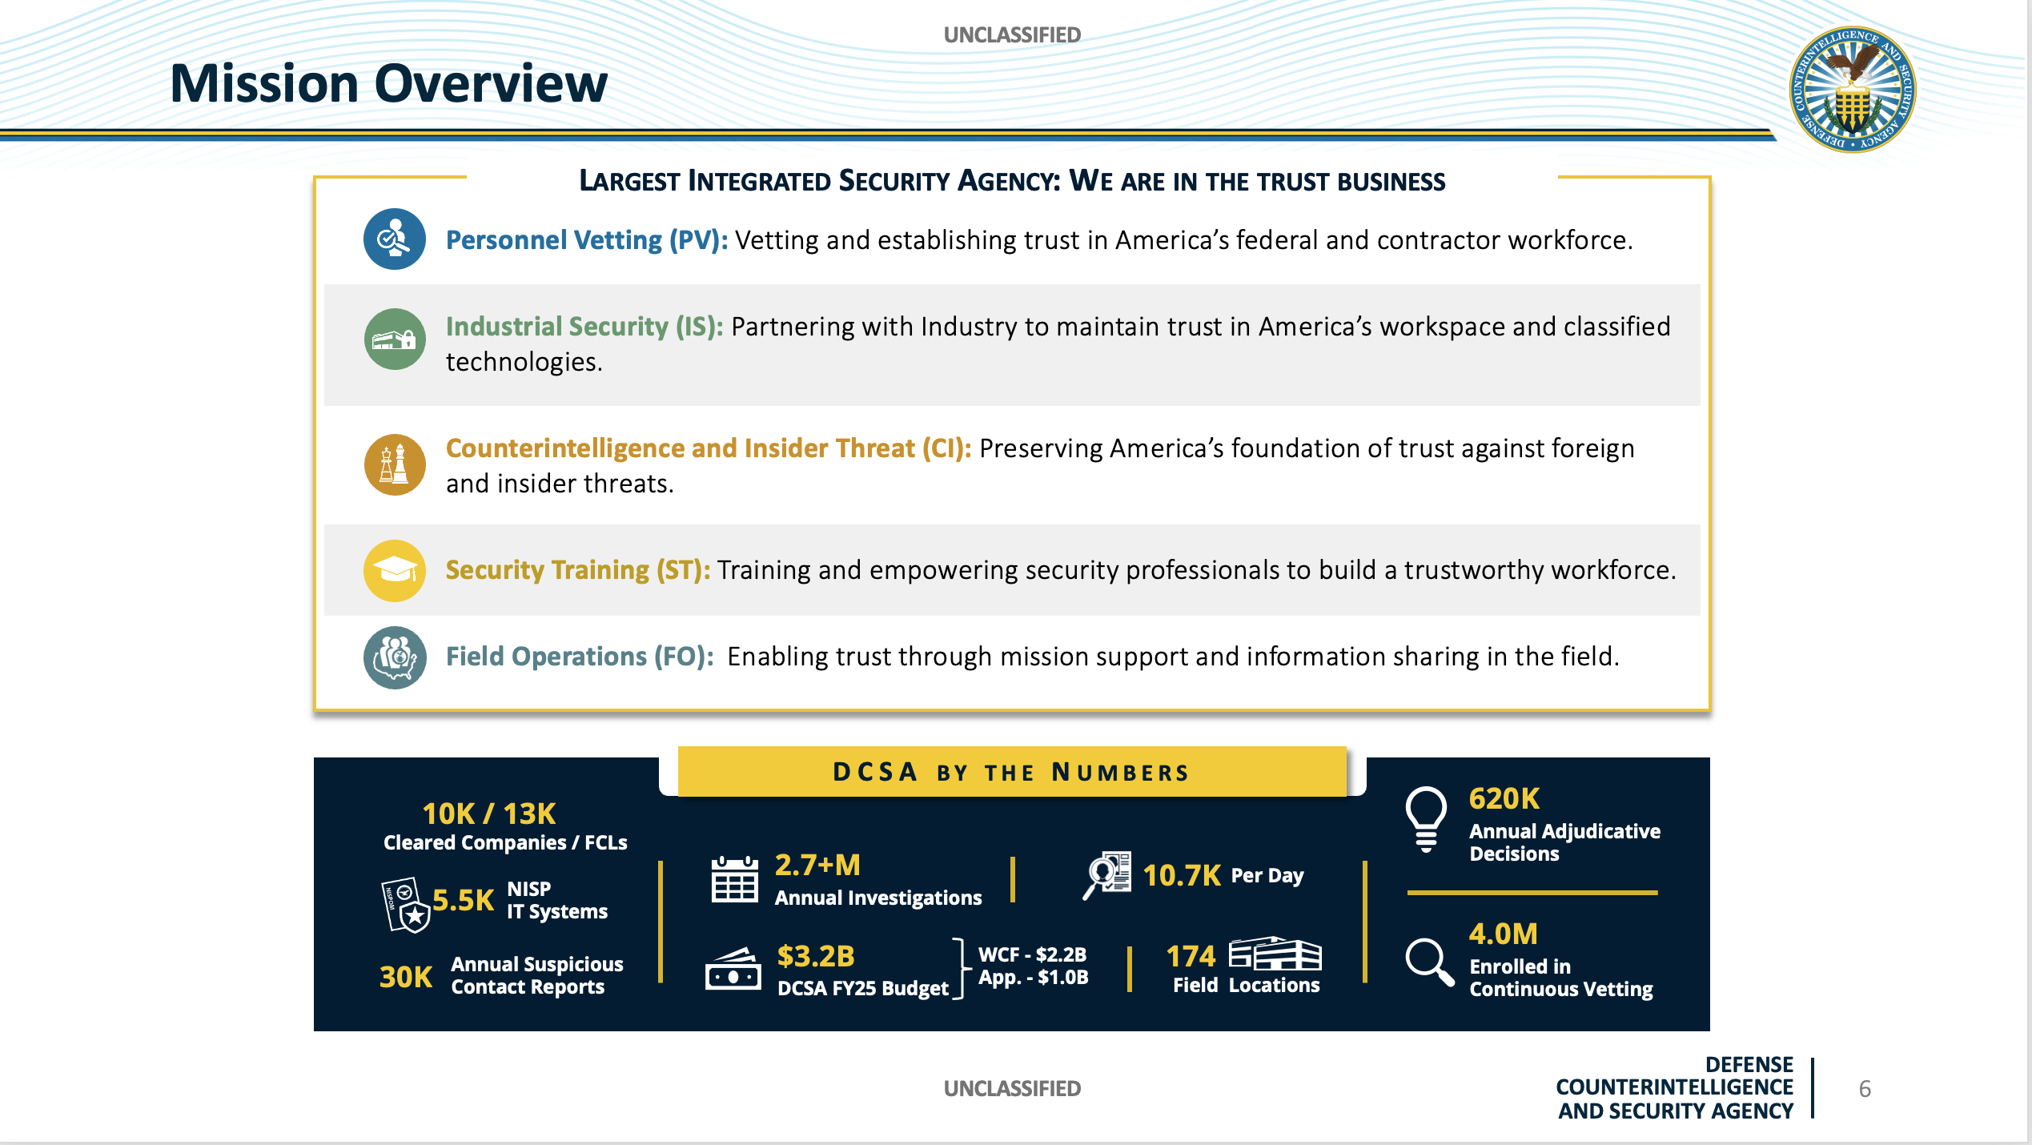

Slide 15
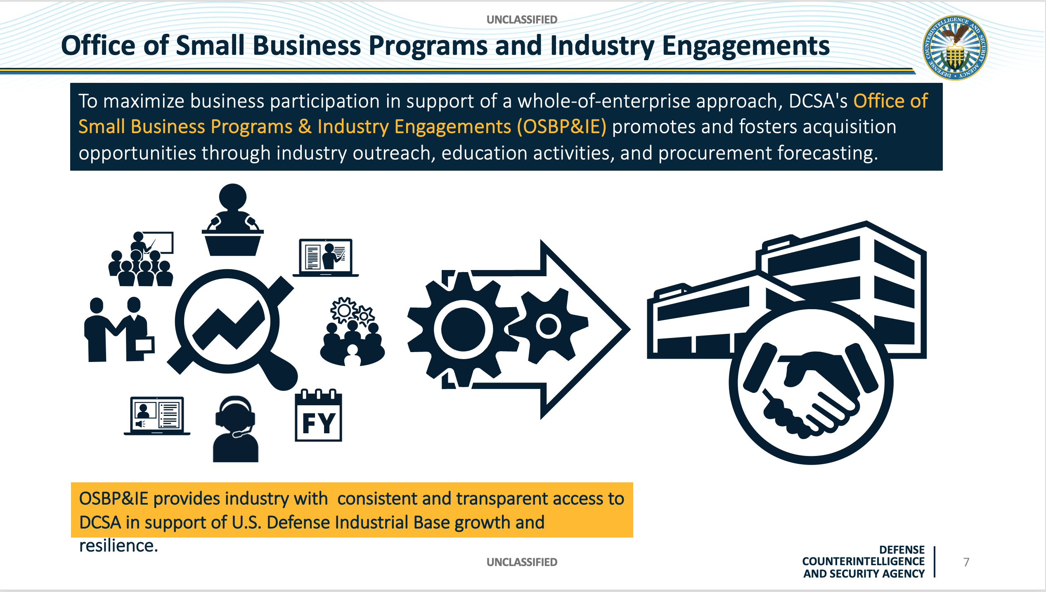

Slide 16
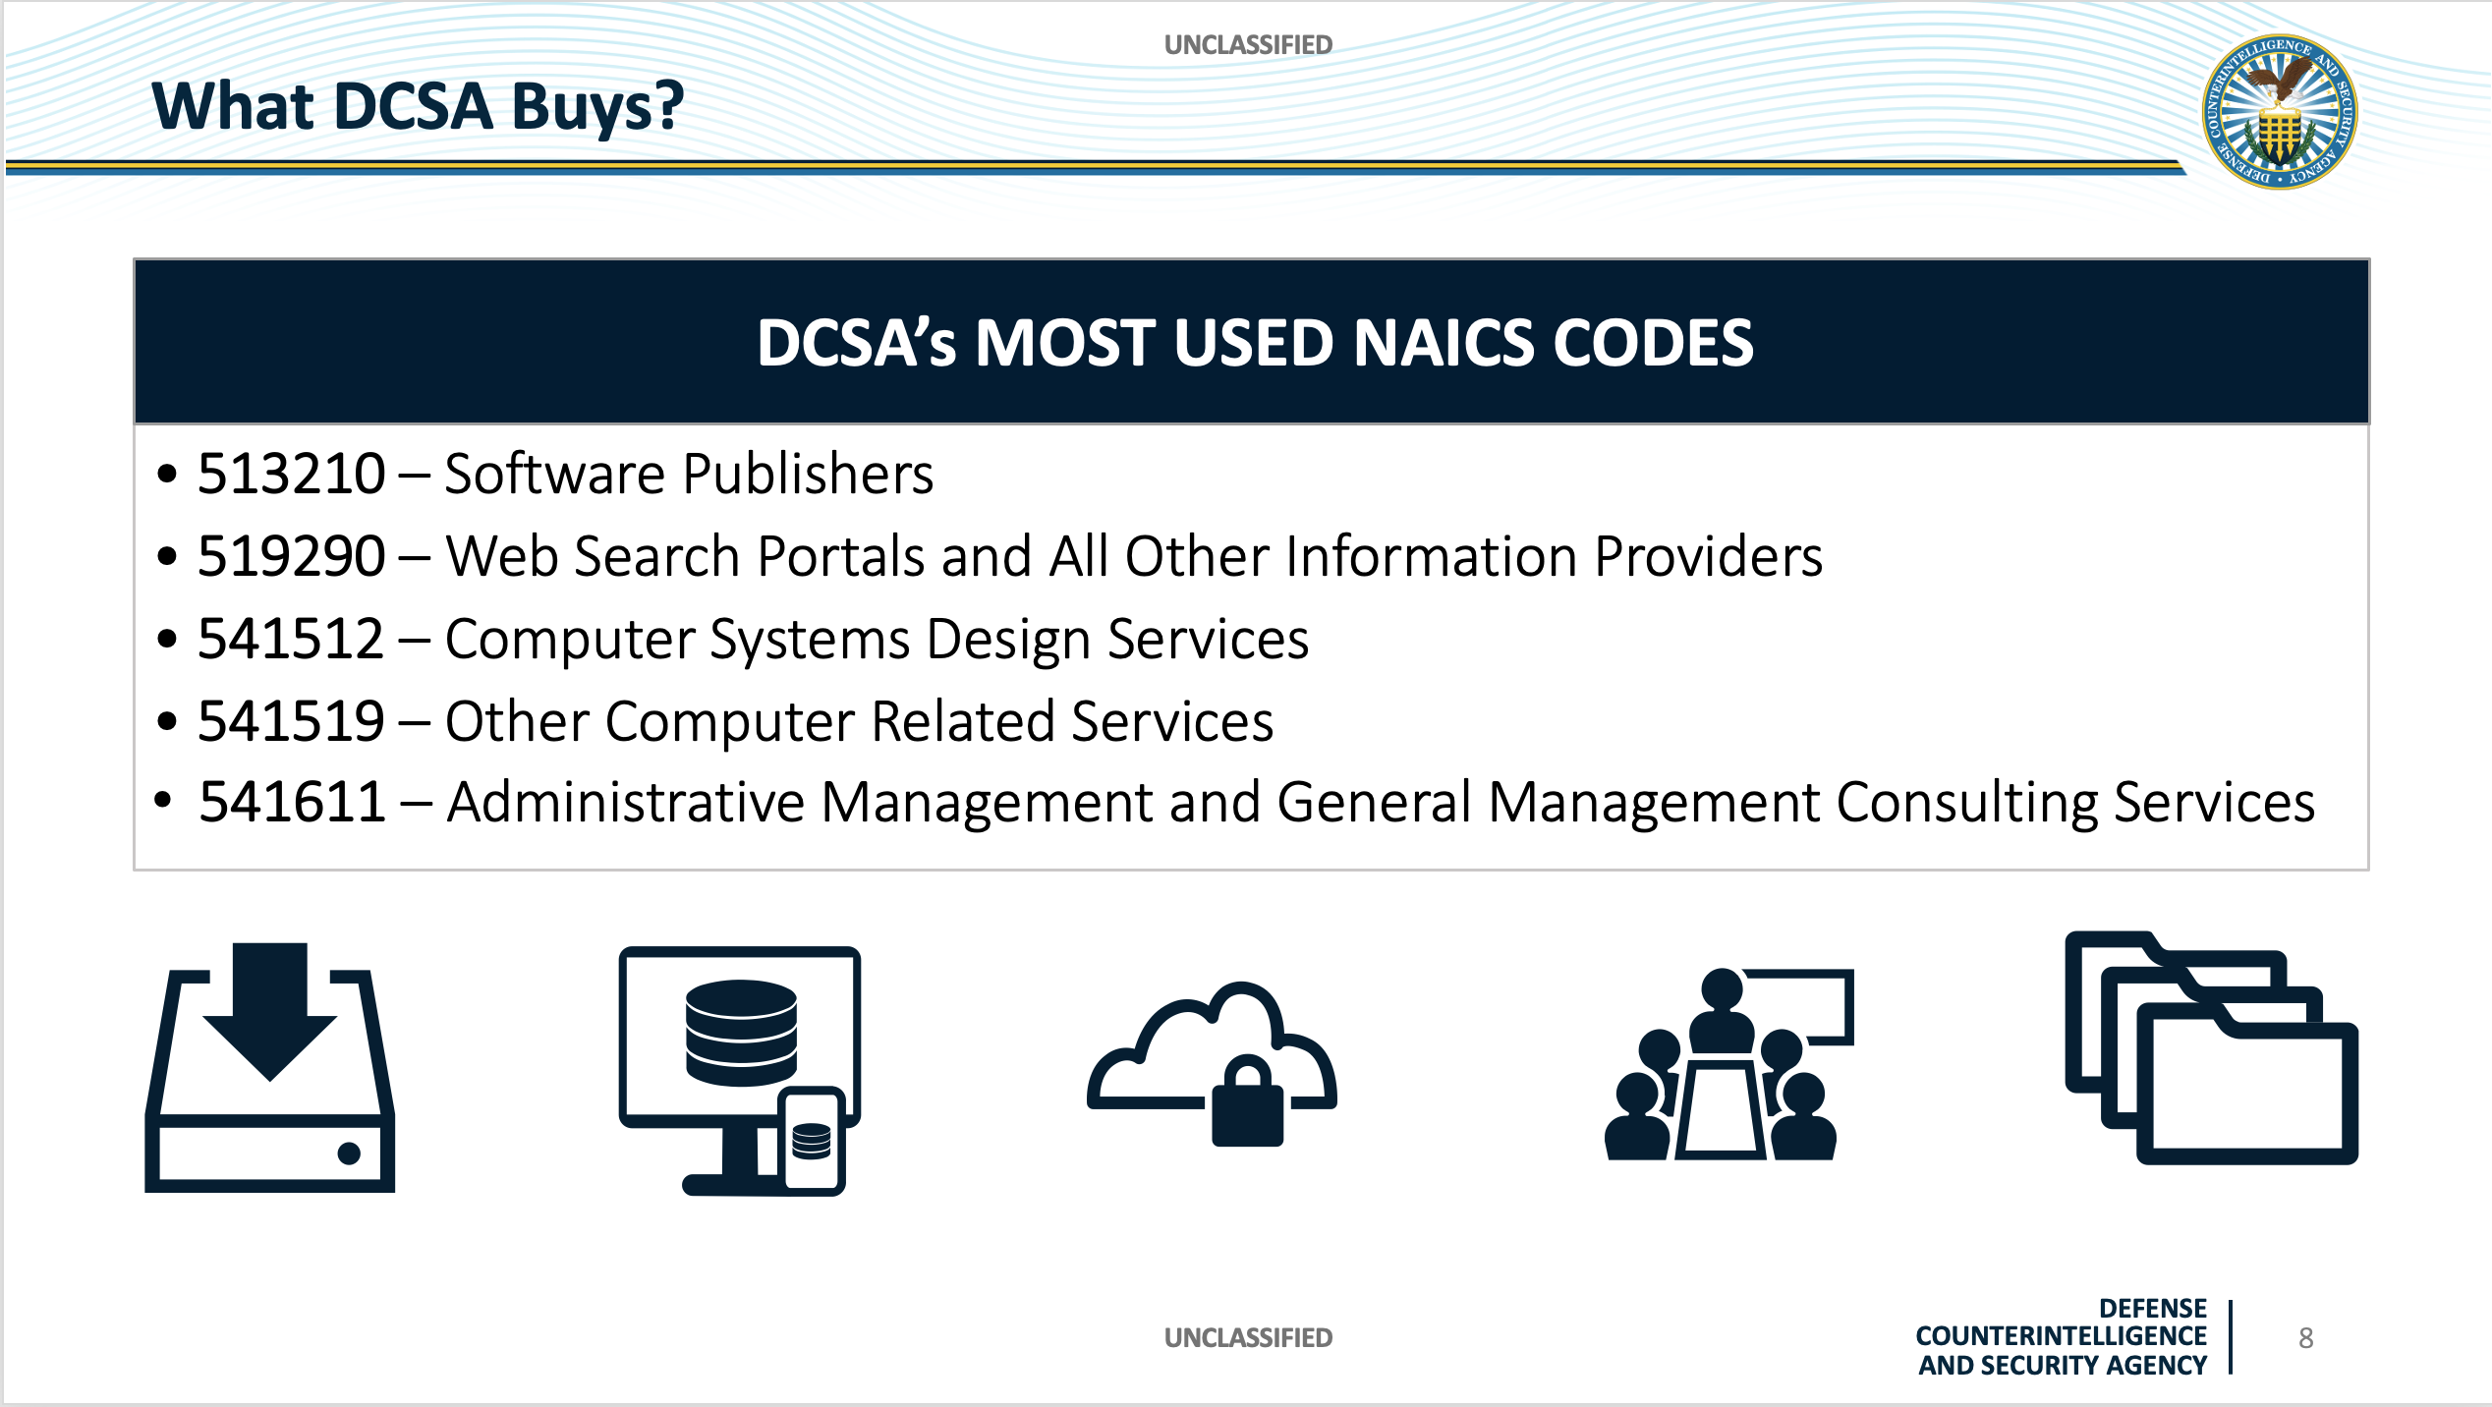

Slide 17
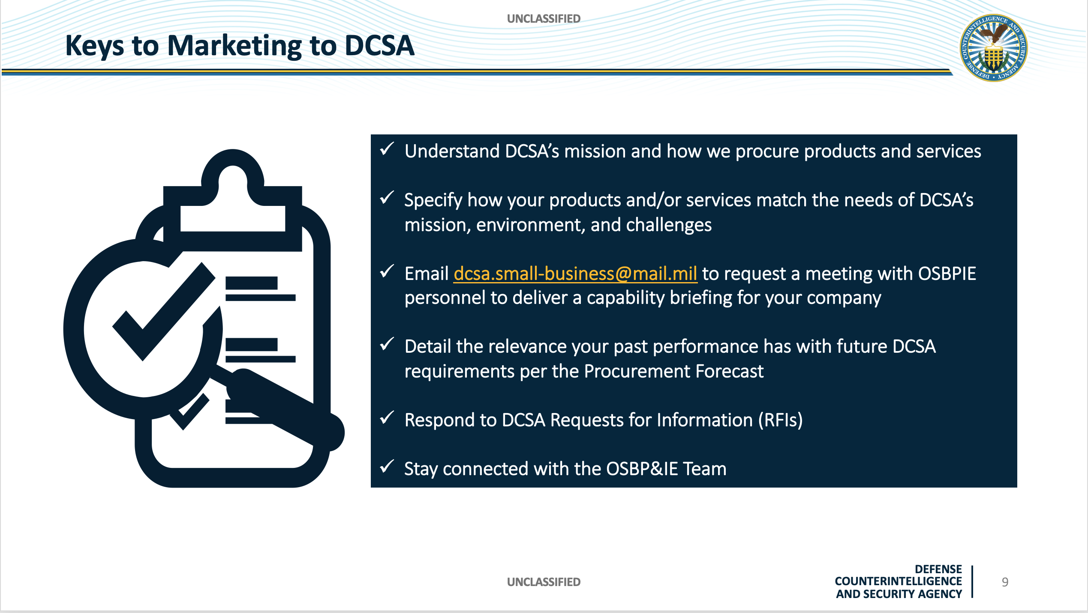

Slide 18
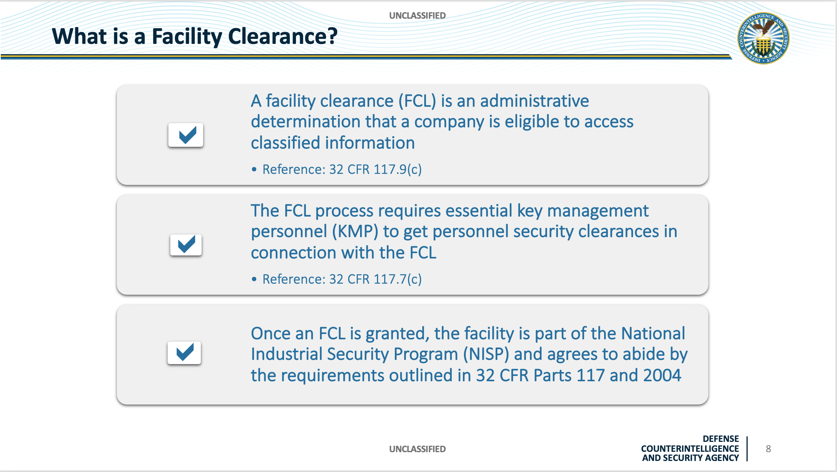

Slide 19
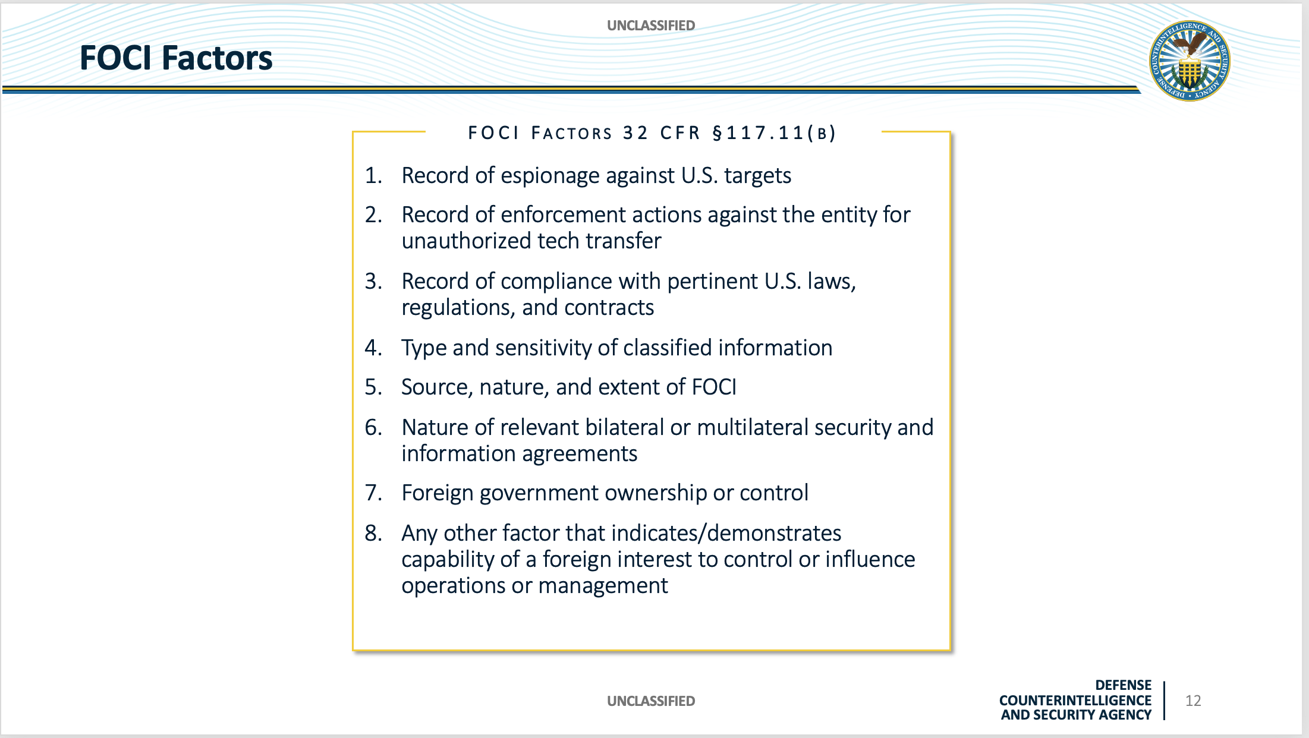

Slide 20
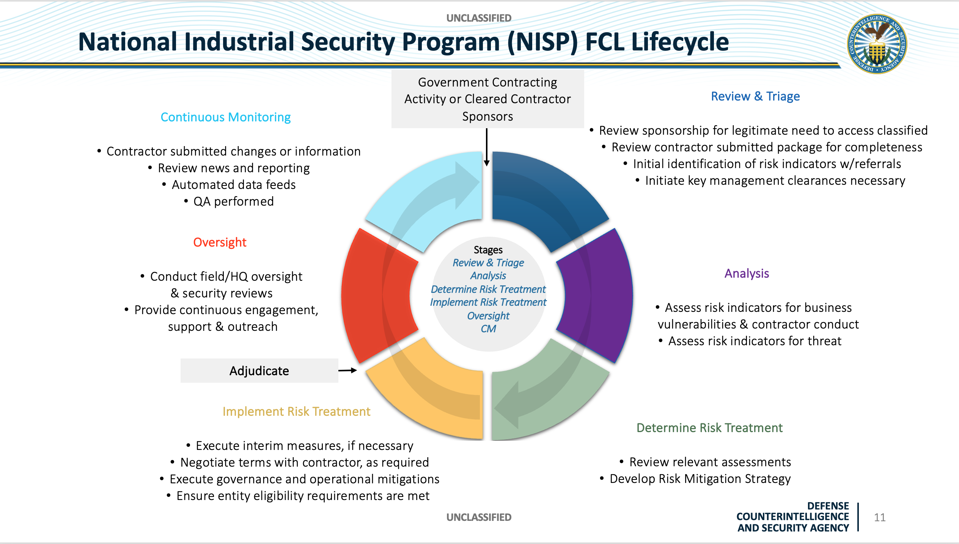

Slide 21
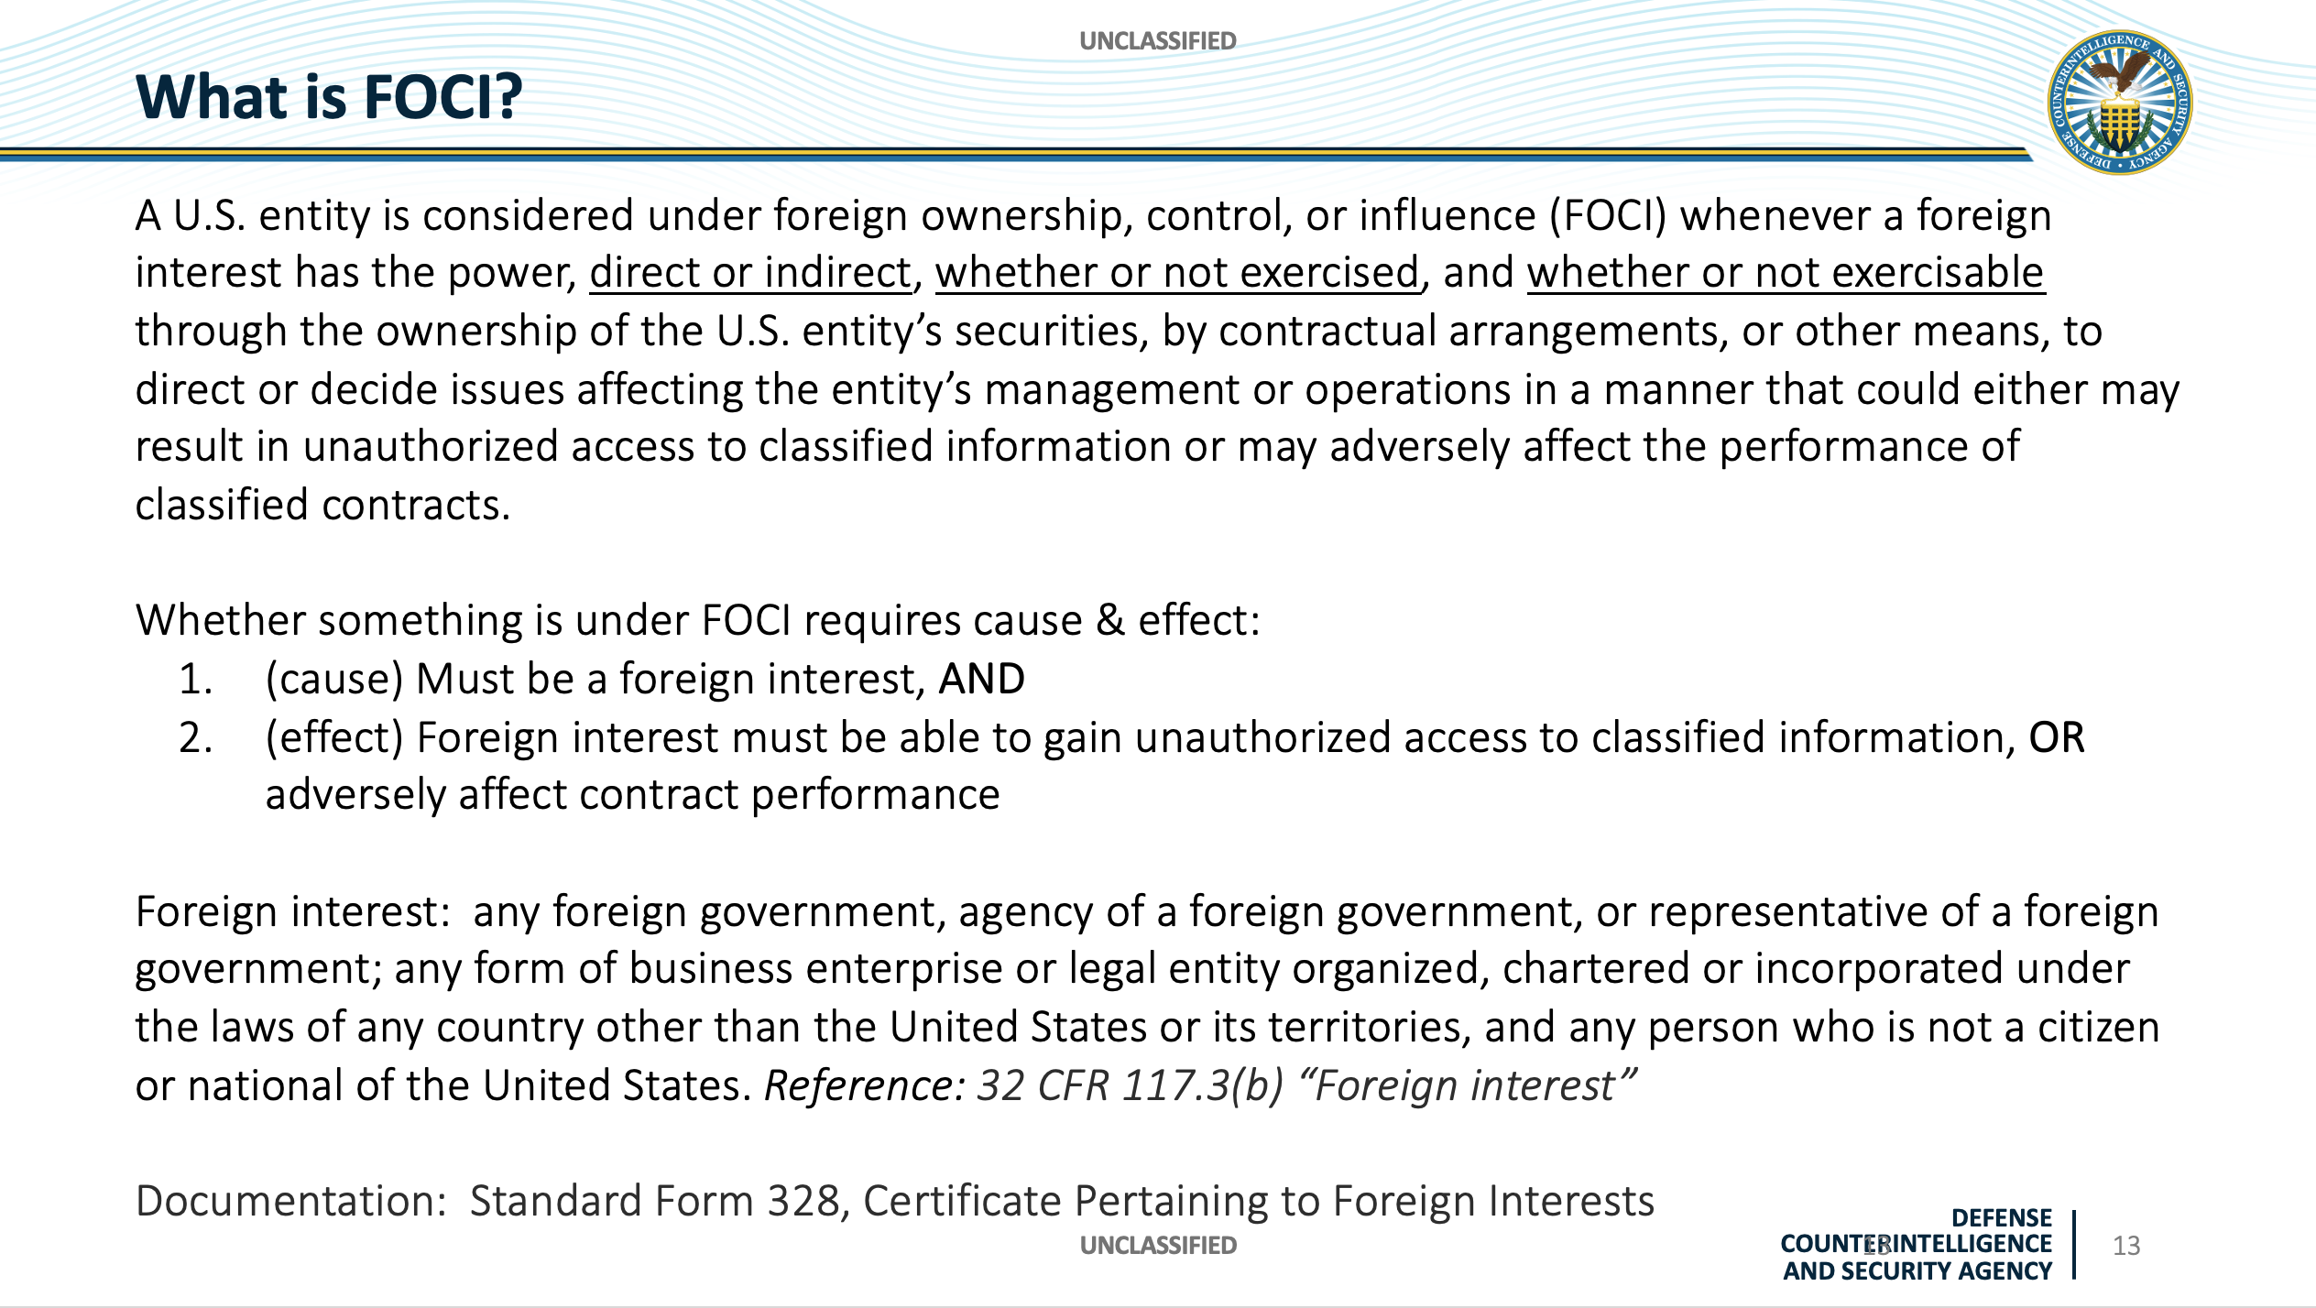

Slide 22
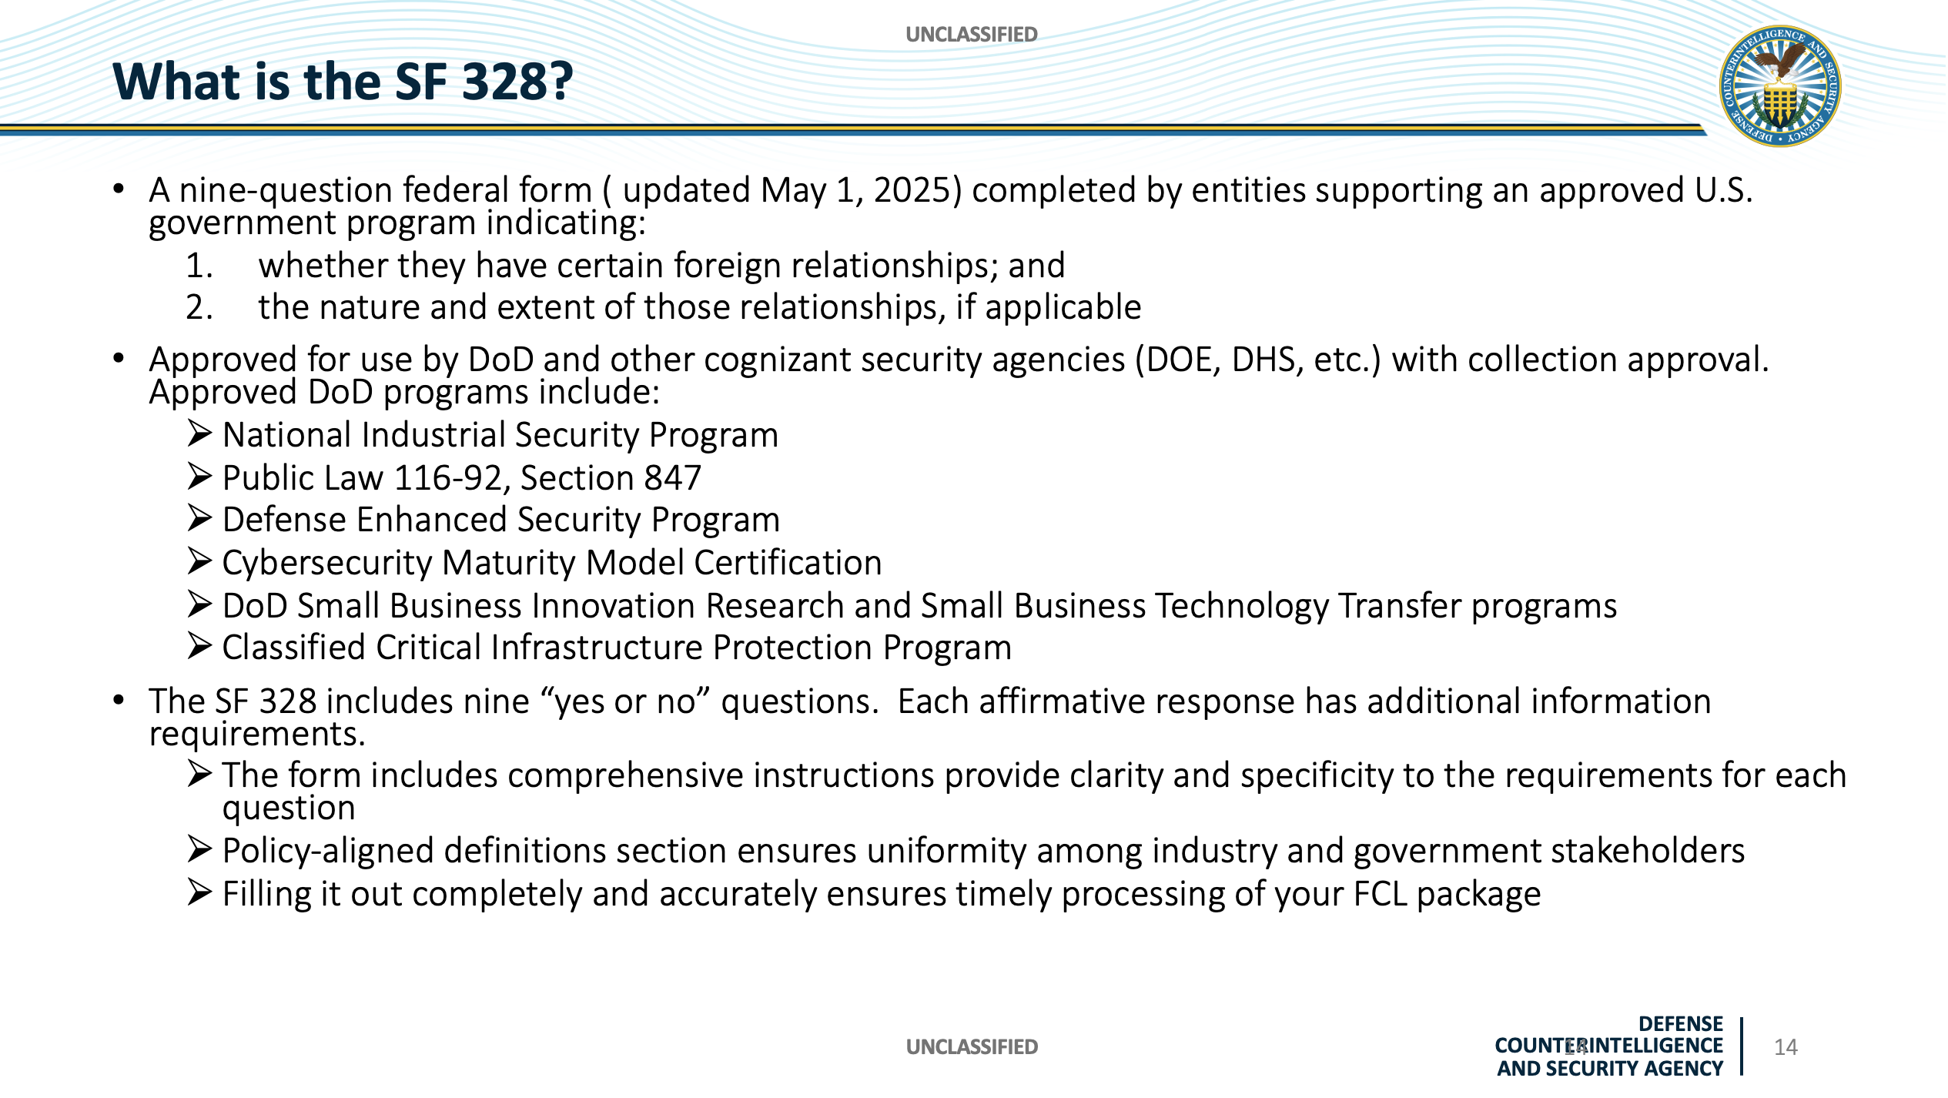

Slide 23
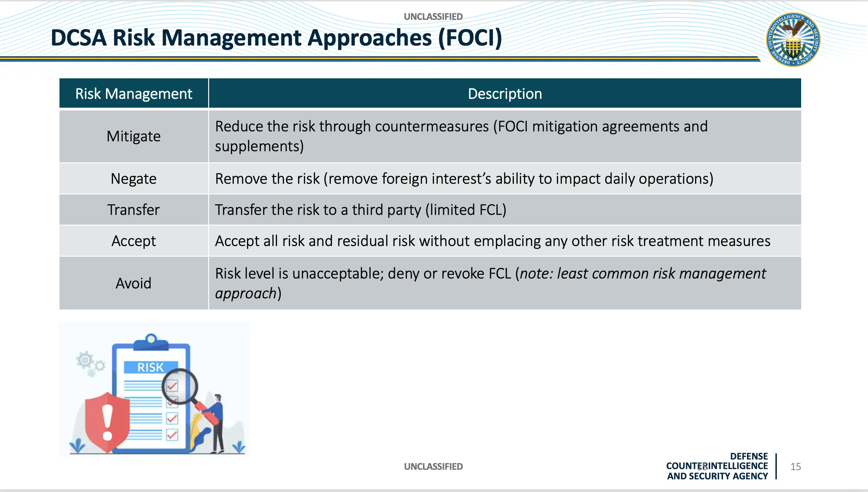

Slide 24
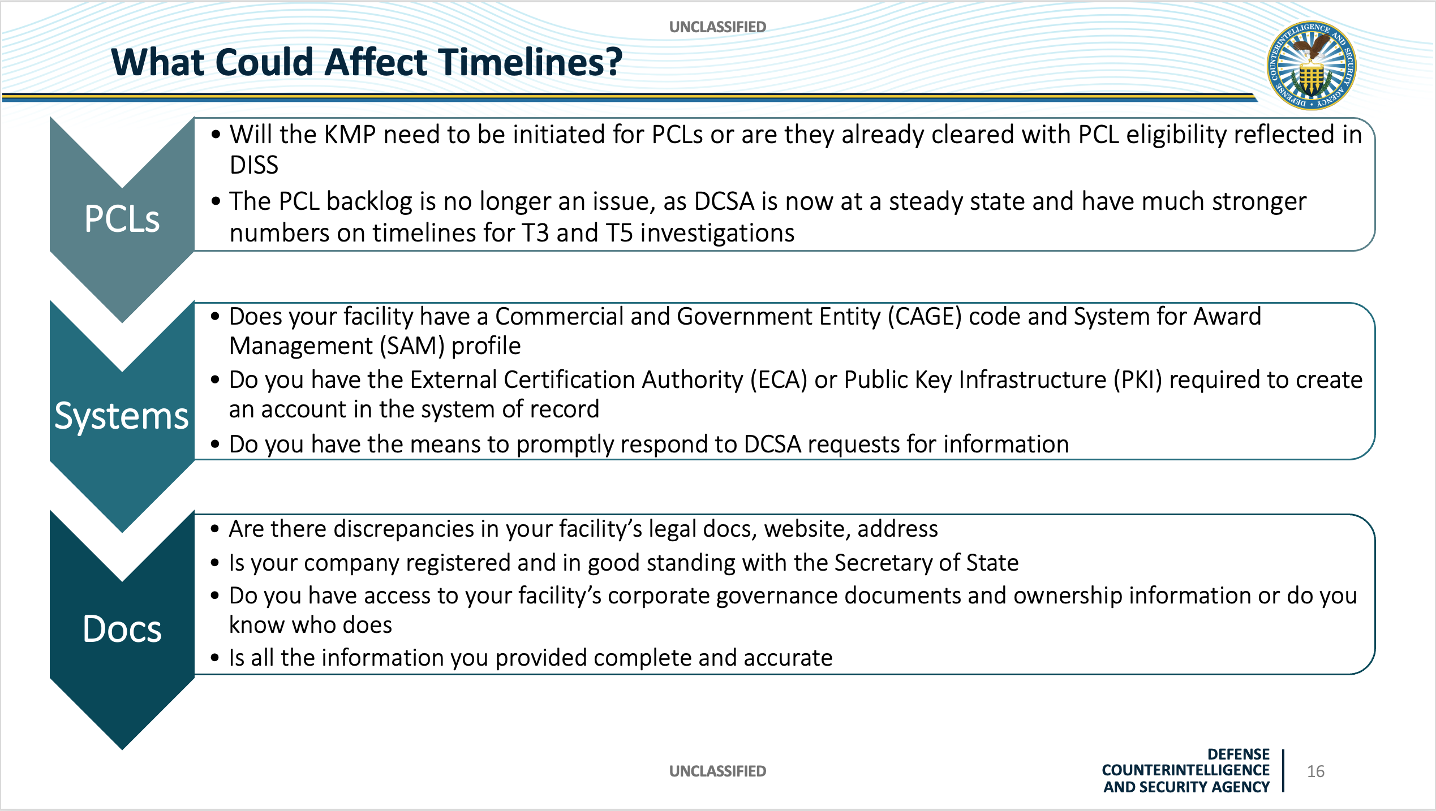

Slide 25
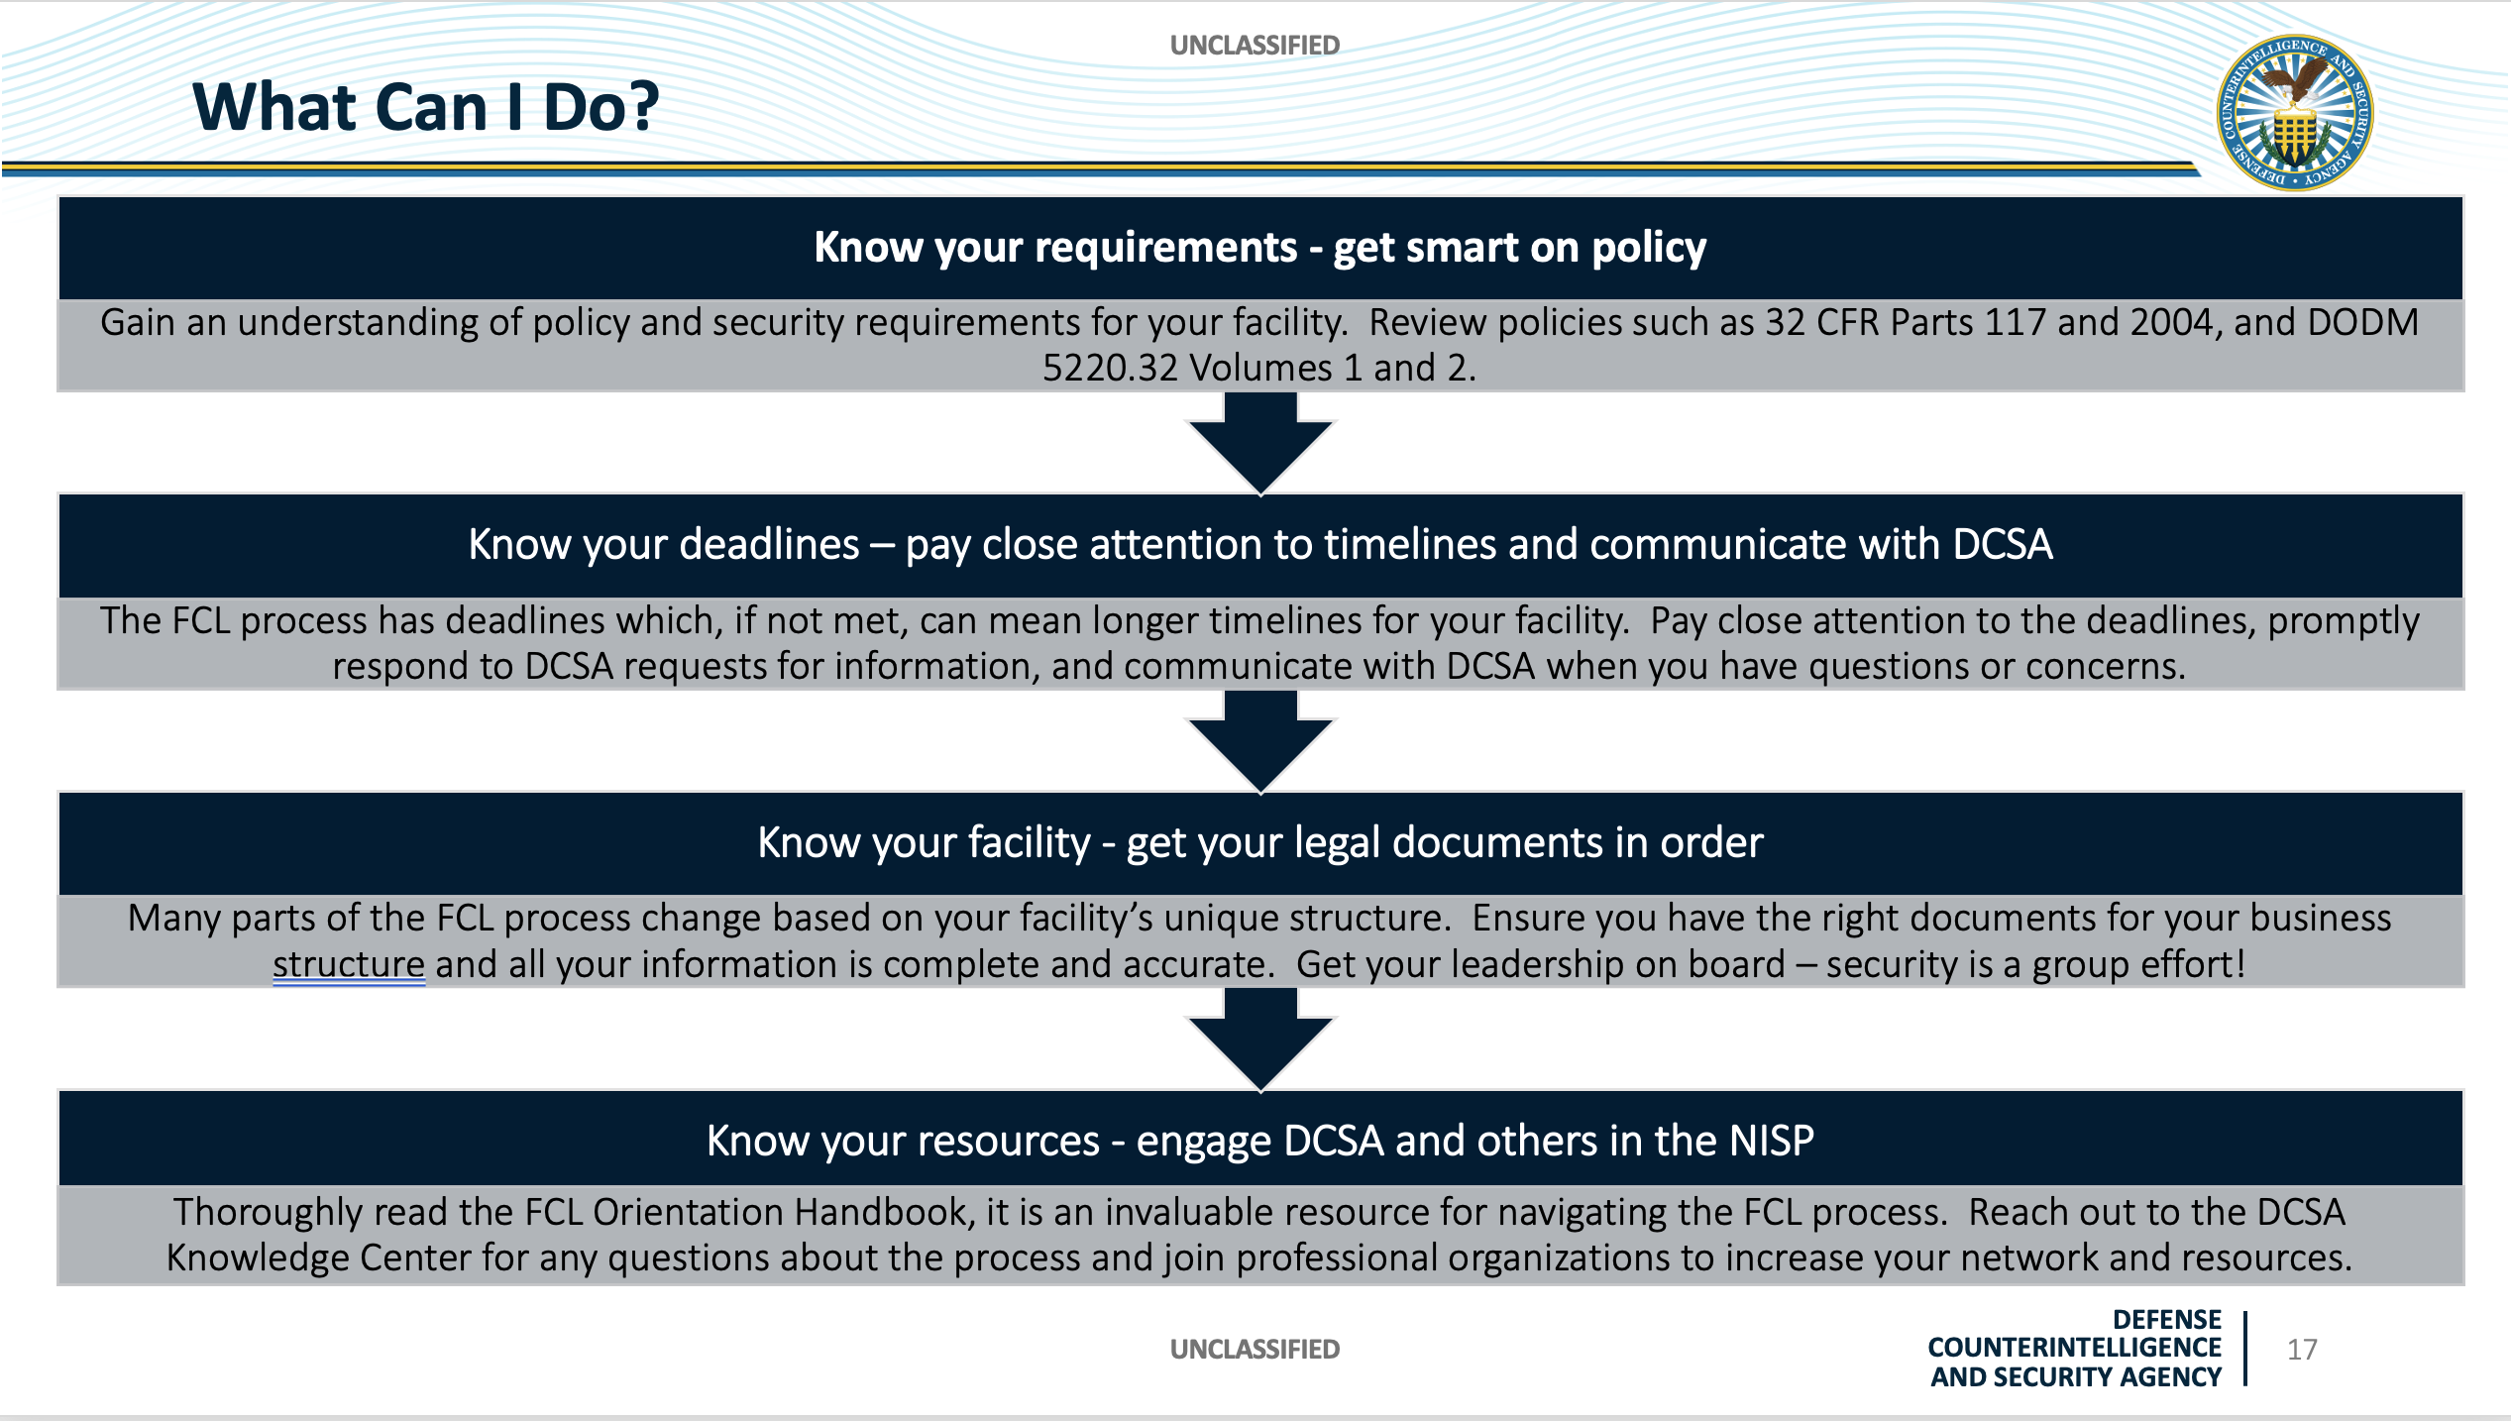

Slide 26
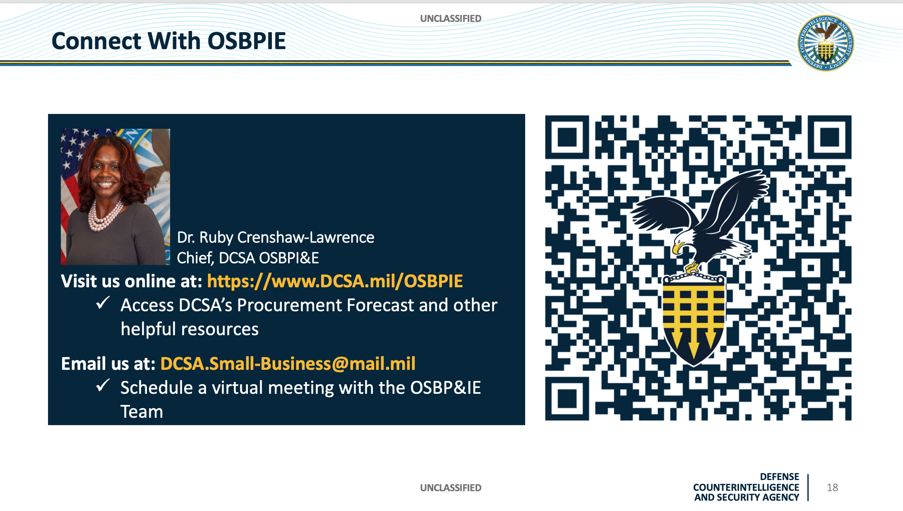

Slide 27
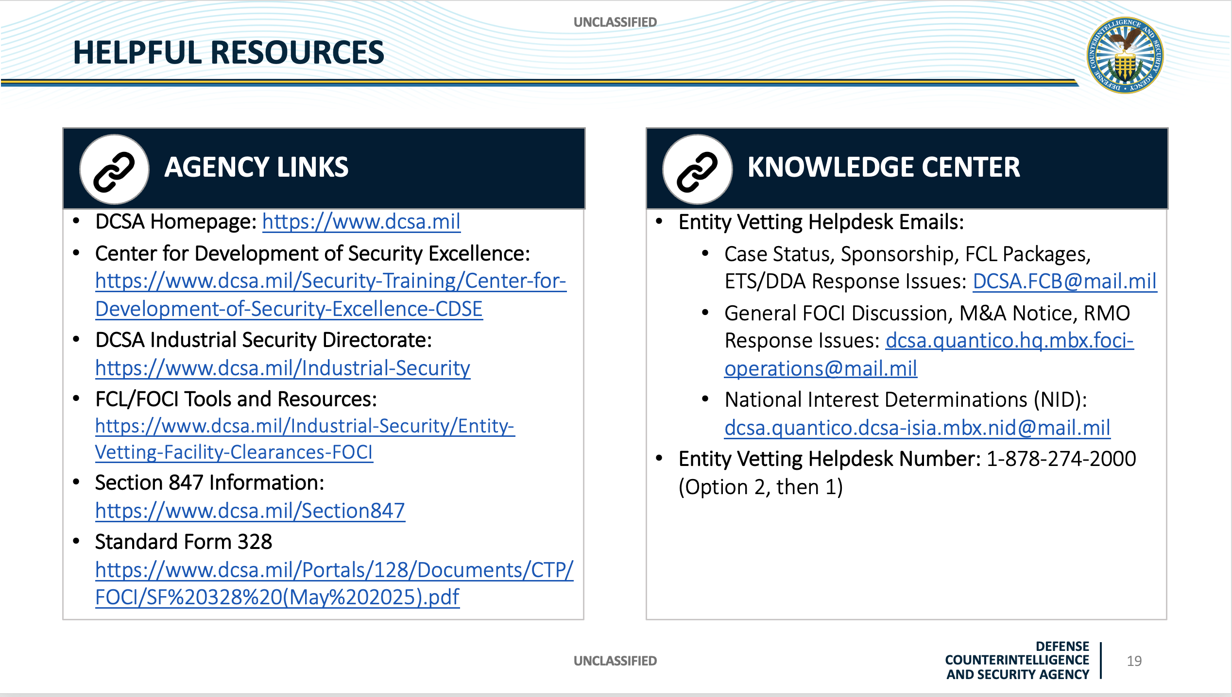

Slide 28


Slide 29
ARMY SMALL BUSINESS SEMINAR
Break Until 3:00pm

Slide 30
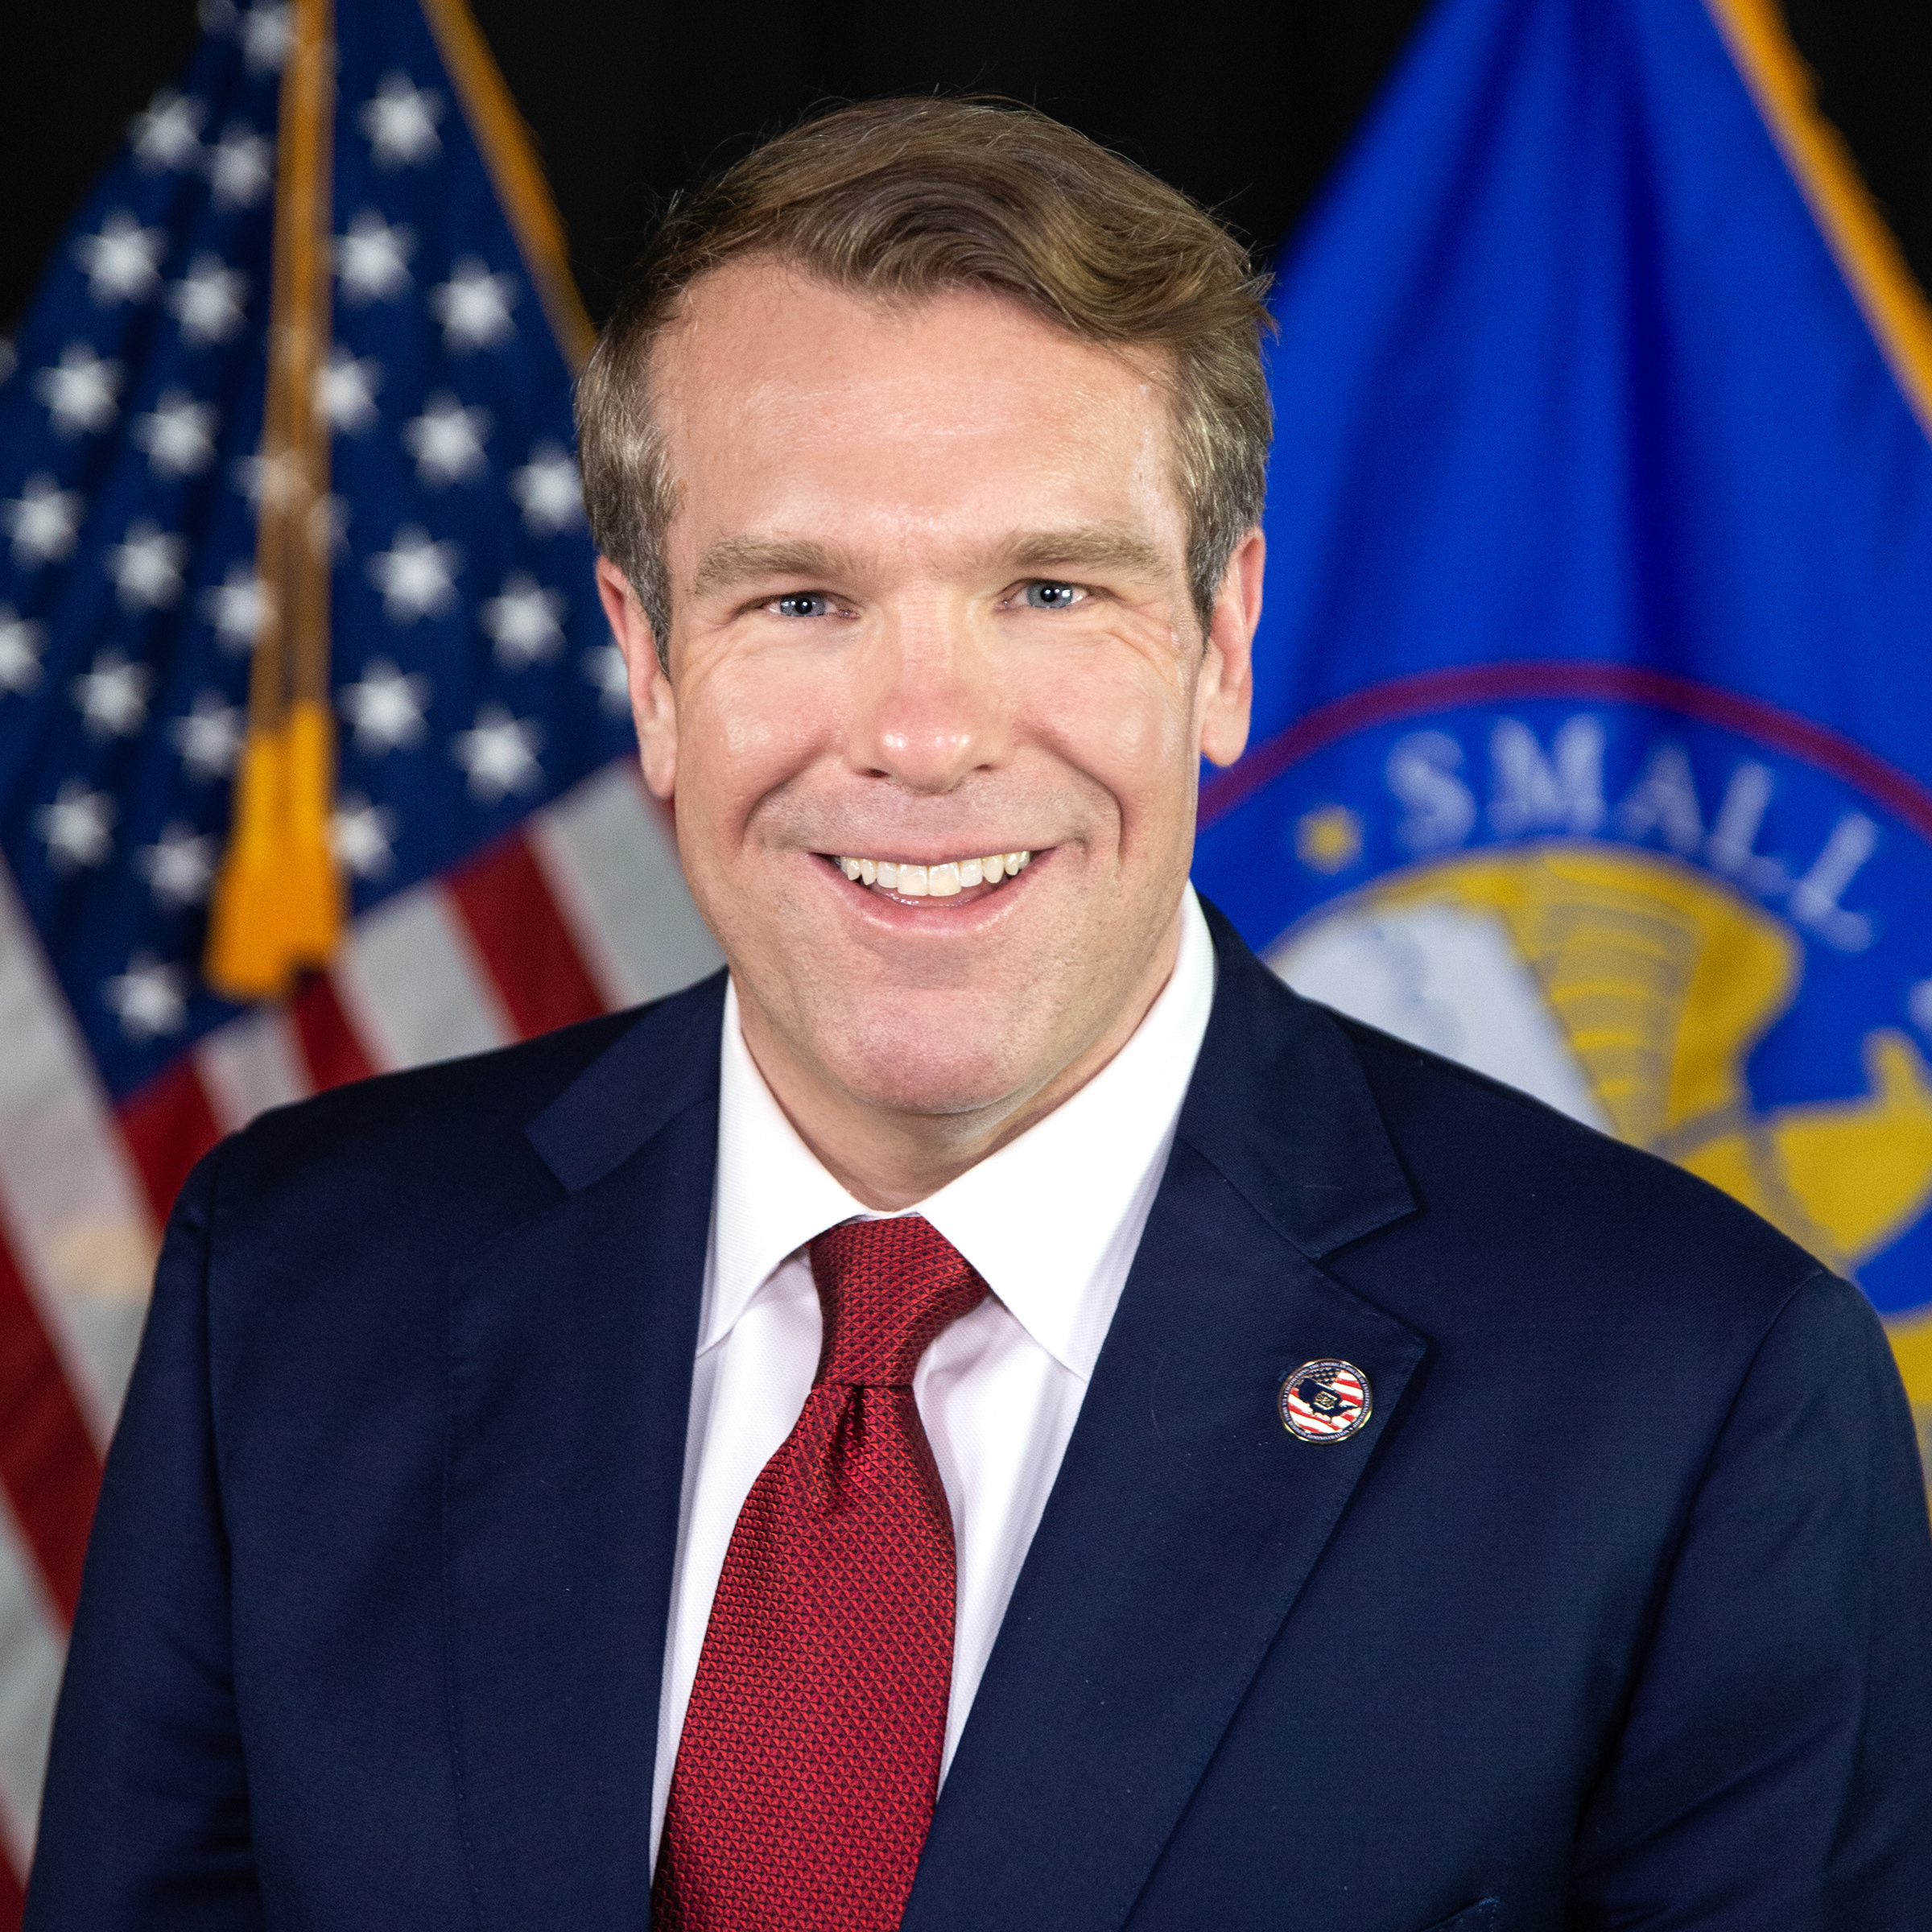

Mr. Bill Briggs
Small Business Administration Remarks
Deputy Administrator
Small Business Administration

