Slide 1
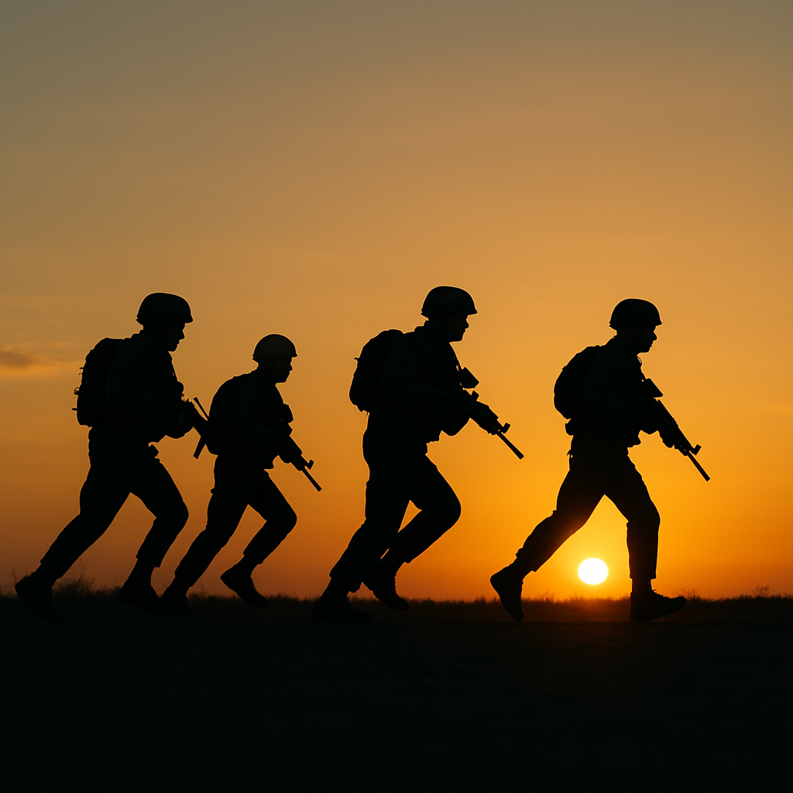


ABCP: MAINTAINING READINESS THROUGH STANDARDS
UNCLASSIFIED
“Trust in Me”
FIT TO FIGHT – READY TO LEAD
The Overall Classification of this document is: UNCLASSIFIED
Classified by: Logan P. Johnson
Source: Multiple Sources
Declassify On: N/A
Version 1.3
POC:1SG Johnson, Logan
logan.p.johnson.mil@army.mil
UNCLASSIFIED

Slide 2
AGENDA
Overview
Weigh-ins
Height and Weight Guidelines
Weight Table and BF% Standards
Exempt From Tape
One Site Tape Test Male/Female
Failed Tape
ABCP Enrollment
Building Packet
Maintaining Packets
Disenrollment from ABCP
Common Questions
References

Slide 3
OVERVIEW
All Soldiers are required to test on HT/WT standards for record, at a minimum, every 6 months and should be flagged if not in compliance IAW AR 600–8–2, para 2-3
Commanders have the authority to direct a body fat assessment on any Soldier that they determine does not present a Soldierly appearance to ensure the Soldier meets the screening table weight for his or her measured height.
The flagging authority, unit commander, or first line supervisor will counsel all Soldiers on active duty, in writing, upon initiation of any flag within 3 working days unless notification would compromise an ongoing investigation.
AR 600-9

Slide 4
OVERVIEW CONTINUED
Soldiers identified as exceeding the body fat standard will be flagged in accordance with AR 600–8–2, para 2-3, and enrolled in the ABCP. Soldiers must meet the body fat standard in AR 600-9 to be released from the ABCP.
In the absence of a designated master fitness trainer (H2F-I), deliver training to designated unit fitness training NCOs and designated NCOs in proper height, weight, and body circumference methodology to assess body fat composition. Provide a memorandum of record documenting completion of training for commander/supervisor file certifying completion of proper height, weight, and body circumference methodology training for unit fitness training noncommissioned officer or other designated NCO completion.
AR 600-9

Slide 5
WEIGH-INS
To ensure the ABCP does not interfere with Soldier performance on the AFT commanders and supervisors will allow a minimum of 7 days between AFT and weigh-in. Commanders may deviate from this standard to meet urgent operational needs.
Some Soldiers that are close to exceeding the screening weight may attempt to lose weight quickly in the days leading up to a weigh-in. This practice may result in the Soldier being unable to perform his or her best on the AFT, if the two events are scheduled close together.
AD 2025-17, Paragraph 5a(7)

Slide 6
HEIGHT GUIDELINES
Soldiers will be measured in APFU’s, w/out shoes, and on a flat service.
Head & body will remain vertical with eyes forward and chin parallel to the
ground.
(1) If the height fraction is less than half an inch, round down to the nearest whole number in inches.
(2) If the height fraction is half an inch or greater, round up to the next highest whole number in inches.
AR 600-9, Appendix B

Slide 7
WEIGHT GUIDELINES
Soldiers will be weighed in APFU’s, w/out shoes, and on a flat service.
Scales used for weight measurement will be calibrated annually for accuracy.
(1) If the weight fraction of the Soldier is less than one-half pound, round down to the nearest pound.
(2) If the weight fraction of the Soldier is one half-pound or greater, round up to the next whole pound.
(3) No weight will be deducted to account for clothing.
AR 600-9, Appendix B

Slide 8
WEIGHT TABLE AND BF% STANDARDS
ALARACT 053-2024, Table B-1
HEIGHT (INCHES) | MINIMUM WEIGHT (LBS) | MALE WEIGHT IN LBS, BT AGE |  |  |  | FEMALE WEIGHT IN LBS, BY AGE
 |  | 17–20 | 21–27 | 28–39 | 40+ | 17–20 | 21–27 | 28–39 | 40+
58 | 91 | - | - | - | - | 119 | 121 | 122 | 124
59 | 94 | - | - | - | - | 124 | 125 | 126 | 128
60 | 97 | 132 | 136 | 139 | 141 | 128 | 129 | 131 | 133
61 | 100 | 136 | 140 | 144 | 146 | 132 | 134 | 135 | 137
62 | 104 | 141 | 144 | 148 | 150 | 136 | 138 | 140 | 142
63 | 107 | 145 | 149 | 153 | 155 | 141 | 143 | 144 | 146
64 | 110 | 150 | 154 | 158 | 160 | 145 | 147 | 149 | 151
65 | 114 | 155 | 159 | 163 | 165 | 150 | 152 | 154 | 156
66 | 117 | 160 | 163 | 168 | 170 | 155 | 156 | 158 | 161
67 | 121 | 165 | 169 | 174 | 176 | 159 | 161 | 163 | 166
68 | 125 | 170 | 174 | 179 | 181 | 164 | 166 | 168 | 171
69 | 128 | 175 | 179 | 184 | 186 | 169 | 171 | 173 | 176
70 | 132 | 180 | 185 | 189 | 192 | 174 | 176 | 178 | 181
71 | 136 | 185 | 189 | 194 | 197 | 179 | 181 | 183 | 186
72 | 140 | 190 | 195 | 200 | 203 | 184 | 186 | 188 | 191
73 | 144 | 195 | 200 | 205 | 208 | 189 | 191 | 194 | 197
74 | 148 | 201 | 206 | 211 | 214 | 194 | 197 | 199 | 202
75 | 152 | 206 | 212 | 217 | 220 | 200 | 202 | 204 | 208
76 | 156 | 212 | 217 | 223 | 226 | 205 | 207 | 210 | 213
77 | 160 | 218 | 223 | 229 | 232 | 210 | 213 | 215 | 219
78 | 164 | 223 | 229 | 235 | 238 | 216 | 218 | 221 | 225
79 | 168 | 229 | 235 | 241 | 244 | 221 | 224 | 227 | 230
80 | 173 | 234 | 240 | 247 | 250 | 227 | 230 | 233 | 236
ALARACT 053-2024, Table B-2
Maximum allowable percent body fat standards
Age group: 17–20
Male (% body fat): 20%
Female (% body fat): 30%
Age group: 21–27
Male (% body fat): 22%
Female (% body fat): 32%
Age group: 28–39
Male (% body fat): 24%
Female (% body fat): 34%
Age group: 40 and older
Male (% body fat): 26%
Female (% body fat): 36%
Table B-1 and B-2 of AR 600-9 will be used to update the forms DA 5500 / 5501
DA Forms 5500 & 5501 are just examples licensing won't allow fillable form on Power Point
AR 600-9, Table B-1/B-2

Slide 9
EXEMPT FROM TAPE
IAW AD 2025-17, all Soldiers who score 465 points or more on the record Army Fitness Test (AFT), with a minimum of 80 points in each event, are *exempt from the Army body fat circumference-based tape assessment. This policy applies to Soldiers who complete all five primary events of the AFT; no alternate events are authorized.
*Only valid for 8 months and stops if subsequent AFT falls below the requirement
IAW AD 2025-17, Soldiers who are exempt are still required to fill out their name, rank, height and weight on their DA Form 5500/5501
Soldiers exceeding HT and WT standards outlined in AR 600-9 will be taped according to the standards of measurements detailed out in the following slide.
AD 2025-17

Slide 10
ONE-SITE CIRCUMFERENCE-BASED TAPE METHOD- DA FORM 5500/5501
STEP 1: Abdominal measurement
Measure the Soldier's abdominal circumference to nearest half inch at the point of the navel (belly button). Round down to nearest half inch and record in block labeled FIRST. (Repeat 3 times accordingly)
STEP 2: Average Abdominal measurement
Find mathematical average of FIRST, SECOND, and THIRD abdominal circumference by adding them together and dividing by three. Place this number to nearest half inch in block marked AVERAGE for STEP 1.
STEP 3: Weight Factor
Enter the weight to the nearest pound.
STEP 4: Percent Body Fat
Determine percent body fat by finding Soldier's abdominal circumference value (value listed in STEP 2) and weight in pounds (value listed in STEP 3) in chart. The percent body fat is the value that intercepts with abdominal circumference value and weight in pounds as listed in chart. This is the Soldier's PERCENT BODY FAT.
ALARACT 032-2025

Slide 11
CIRCUMFERENCE SITE AND LANDMARKS FOR MALES & FEMALES
Abdomen. Measure abdominal circumference against the skin at the navel (belly button) level and parallel to the floor. Arms are at the sides. Record the measurement at the end of Soldier’s normal, relaxed exhalation. Round abdominal measurement down to the nearest half inch and record (for example, round “34 3/4 inches” to “34 ½ inches”).
Unidentified umbilicus (belly button) marker due to skin fold. Attempt to identify the direct location of the umbilicus on the outer skin (or fold) as accurately as possible and make a small “x” with a sharpie on the skin fold (a tape measurer can be used to assist). Tape the outer most circumference of the abdomen across this “x” mark (as if the umbilicus were visual). Taking a measure under the skin fold would be underestimating the actual circumference/size of the Soldier at this location. The fat/skin fold is part of the measurement because it is metabolically active tissue and plays a role in health-related outcomes (e.g., obesity link to cardiovascular health).
No identified umbilicus (belly button). In the event no umbilicus (belly button) is anatomically present, locate the Soldier’s hip bone (anterior superior iliac spine) and mark 2 inches above with a sharpie. Use this as the reference point to measure an alternative abdominal circumference.
ALARACT 032-2025

Slide 12
FAILED TAPE
If it is determined that the Soldier’s body circumference does not meet the ABCP standards, a confirmation test will be completed immediately. The process will be completed by a different team than the one that completed the initial set of measurements. This must occur before any actions are taken by the commander.
Soldiers are authorized one supplemental body fat assessment performed no earlier than 24 hours of the failed tape test. This is to ensure accuracy of the supplemental assessment based on the manufacturer’s recommended pretesting/preparatory procedures. Company Commanders may grant a timeline exception of up to 60 days. If a supplemental body fat assessment cannot be obtained within this time, it is not reasonably available.
*The only authorized methods to be used for a supplemental assessment are the: Dual-energy X-Ray Absorptiometry (DXA), Bioelectrical Impedance Analysis (BIA), or Air Displacement Plethysmography (ADP).
AR 600-9 & ALARACT 032-2025

Slide 13
ABCP ENROLLMENT
Soldiers who exceed body fat standards in AR 600-9, Appendix B will be enrolled in the unit ABCP. Enrollment in the ABCP starts on the day that the Soldier is notified by the unit commander that he or she has been entered in the program. (Flag initiated during counseling)
On a Soldier’s enrollment in the ABCP, the commander will request a medical examination to verify that there is no underlying medical condition that may be the direct cause of weight gain or the direct cause of the inability to lose weight or body fat.
While enrolled, Soldiers will be provided exercise guidance by the unit master fitness trainer/H2F Trainer; counseled by a registered dietitian (or health care provider) on sleep, activity, and performance nutrition for obtaining and maintaining optimal body composition and performance.
AR 600-9, 3-5 & Appendix B & AD 2025-18 Encloser 3

Slide 14
BUILDING THE PACKET
Grab yourself a Tri-Fold File Folder
Add cover sheet to Folder
Fill out excel ABCP Check list and Print and put on left side
Grab Soldiers Information Documents on check list and place in middle section
Use Examples to create Counseling and Supporting Documents, add to right side
ABCP Cover Sheet Example
ABCP Packet Check List
SFPA Flag, Par (Example)
Initial Counseling Flag Notification
Enrollment Notification MFR
Enrollment Notification Acknowledgement
Soldier Action Plan
Medical Request MFR
Monthly
Sat-Unsat Counseling
AR 600-9, 3-5, TABLE 3-1, & ALARACT 032-2025

Slide 15
MAINTAINING PACKETS
The ABCT Packet check list excel file has everything you need to do, down to the dates that you need to accomplish monthly counseling with notes in every section.
A monthly loss of either 3 to 8 pounds or 1 percent body fat are both considered to be safely attainable goals that enable Soldiers to lose excess body fat and meet the body fat standards. Soldiers that meet either of these goals are considered to be making satisfactory progress in the ABCP.
Soldiers enrolled in ABCP must complete monthly HT/WT assessments without exception. Field exercises are not a valid reason to miss an assessment, and missed assessments will not hold up legally during separation actions. Consistency in assessments is required.
AR 600-9, 3-12

Slide 16
TRIGGERS SEPARATION
Soldier exhibits less than satisfactory progress on two consecutive monthly ABCP assessments; OR if Soldier still exceeds body fat standards after six months in the ABCP.
If a Soldier again exceeds the body fat standard within 12 months after release from the ABCP, a SFPA PAR will be initiated on the Soldier.
The Soldier will undergo a medical evaluation. If the Soldier is found to have a temporary medical condition that prevents weight or body fat loss, the Commander will follow the requirements of paragraph 3 – 11.
If no underlying medical condition is found, the commander will initiate separation action, bar to continued service, or transfer to the IRR per paragraph 3–12d.
AR 600-9, 3-12, 3-14 & AD 2025-18 Enclosure 3

Slide 17
SEPARATION CONTINUED
If, after 12 months but less than 36 months from the date of release from the ABCP, it is determined that a Soldier again exceeds the body fat standard, a SPFA PAR will be initiated on the Soldier. The Soldier will undergo a medical evaluation.
If the Soldier is found to have a temporary medical condition that prevents weight or body fat loss, the Commander will re-enroll the Soldier in the ABCP under the requirements of paragraph 3 – 11.
If no underlying medical condition is found, the commander will re-enroll the Soldier in the ABCP. The Soldier will have 90 days to meet the standards. Soldiers who meet the body fat standard at the 90-day point will be released from the ABCP.
Soldiers who do not meet the ABCP body fat standard at the 90-day point are considered ABCP failures. Commanders will initiate separation action or bar to continued service, for all Soldiers who fail to meet the body fat standard at the 90-day point.
AR 600-9, 3-12 and 3-14

Slide 18
ABCP DISENROLLMENT
As soon as a Soldier complies with the body fat standard in AR 600-9, you must disenroll them from the ABCP program. Soldiers that meet the screening table weight will remain in the ABCP program until they no longer exceed the required body fat standard.
Notify Soldier of Disenrollment DA Form 4856
Remove SFPA Flag, PAR
MFR Notification of removal from ABCP
Notification of Removal
DA Form 4856
SPFA Flag Removal
AR 600-9, 3-13 & ALARACT 032-2025

Slide 19
DISENROLLMENT CONTINUED
Last thing you must do is ensure these four documents make it to S1 so it can be loaded into IPPS-A/IPERMS accordingly. If you fail to do that then there is no way to track the Soldier has ever been enrolled in ABCP.
ABCP Enrollment Notification Counseling (AR 600-9, figure 3-1)
Soldier Enrollment Acknowledgment (AR 600-9, figure 3-3)
Soldier Action Plan (AR 600-9, figure 3-4)
Notification of Release from the ABCP (AR 600-9, figure 3-8)
Notification of Removal
Enrollment Notification MFR
Enrollment Notification Acknowledgement
Soldier Action Plan
AR 600-9, 3-13 & ALARACT 053-2024

Slide 20
COMMON QUESTIONS
1. If a SM has been on the program for x number of months but there is no packet, what do I do?
Check Flag to see if at minimum they have an initial counseling notifying SM they are being flagged for being overweight. If the Flag has the counseling you need to write an MFR stating, you are restarting the program due to unmaintained packet.
If the SM has no counseling on the flag notifying the SM they have failed HT/WT and will be enrolled in the ABCP. You need remove the flag marked as ERRONEOUS and completly restart the program.
2. Can a SM be weighed in ACUs and we just subtract weight?
No, you can not subtract weight for any clothing. The only authorized uniform for tape is short, shirt, and stockings. Commanders should take into consideration when weighing SMs who have temporary braces that could hinder the outcome of being HT/WT.
3. What happens if a SM becomes pregnant while enrolled in ABCP?
Flag is suspended during pregnancy and 180 days post postpartum.
4. Who can conduct Height/Weight and body fat assessments?
NCOs who have been trained and certified by AWC, Dietitians, or H2F-I (Formally known as MFTs)
5. Can a SM who is flagged and on the Army Body Composition Program PCS or move units?
No, being flagged for HT/WT failure is no longer transferable. SM must overcome flag before they can move

Slide 21
REFERENCES
ARMY REGULATION 600-9 ARMY BODY COMPOSITION PROGRAM
ALARACT 032-2025 NOTIFICATION OF NEW ARMY BODY FAT ASSESSMENT FOR THE ARMY BODY COMPOSITION PROGRAM
DA FORM 5500/5501
AD 2025-17 Army Body Fat Standard for Army Fitness Test Score
AD 2025-18 Enclosure 3
MILPER 25-094 Guidance for Execution of the One-Site Circumference-based Body Fat Percent Confirmation Assessment, and Criteria for Removal from the Army Body Composition Program (ABCP)
ARMY DIRECTIVE 2023-11 ARMY BODY FAT ASSESSMENT FOR THE ARMY BODY COMPOSITION PROGRAM

Slide 22
ABCP: MAINTAINING READINESS THROUGH STANDARDS
UNCLASSIFIED
“Trust in Me”
Questions?
UNCLASSIFIED

