Slide 1
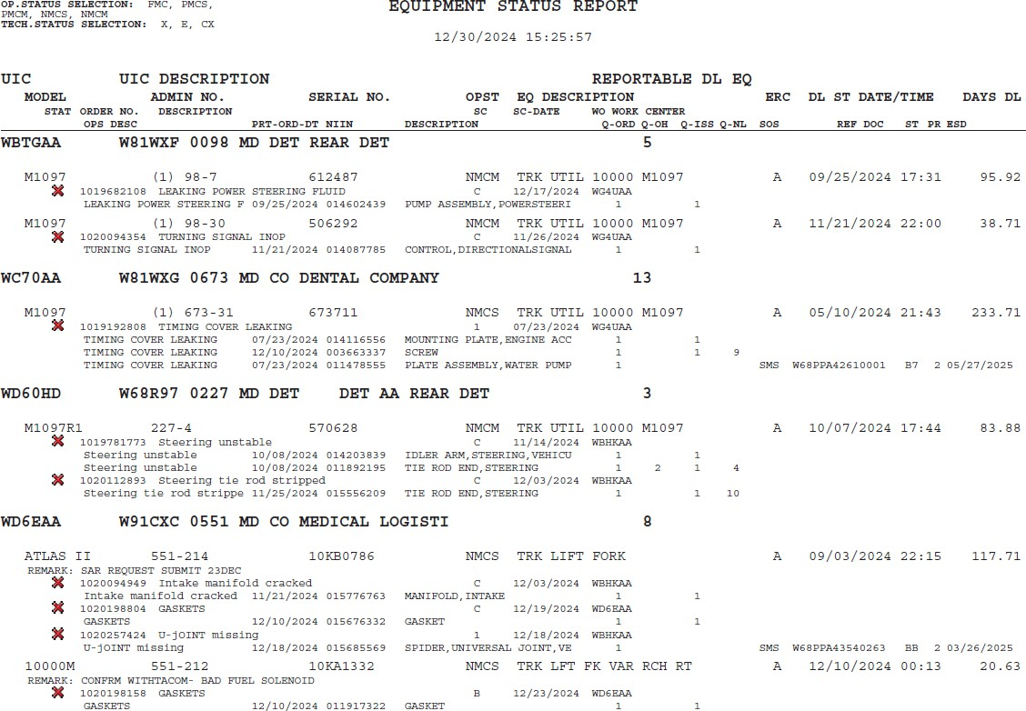
HOW TO READ THE ESR 1 of 2
UNCLASSIFIED//FOUO
UIC
UIC Description
Admin Number
Non-Mission Capable Supply
Equipment Readiness Code
Model
Serial Number
Equipment Description
Date/Time NMC Started
Number of days NMC
Non-Mission Capable Maintenance
Work Order #
System Condition
Technical Status
Work Order Description
2/28/2025

Slide 2
HOW TO READ THE ESR 2 of 2
UNCLASSIFIED//FOUO
Material Description
Quantity Issued
Material NIIN
Quantity Ordered
Quantity On Shop Stock
Quantity @ SSA
Vehicle NMCM, all parts on hand and issued to a work order
Units may utilize the remarks feature to provide transparency on current maintenance status
Vehicle NMCS Source of Supply (SMS=DLA)
BB Status (Back-ordered) Estimated ship date (ESD): 3/26/2025
2/28/2025

