Slide 1
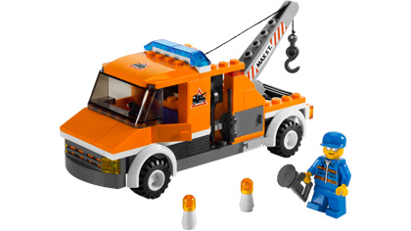
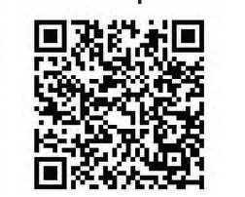
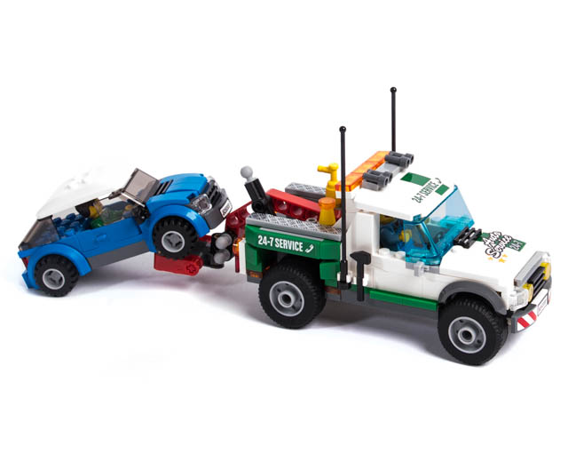
DES Abandoned Vehicle Flow Chart
Vehicle identified or reported as abandoned and vehicle status is checked through JBECC
Is vehicle subject to criminal activity , (i.e., used in a crime / is reported stolen etc.) or a safety risk to the community (i.e., creating a safety hazard / being stripped etc.)
Start
TAI generates an RDF
Vehicle impounded by contract towing company
Do you suspect an abandoned vehicle? use this QR code to report it
no
yes
Patrol calls for tow
Patrol tags vehicle with DD 2504
Attempt to Contact RO/Unit
Mission complete
End
Does owner respond?
yes
no
3 days later
yes
Has vehicle moved?
MWR notified
Vehicle impounded By MWR
no

