Slide 1
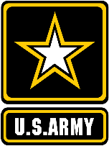
PRE-COMBAT CHECKS/ PRE-COMBAT INSPECTIONS( PCC/PCI ) Instructor:

Slide 2
TERMINAL LEARNING OBJECTIVE
TASKS: Instruct Soldiers on how to conduct proper PCC/PCI’s
CONDITIONS: BATTALION CLASSROOM
STANDARDS: Soldier(s) will be able to understand the purpose and conduct proper PCC/PCI ‘s before any given mission and/or tasks; and be able to tell the difference between the two.

Slide 3
KEY POINTS OF DISCUSSION
The purpose of Checks and Inspections
Conducting Inspections
Checking Equipment
PCI Check list

Slide 4
Purpose of Checks and Inspections
As you already know checks and inspections are part of the steps in the Troop Leading Procedures ( TLP ).
Pre-combat checks (PCCs), Pre-combat inspection (PCIs), and pre-execution checks ensure that you and your unit are adequately prepared to execute operations and training according to standard. They are the detailed final checks that all units conduct before and during training and combat operations. You must perform checks and inspections before each event or exercise to check personnel, equipment, vehicles, and mission knowledge. By requiring your unit to adhere to standards, you ensure that every individual and every piece of equipment will be combat ready.

Slide 5
Purpose of checks and inspections cont.
-
Pre-combat checks and inspection are an individual and leader responsibility. It is impossible to overstate their importance.
The Individual Soldier is responsible for ensuring through their PCCs that all equipment necessary for the mission is on hand.

Slide 6
Purpose of checks and inspections
cont.
The Team Leader, is responsible for checking during PCIs that the equipment is serviceable and for making corrections. In addition, he conducts pre-execution checks to ensure that all equipment specific to a given mission is prepared and in working order before combat.
The Team Leader can not delegate the responsibility for inspections. The rigor with which they conduct them and the standards that are set will affect how well the unit performs in combat

Slide 7
Purpose of checks and inspections cont.
Checks and Inspections are your best tool to combat-apathy and complacency.
It’s human nature for people to get used to their surroundings and creating a new standard

Slide 8
Purpose of checks and inspections
cont.
By ordering/doing regular inspections, you will be able to correct small problems before they become big problems.
Checks and inspections also help to bond Soldier’s together. They will feel a sense of satisfaction and pride in themselves and their unit as they meet standards for their personal appearance, living quarters, and equipment.

Slide 9
Purpose of checks and inspections cont.
You conduct PCCs and PCIs at the beginning of each training exercise or mission as part of your troop leading procedures. They are a systematic way to ensure that you and your Soldiers can successfully and efficiently execute your assignment.

Slide 10
Conducting Inspections
I
It’s essential that you schedule time for inspections and allocate adequate time for back briefs during the inspection to ensure that all Soldiers understand the mission at hand. You must also allow time for corrections as needed. When working under the troop leading procedures, squad leaders should conduct initial inspections shortly after the warning order (WARNO) has been issued. The Team leader makes initial inspection of his team . The PL and PSG make the final inspection:
-weapons and ammo
-uniforms and equipment
-mission essential equipment ** By making these inspections a regular
-mission back brief and activity, you will help reinforce standards
Understanding of responsibilities and instill discipline. **
-communications
-rations and water
-Deficiencies noted during
early inspections

Slide 11
Inspecting Equipment
General: All equipment when grounded will be dressed and neat. Equipment is removed only for sleeping, eating, personal hygiene, AARs (After Action Reviews), or as directed by the PSG. Uniformity will generally be maintained; e.g., if one Soldier wears wet weather gear, everyone must wear wet weather gear.
Tape: Only olive-drab green tape is authorized when taping up weapons or equipment. Black electrical or silver duct tape isn’t an acceptable replacement. Tape down any loose or excess straps on equipment.
Weapons: Weapons will always be within arm’s reach when not carried in the field. M240s will move with a 50rd feeder belt. M249s will move with a 100rd assault pouch attached. Weapons are carried at the low ready. Until engaging a target, finger is not on the trigger; rather hand is wrapped around the pistol grip. Weapon slings are taped to prevent them from coming off and to ensure noise discipline is maintained. Magazines will be taped and have a loop of 550 cord inserted in the end to allow for easier access from the LBV pouches. Magazines will be up when empty and down when loaded.
5. Tie-downs: All sensitive items will be tied down using 550 cord. The 550 cord will be gutted and the ends will be burned to prevent fraying.

Slide 12
Inspecting equipment cont.
6. ACH: The ACH is configured in accordance with BN SOP. Names are embroidered on the right ACH band.
7. LBV (Flik/molle vest): The LBV is configured in accordance with battalion SOP. When worn, the LBV is buckled at all times. Extenders are authorized and encouraged due to the wearing of IBAs and cold weather gear.
a. All items (canteen covers, ammo pouches, first aid pouch, etc.) are secured to the vest by their clips
b. canteens are secured in their canteen pouches and buttoned; canteen cup will in the right canteen pouch.
c. compasses( if issued )will be in a pouch that’s easily accessible in the front of your vest.
d. earplugs will be in their case and on your front right belt loop.
e. first aid pouch will be complete and attached to the left side of the vest with a red cross marked on top; NATO nine-line medevac card, casualty feeder cards, and ROE will be inside of first aid pouch at all times.

Slide 13
f. Each soldier will carry 7 magazines or more ( to include SAW[squad automatic weapon] and machine gunners). These extra magazines can greatly assist during consolidation and reorganization. Magazines will be placed up (so you can see the loading slots) when empty and down when loaded. Magazines will have 550 cord loop on the bottom to facilitate rapid withdrawal from the vest or pouch and be taped to aid in noise discipline.
10. Rucksack: The rucksack will be configured in accordance with battalion SOP. Rucksack will be packed in accordance with the prescribed packing list with zero defects. The rucksack frame. A nametape is machine sewn and centered just above the stitching at the bottom edge of the flap. Two luminous strips depicting company identification markings are machine sewn and centered equidistant from the US and the top of the nametape.

Slide 14
Inspecting equipment cont.
a. The E-tool is secured inside the E-tool carrier which is secured to the rucksack frame.
11. Gloves: Gloves will be worn at all times cutoffs are not authorized.
12. NVGs: will be inside canteen pouch on the right side of IBA
13. Flashlights: Flashlights are used for sensitive items and map checks and during MOUT operations. They should be equipped with a red lens and push-button activated.
14. Gortex jacket: The gortex jacket may be worn during inclement weather. A nametape will be machine sewn flush with the bottom of the pocket flap on the upper left sleeve.
15. IBA: Body armor will have a nametape on the top right corner of vest.
16. Assault packs: Assault packs will have a nametape sewn on the outside pocket with luminous tape sewn on top of nametape.

Slide 15
What are the positive effects of regular, impartial inspections on Soldiers? Are there negative effects? How do you ensure checks and inspections are not just “make-work”? “In every case where the Sergeant stops enforcing fundamental standards and senior leaders do not hold him accountable, the enforcement of standards in other areas begins to slip…PCCs are not performed in detail, complacency begins to set in, and Sergeants stop making on-the-spot corrections. The importance of the squad and platoon leadership in establishing standards and holding Sergeants accountable is critical to the performance of the organization. When you walk into an organization as an outsider and you see everyone in the same uniform, vehicle load plans are organized, basic fundamental drills are performed as routine, you learn a lot about the unit’s discipline. You know as an outsider that standards are established, everyone knows the standard, and there is a leader in charge.” Sergeant Major of the Army Kenneth O. Preston

Slide 16
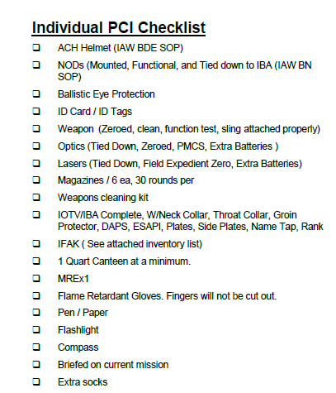
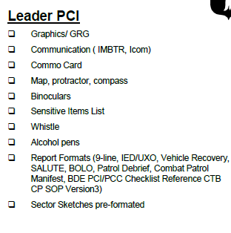
Examples
Mounted / dismounted

Slide 17
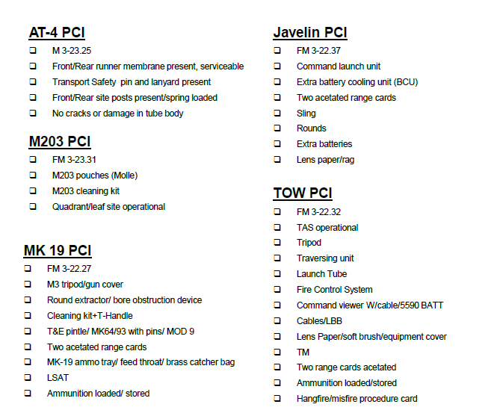
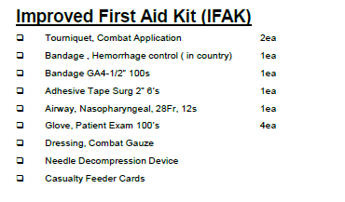
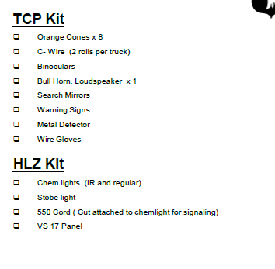
Specialize Equipment

Slide 18
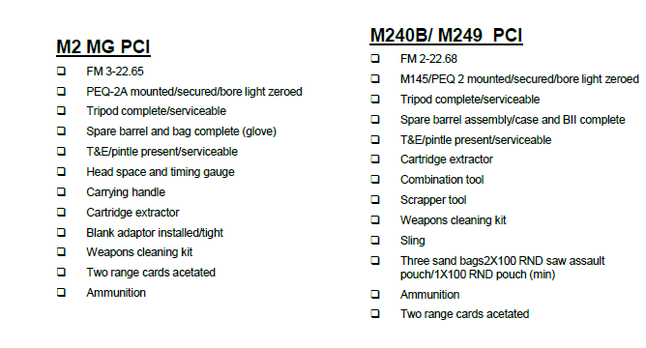
Machine Guns

Slide 19
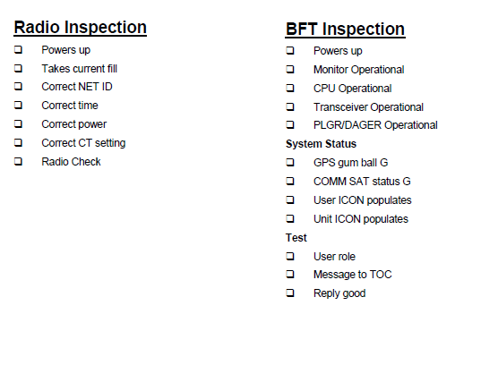
Communication

Slide 20
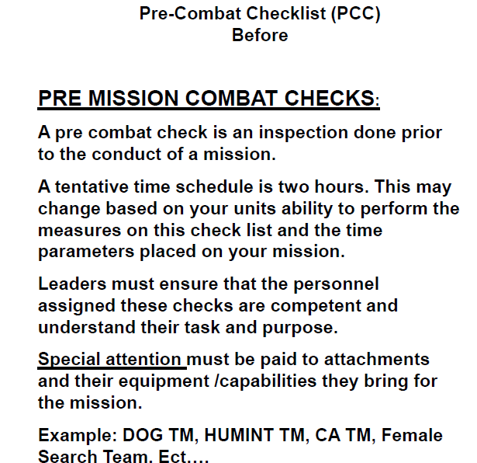

Slide 22
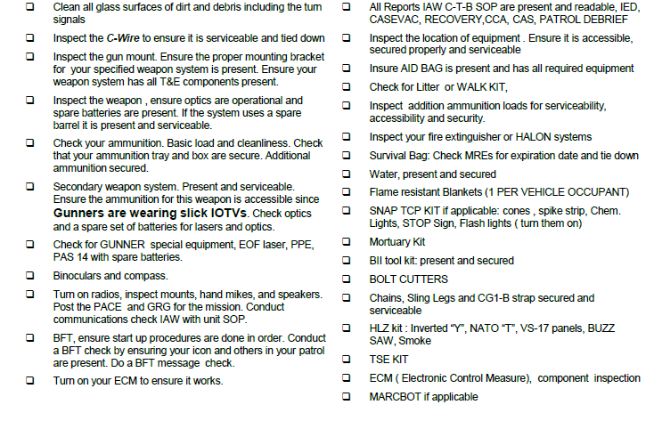

Slide 24
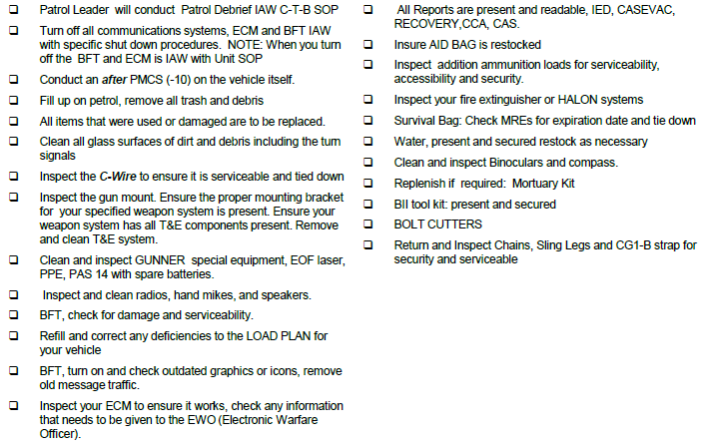

Slide 25
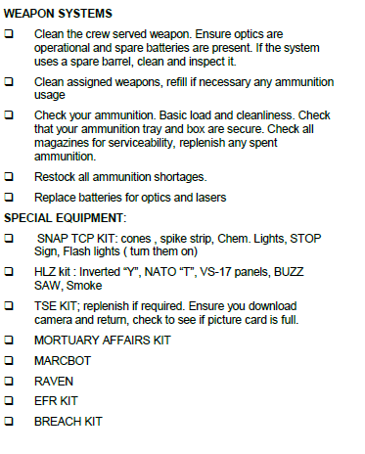
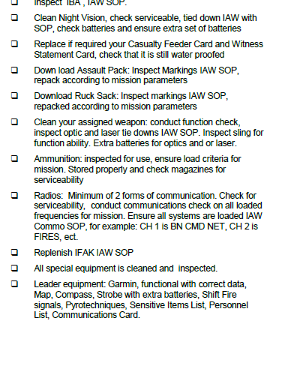

Slide 26
CONCLUSION Inspections enable leaders to correct small problems before they escalate into larger ones. Pre-combat checks and Pre-combat inspections contribute to the overall preparation and readiness of leaders and Soldiers. In addition to helping prepare Soldiers for missions, the inspections and checks demonstrate that you care about your troops, making these checks important tools in maintaining morale and discipline. Your care and diligence in conducting and supervising pre-combat checks and inspections speak volumes about your skill as an Army Leader.

