Slide 1
CUI
A/C Installation Guide for Service Members
U.S. Army Installation Management Command

Slide 2
•Typical barracks rooms have 15 amps/1800 Watts of available power. If the amount is exceeded the breaker will trip and need to be reset.
•Damage to the electrical system and personal equipment will occur after repeated resets.
•The room occupant is responsible for maintenance of the unit and damage caused from improper use.
3. Check the box or data sticker for power use.
Never exceed 1000 Watts or 8.5 Amps
1. Select a self evaporating portable unit not a wall unit.
4. Typical power use by device.
You have 1800 Watts available.
Hair dryer 1,500W
Clothing Iron 1,000W
Gaming computer 300 to 500 W
Gaming console 150W
Room Lighting LED 100W
Computer monitor 90W
42 inch TV 60W
Portable Fan 50W
Standard Phone charger
5 W
2. Select proper size AC Unit.
Room size 100 to 150 sq ft- No more than 5,000 BTU’s
Room Size 150 to 250 sq ft No more than 6,000 BTU’s

Slide 3
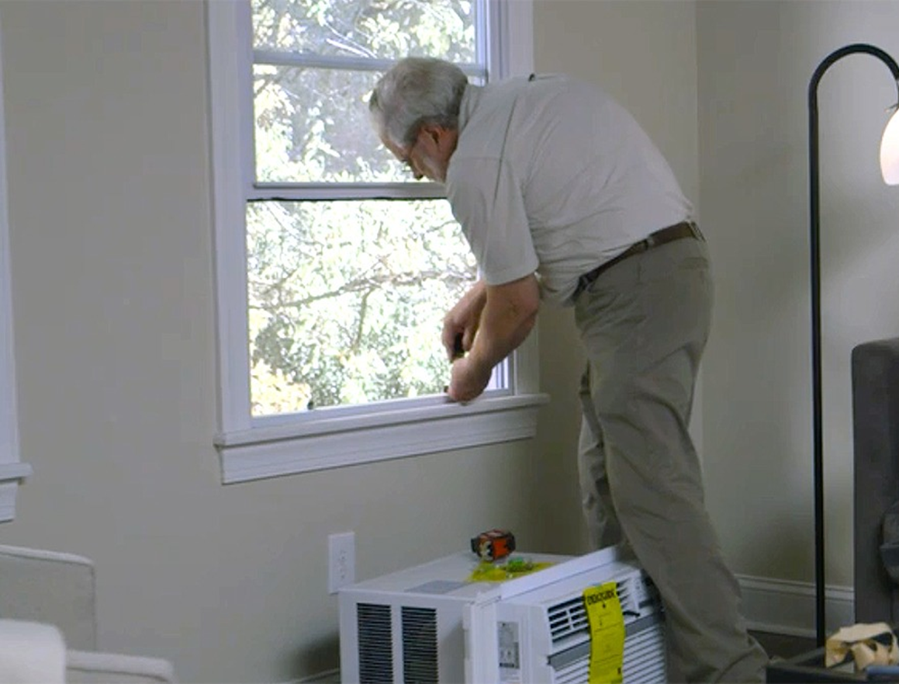
STEP 1
Before learning how to install a window air conditioner, be sure that your window is sound and sturdy. It needs to be strong enough to support the weight of the air conditioning unit. See if there’s any rot or damage around the window frame. Place a work order if necessary.
Learning how to install a window AC unit includes deciding whether to use a support bracket. A support bracket transfers some of the weight of the air conditioner off the window sash and sill. A support bracket will minimize the chance of damage to the window, window parts or the outside wall.
Some support bracket models require no tools. They can be easily removed for seasonal storage. Other types of support brackets permanently attach to the window frame.
Open the lower window sash.
Attach the bracket using the provided hardware.
Slide the accordion panels onto both sides of the air conditioner.
Air conditioners are very heavy. Installing a window AC unit is a two-person job. Carefully lift the air conditioner with a helper. Place it gently inside the open window.
Rest the unit on the bottom of the window frame and mounting support bracket.
Center the air conditioner in the window opening.
Position the unit’s bottom guide, or flange, flush against the window stool.
Tip: Always refer to the manufacturer’s instructions on how to install a window air conditioner support bracket.

Slide 4
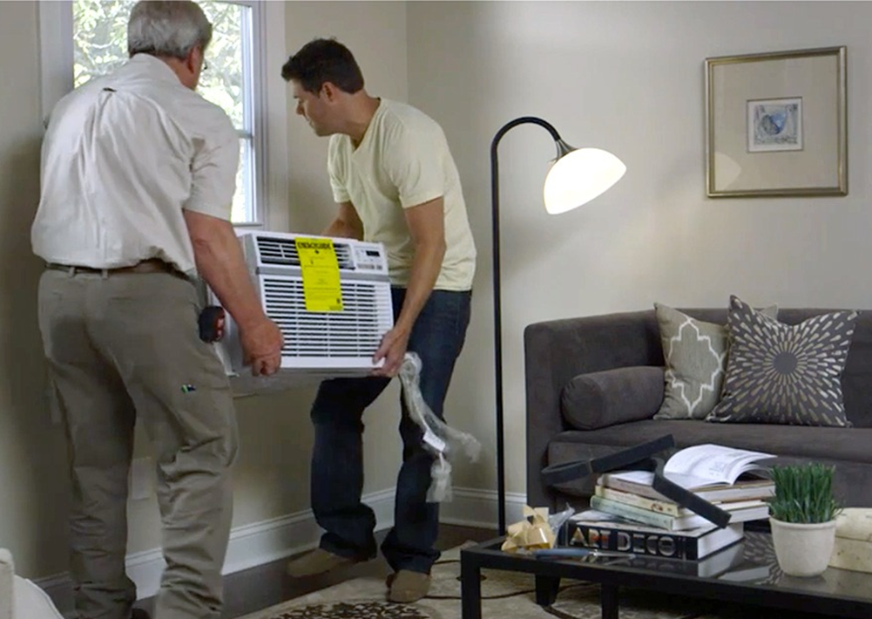
STEP 2
Most instructions for how to install a window AC unit are about the same. However, some types might have steps specific to that model. You will need help to balance the heavy unit in the open window.
Set the air conditioner on the window frame. Pull the upper window sash down to the top of the box and behind the upper flange. This will provide additional stability.
Try to not use any screws or nails to install your window A/C unit. Any damages to the windowsill or frame will fall under NFWT and be at cost to the unit if found negligent.
NOTE: If you need to use any hard ware contact your first line and barracks manager. The submit a DMO through ARMA and a 4283 for any modifications or new work for your installation of your A/C Unit.
Attached DA FORM 4283 Click Icon below

Slide 5
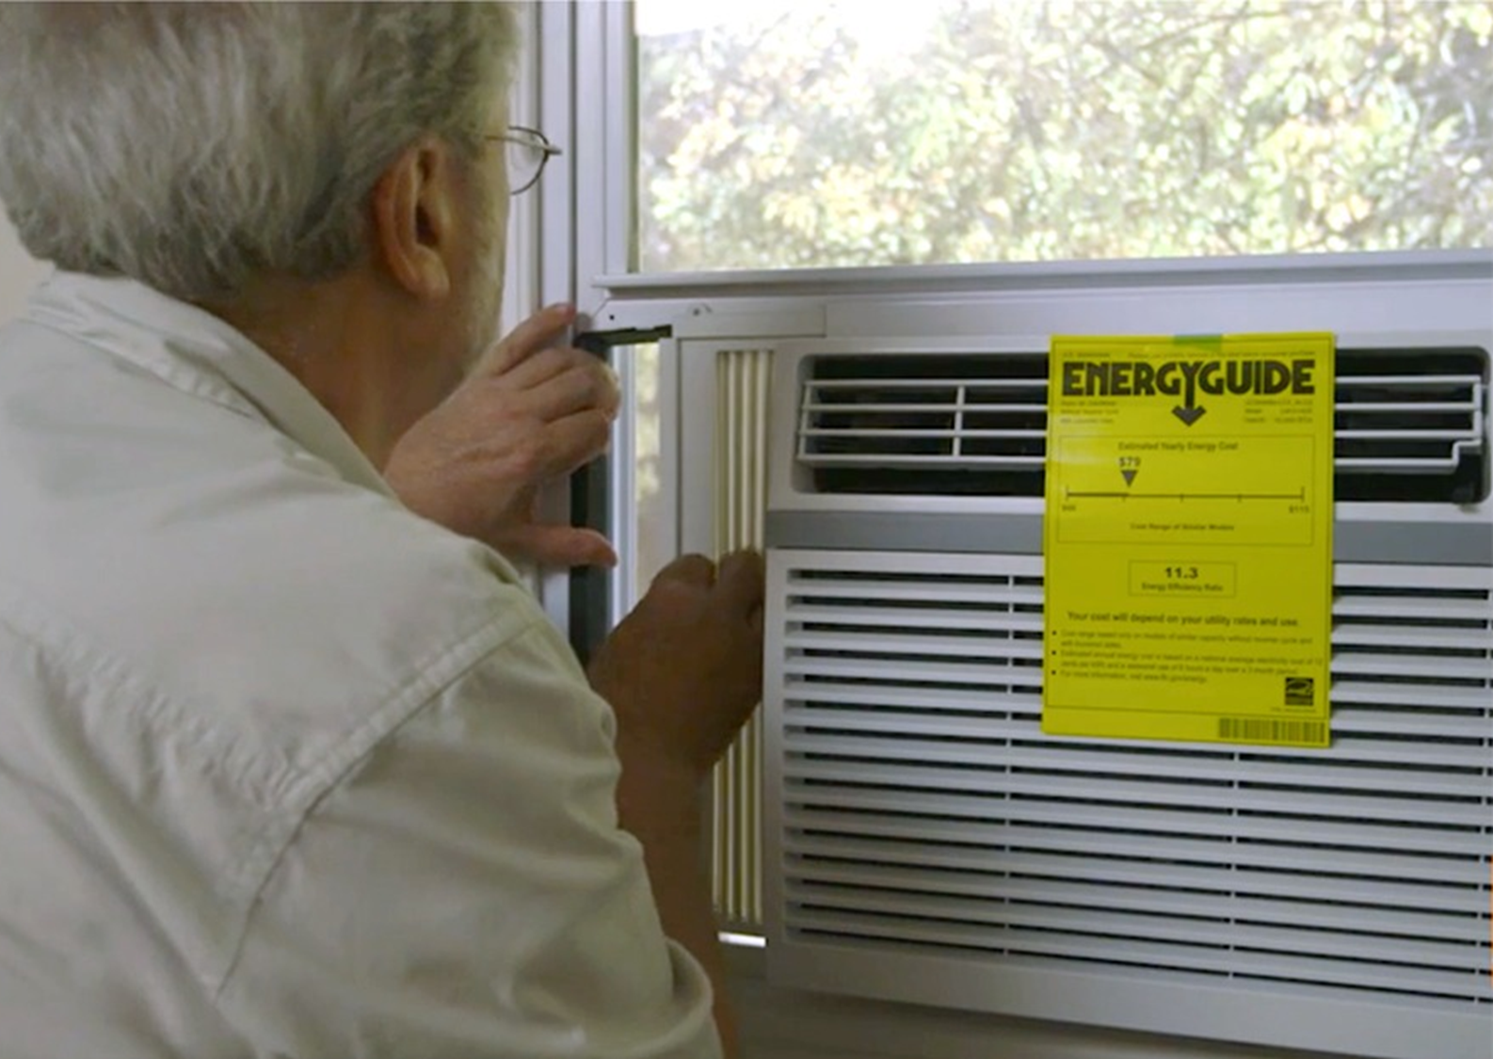
STEP 3
Once the window air conditioner is secure, keep the warm air outside and the cool air inside.
Extend the accordion panels from both sides of the air conditioner to the window sash track.
Secure the side panels with screws.
Window air conditioners often come with a foam insulating strip.
Cut the strip of foam to the correct length. Insert it between the upper window sash and the lower window sash.
Look over the manufacturer's instructions for how to install a window AC unit. Make sure you've used all the included hardware.
Plug the air conditioner into an outlet and turn on the unit.
Tip: You can also use non-adhesive foam stripping to fill the gap between the window sashes
Tip: If you are missing or need to replace side panels for you A/C units see these links:
https://www.itsoverflowing.com/diy-air-conditioner-side-panels/
https://www.amazon.com/Breeze-Stop-Surround-Insulation-Conditioner/dp/B08QDL1XTC?source=ps-sl-shoppingads-lpcontext&ref_=fplfs&psc=1&smid=A1AILYV2G6A184

Slide 6
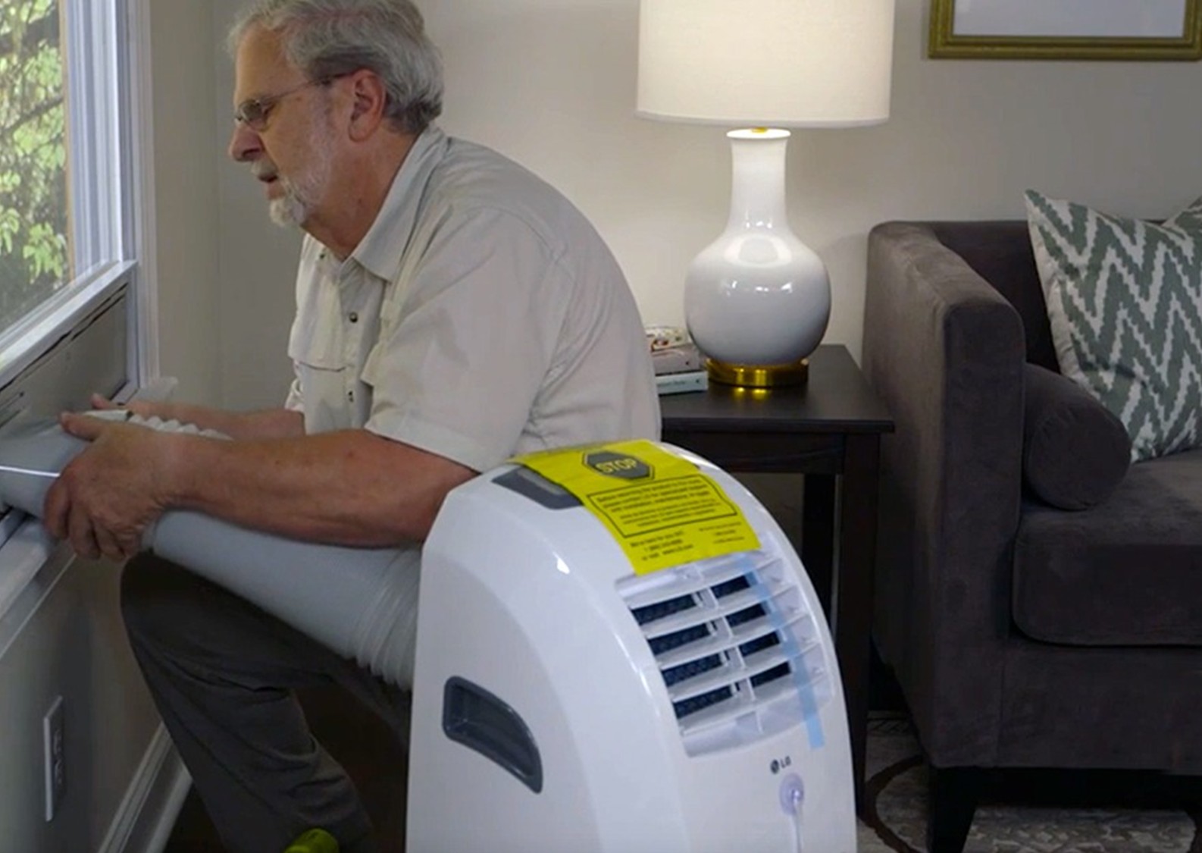
Installing Portable AC unit
A portable air conditioner is a less-permanent alternative to a traditional window air conditioner. The unit sits on the floor. Its exhaust is vented through a panel in the window opening.
Open the window where the portable air conditioner will be located.
Cut foam weather stripping to length and attach to the window sash and frame.
Adjust the AC unit’s window vent panel to extend across the width of the opening. Lower the window sash until it rests on top of the vent panel. Install an L-shaped security bracket to prevent the window from opening, if desired insert the vent tube into the vent panel.
Attach the vent tube into the rear of the air conditioner.
Plug the unit in and turn on the power button. Set to the desired temperature.
Installing a window AC unit is a simple DIY project. It requires minimal heavy lifting and tightening a few screws. For a little effort you get a cool room to enjoy during the warm season. Many window air conditioners can also provide heating for a chilly room. Learning how to install a window air conditioner can have year-round benefits.
Before you install the unit, check around the area. Remove any interior and exterior objects that may block or inhibit airflow. After installation, clean the air conditioner filter regularly to optimize performance.

