Slide 1
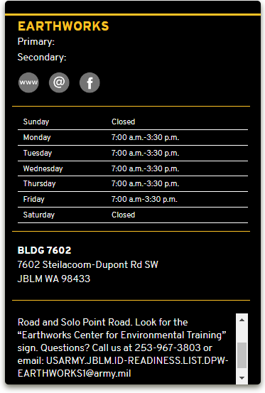
Take it to JBLM Earth Works in Mil or TMP vehicle. Building 7602

Slide 2
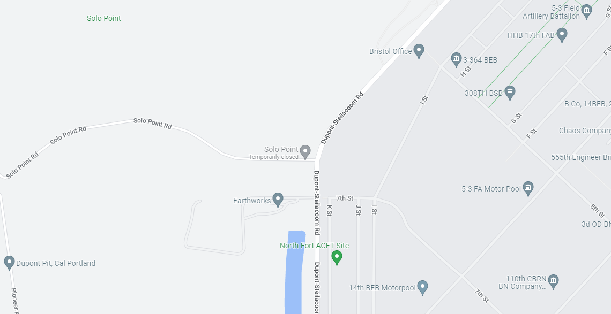
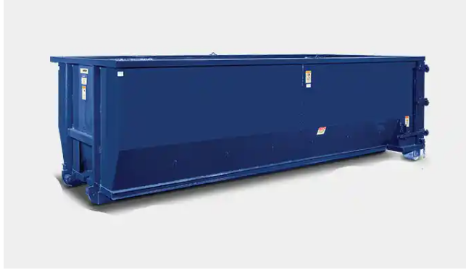
Take it to JBLM Earth Works in Mil or TMP vehicle. Building 7602
They have a 40 -yard dumpster for bulk items and trash.

Slide 3
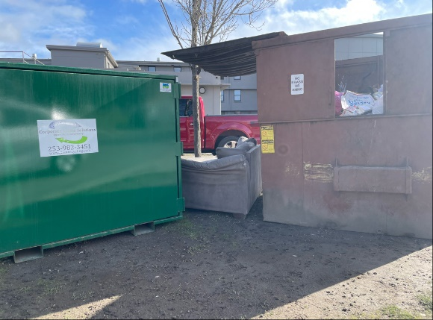
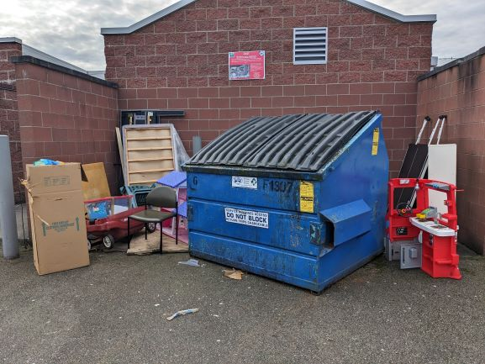
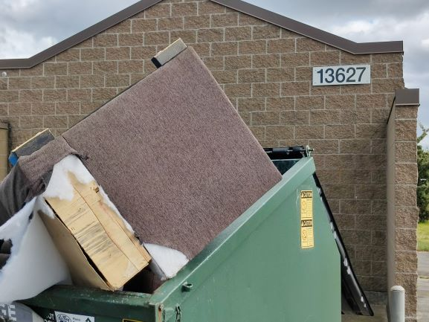
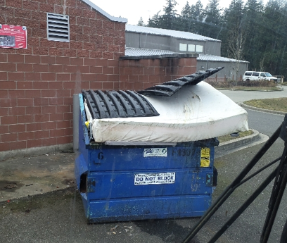
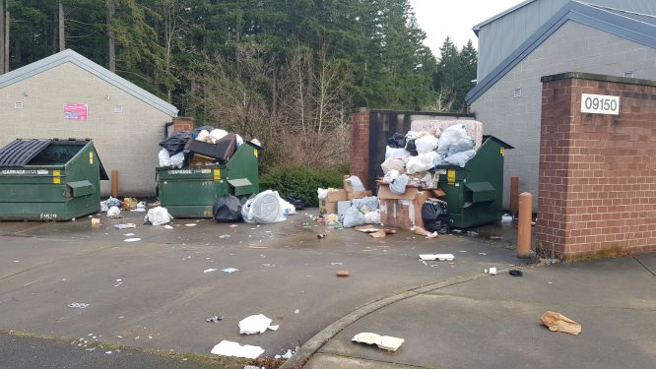
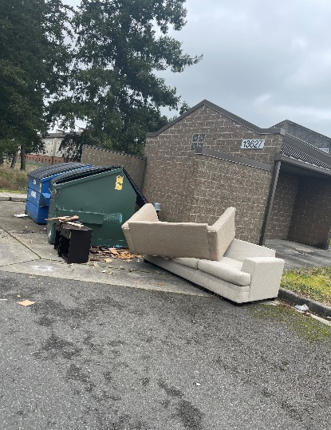
Take it to JBLM Earth Works in Mil or TMP vehicle. Building 7602
No bulk trash around dumpsters pallets can be taken to Recycling yard on JBLM.
Items such as these do not go into any LeMay dumpster. They go to public dump or Earth works..
Another item that can be taken to Earth works
Units must ensure all trash is inside dumpster and not in front as shown drivers will not pick up the trash on ground or service the dumpster till it is free and clear.

