Slide 1
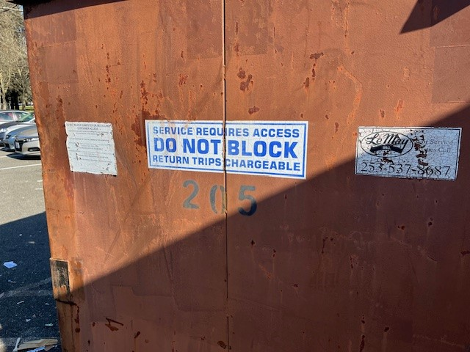
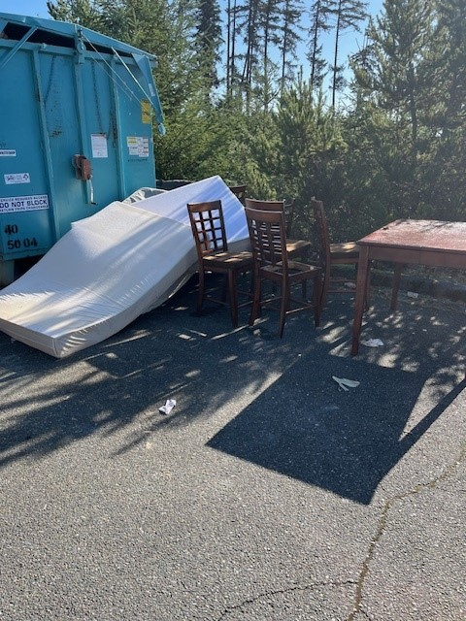
JBLM Cantonment Area – Unit Refuse Dumpster Response Protocol
U.S. AIR FORCE
The LeMay Refuse contract requires a minimum of 1x week pick up of dumpsters. The frequency can vary up to 5x week pick up.
Where dumpsters are overflowing, the facility manager/unit rep should call DPW Refuse Contract COR, Debbie Humble at work number (253) 967-9486 or mobile number (253) 495-0576 (weekdays only) to arrange LeMay pick-up.
Please provide the dumpster number stenciled on the container (see photo).
LeMay operators need to be able to access the dumpster and will not remove bulk waste items but will remove smaller trash bags inside of a 10-foot radius of the dumpster.
Addressing unit generated bulk waste requirements needs to be coordinated separately with Ms. Humble.

