Slide 1
Furniture & Appliance How to Guide
UH Branch
Housing Division
Subtitle Here
Version Number
As of DD MMM YYYY

Slide 2
Inventory and Sign for Barracks Property
Contact Furnishings Management Officer (FMO) @ 253-966-2894 Building 9660 Bay C, Perry AVE, JBLM 98433 to sign out scan tool or to schedule an appointment.
Barracks Manager and Commander conduct joint inventory of Barracks property using the scan tool.
Return scan tool to FMO.
Hand receipt will be emailed to the Commander.
Commander must send signed copy back to FMO.
Maintain copy of signed hand receipt in Barracks Managers Binder.
Commanders sign Barracks Property to the Barracks Manager on a DA Form 2062.
Barracks Manager sub-hand receipts common area property to CQ DAILY. Maintain sub-hand receipts on file for 2 years.
Notes:
During shift change, common area property (Laundry room, day room, CQ area) should be inspected, inventoried and signed for by the incoming CQ on a DA Form 2062. Submit DA Form 2062 to 1SG and maintain on file for 2 years.
Barracks property hand receipt is only valid for 12 months. Prior to the 12th month, Barracks Managers and Commander must re-inventory the barracks property with the scan tool and the Commander must sign the new hand receipt.
***Commander can designate any leader to sub-hand receipt furniture, the Barracks Manager is a recommendation.

Slide 3
Furniture & Appliance Replacement Procedures
Annex C (ABMP Roles and Responsibilities Defined) to
FRAGO 1 HDA EXORD 068-18: Army Barracks Management Program

Slide 4
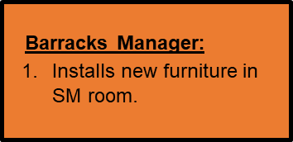
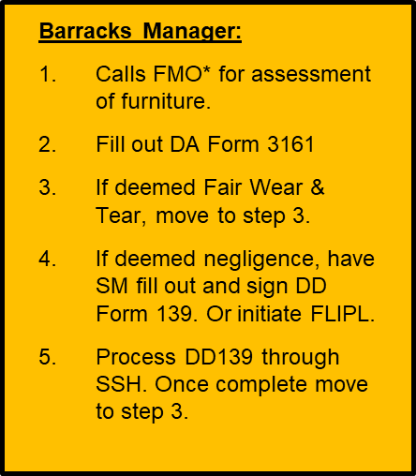
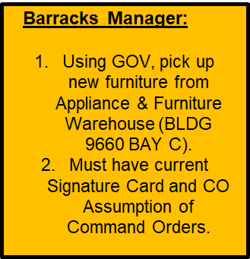
Barracks Furniture Replacement Flow Chart
Annex C (ABMP Roles and Responsibilities Defined) to
FRAGO 1 HDA EXORD 068-18: Army Barracks Management Program
Notes:
*FMO = Furnishings Management Office @ 253-966-2894 Building 9660 Bay C, Perry AVE, JBLM 98433

Slide 5
Furniture Replacement Process
Annex C (ABMP Roles and Responsibilities Defined) to
FRAGO 1 HDA EXORD 068-18: Army Barracks Management Program
Replacement process:
Identify damaged furniture.
Coordinate with Furnishings Management Officer (FMO) at 253-966-2894 if damage is Fair Wear and Tear (FWT) or negligence.
- Unit must a have Soldier sign DD Form 139 or initiate FLIPL.
- If deemed negligence a Soldier or unit must be charged. (See “DD Form 139 example”)
Initiate DA Form 3161 for furniture turn in (see example). Only Commander or appointee deemed on signature card can initiate a DA Form 3161
Take damaged furniture to the DPW furniture warehouse located at BLDG 9660 BAY C.
Must use government vehicle.
- Transfer site must stamp DA Form 3161.
Take the stamped DA Form 3161 to building 9660 to pick up the replacement furniture.
Someone must be designated on the signature card, in order to: Requisition, Receive and Turn-In Furnishings & Appliances. (See “Example: Signature Card”) See slides 11 and 12.

Slide 6
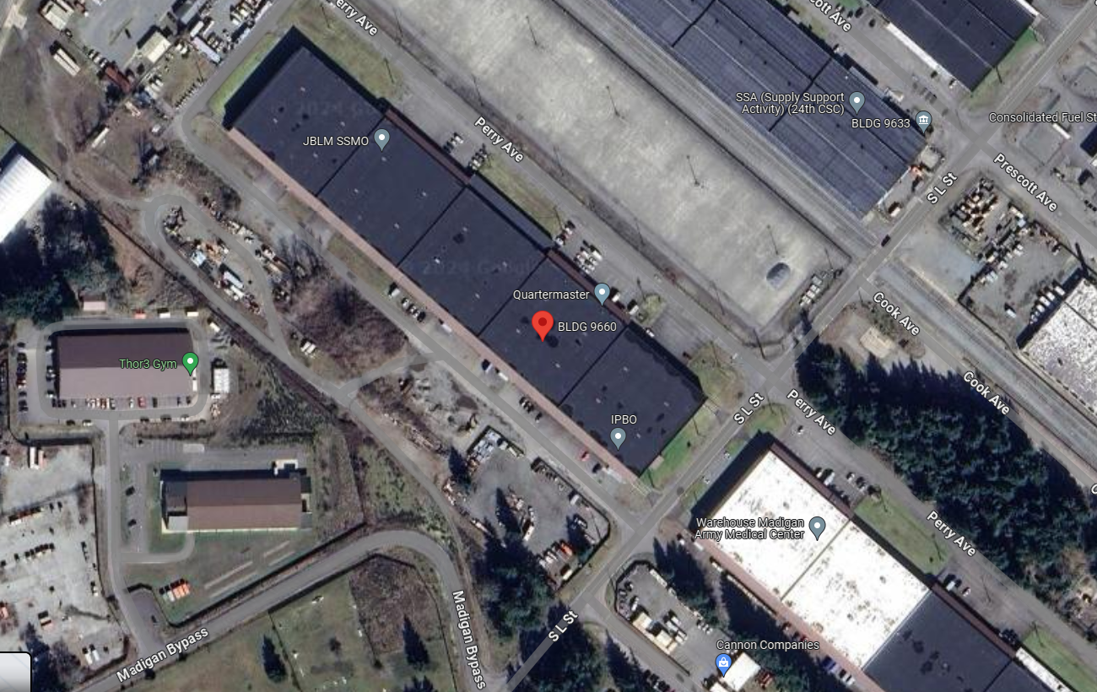
FMO Location 253-966-2894 Building 9660 Bay C, Perry AVE, JBLM 98433
Annex C (ABMP Roles and Responsibilities Defined) to
FRAGO 1 HDA EXORD 068-18: Army Barracks Management Program

Slide 7
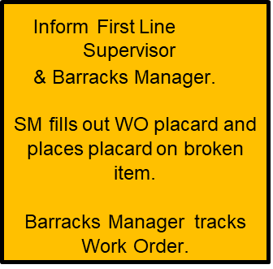
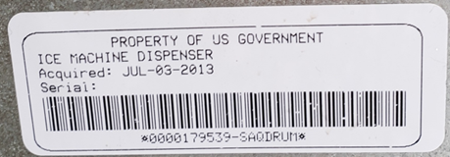
Barracks Appliance Replacement Flow Chart
Annex C (ABMP Roles and Responsibilities Defined) to
FRAGO 1 HDA EXORD 068-18: Army Barracks Management Program
Barracks Manager:
Takes Appliance back to barracks and puts in place.
If install is required, DPW will install.
Report completion to resident and leadership.
Barracks Manager:
Calls FMO* to schedule appointment for replacement.
Using GOV/LMTV, take Appliance to Furniture & Appliance Warehouse (BLDG 9660 BAY C).
Must have current Signature Card and CO Assumption of Command Orders.
Appliance must be clean so techs can try to fix it or use it for parts.
DPW:
1. If able fix appliance on spot.
No further action required.
2. If unable to fix appliance DPW will put sign on appliance for replacement.

Slide 8
Appliance Replacement Process
Replacement process:
Identify damaged appliance.
Submit service order through ArMA.
Must include the bar code number.
DPW will attempt to repair appliances in place.
If unable to repair, DPW will place a notice to replace on the appliance.
Once the unit receives the notice to replace the appliance, the unit must provide:
a government vehicle and detail.
Someone must be designated on the signature card, in order to: Requisition, Receive and Turn-In Furnishings & Appliances. (See “Example: Signature Card”)
Take the appliance to Furnishings Management Officer (FMO) at BLDG 9660.
STEP 1: Unit must initiate a FLIPL if SM refuses to pay for any appliance damages as result of Non-Fair Wear and Tear.
STEP 2: If appliance was damaged due to neglect of a Soldier, then a DD Form 139 must be submitted.
All returns and pick-ups are at BLDG 9660.
Appliances must be returned to the warehouse clean inside and outside.
Replacement process:
Identify damaged Appliance.
Submit service order through ArMA.
Must include the bar code number.
DPW will attempt to repair appliances in place.
If unable to repair, DPW will place a Notice to replace on the Appliance.
Once the unit receives the Notice to Replace the appliance, the unit must provide:
a Government vehicle and detail.
Someone must be designated on the signature card, in order to: Requisition, Receive and Turn-In Furnishings & Appliances. (See “Example: Signature Card”)
Take the appliance to Furnishings Management Officer (FMO) at BLDG 9660.
If appliance was damaged due to neglect of a Soldier, then a DD Form 139 must be submitted first.
All returns and pick-ups are at BLDG 9660.
Appliances must be returned to the warehouse clean inside and outside.

Slide 9
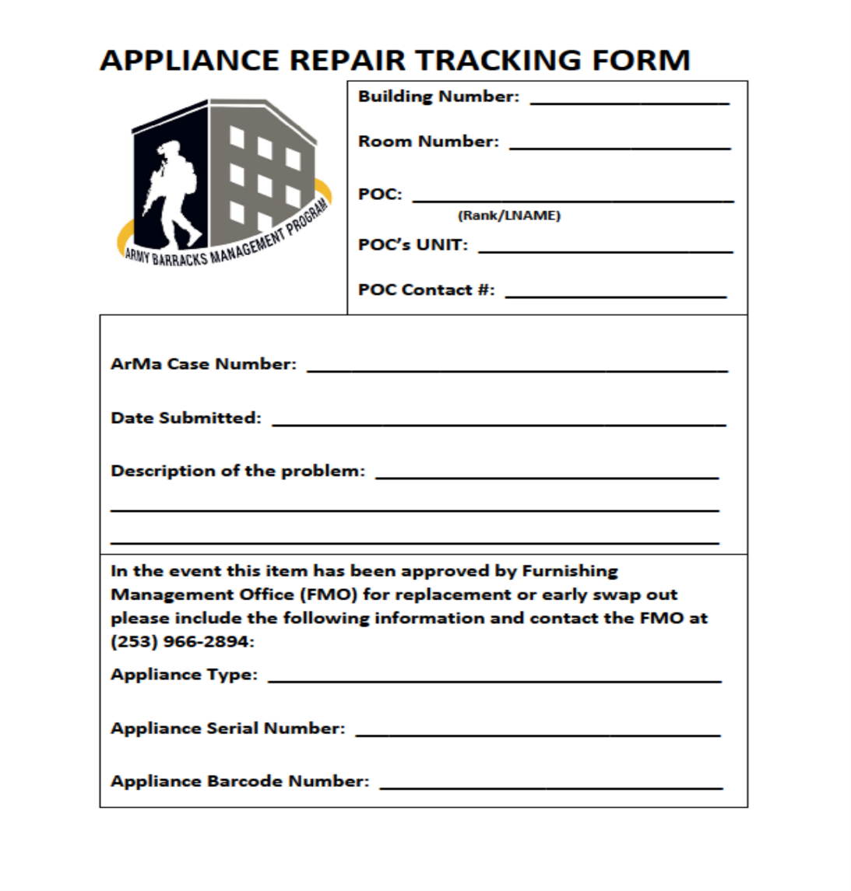
Appliance Replacement Process
Soldiers must notify the Barracks Manager when they see this sign on an appliance.
Work order number.
Date serviced.
Barracks Manager and contact info.
DPW POC for turn in.

Slide 10
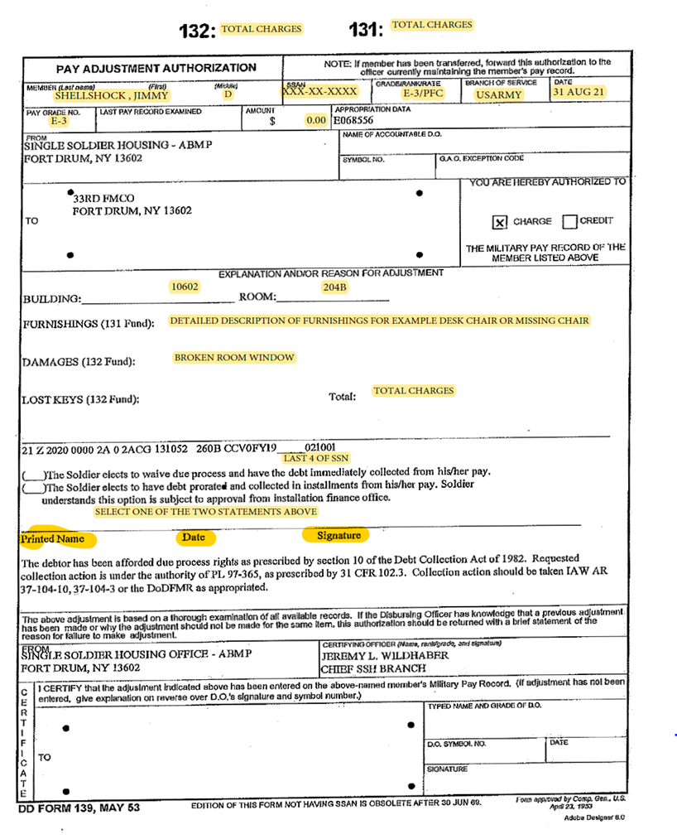
Example: DD Form 139
Double Click PDF Icon to Open form.

Slide 11
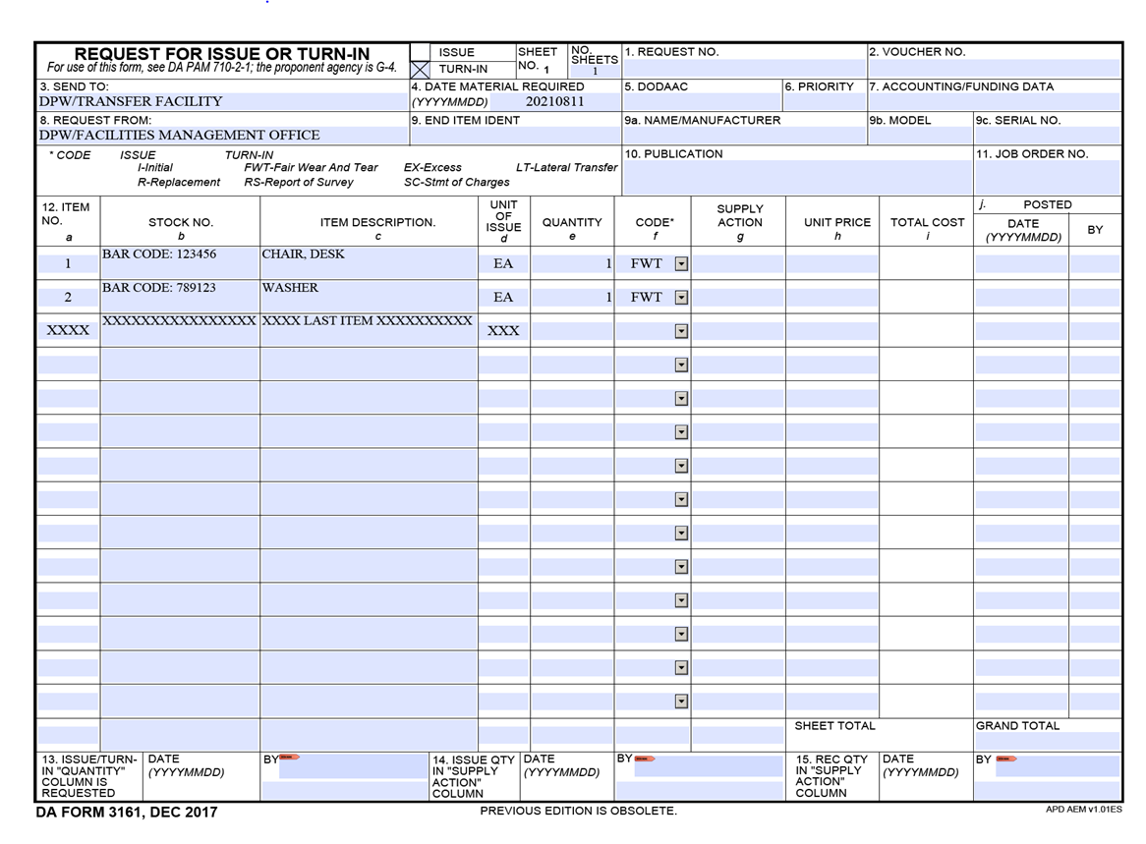
Example: DA Form 3161
Double Click PDF Icon to Open form.
NOTE: Commander or appointed designee are the only people authorized to initiate this form.

Slide 12
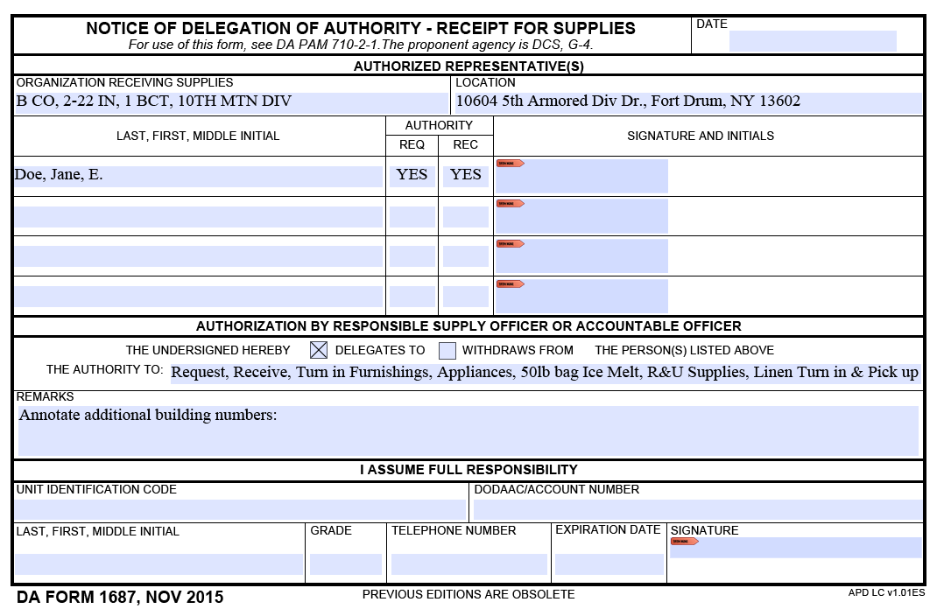
Example: Signature Card (DA Form 1687)
Company Commander or appointed designees are placed on here.
Double Click PDF Icon to Open form
Up to 4 Soldiers authorized to Turn-in/Receive Furniture, Appliances, Ice Melt, R&U Supplies and Linen
Needs to have all this information
Needs to have all this information
List all buildings that belong to the CO

