Slide 1
NCO Field Leader Guide

Slide 2
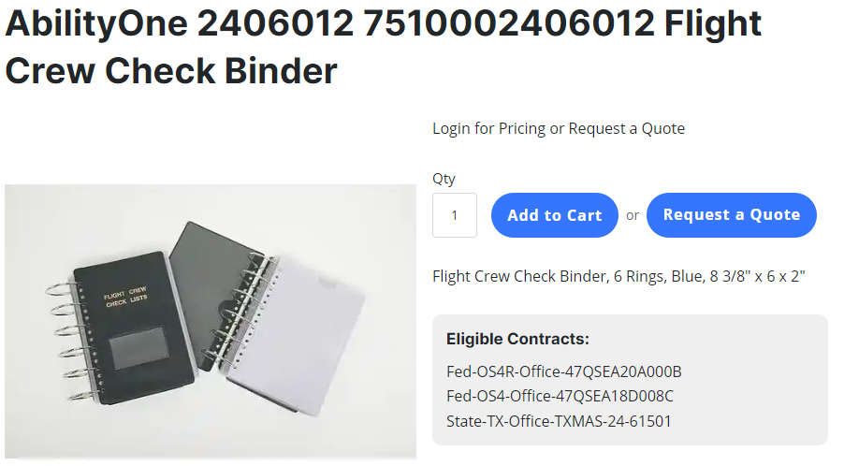
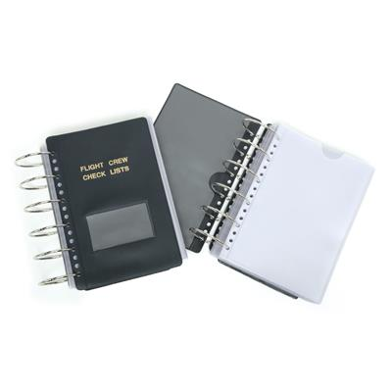
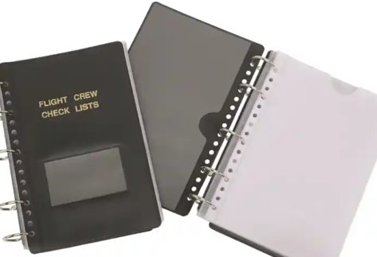
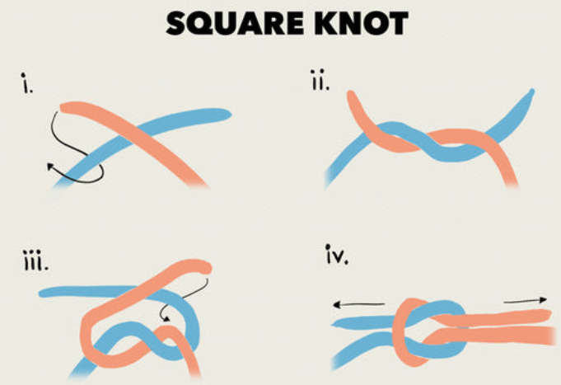
NCO Field Leader Guide Construction Methods
Tactical Leader Book Build Option 1:
Flight Crew Check List Binders
To order, a GPC holder, WITH a BSC account, must go to your local BSC or order online. They will receive a quote. With said quote, they create an exhibit 6, and then the order can be made.
Binders come in 2 sizes:
Size 2: at the bottom, has 25 pages. Enabling up to 50 total slides.
Size 4: to the right, is dimensionally the same size, but has double the pages. Thus, enabling up to 100 slides.
Flight Book Production: (Continued on next page. Visualization on next page)
Print according to the instructions on the next page.
After printing and filling the needed sleeves, replace rings with 550 cord loops, tied with a square knot. (If no sleeves will be added or removed, finish the square know w/ 2 overhands.) Burn and smash ends after trimming cord.
If retaining the gut, slide the nylon outer shell down the gut 1/8”, trim the gut, extend shell, and burn
A video covering how to order WILL be published.
FLIGHT CHECKLIST BINDER, SZ 4 NSN7510002406012 | NSN2406012
$18.16/EA
$10.05/EA
FLIGHT CHECKLIST BINDER, SZ 2 NSN7664269 | NSN7510007664269
Cost estimate:
1 for every NCO in a Rifle Company:
(L) (47 NCOs)= Sz2 $472.35 / Sz4 $853.52
(S) (59 NCOs)= Sz2 $592.95 / Sz4 $1071.44
Notes:
How to Order Aviator Book
Instructions for ordering book card….the product you made here with small changes we discussed.
Paste the card.
At bottom say there will be a video too.

Slide 3
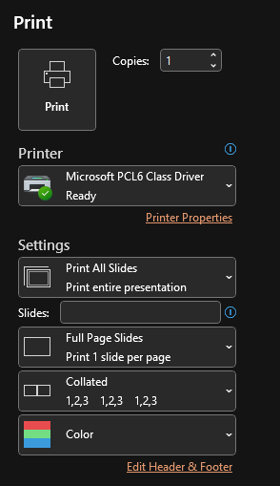
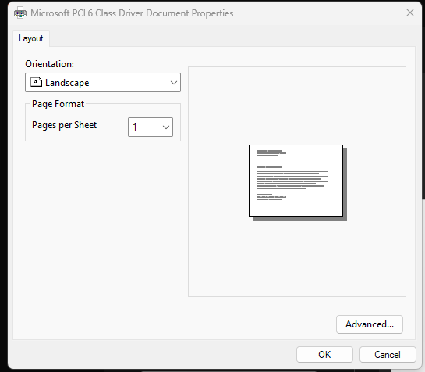
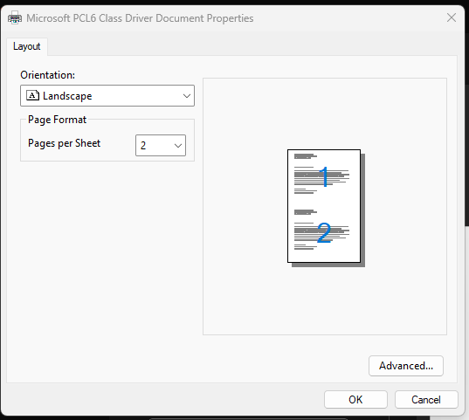
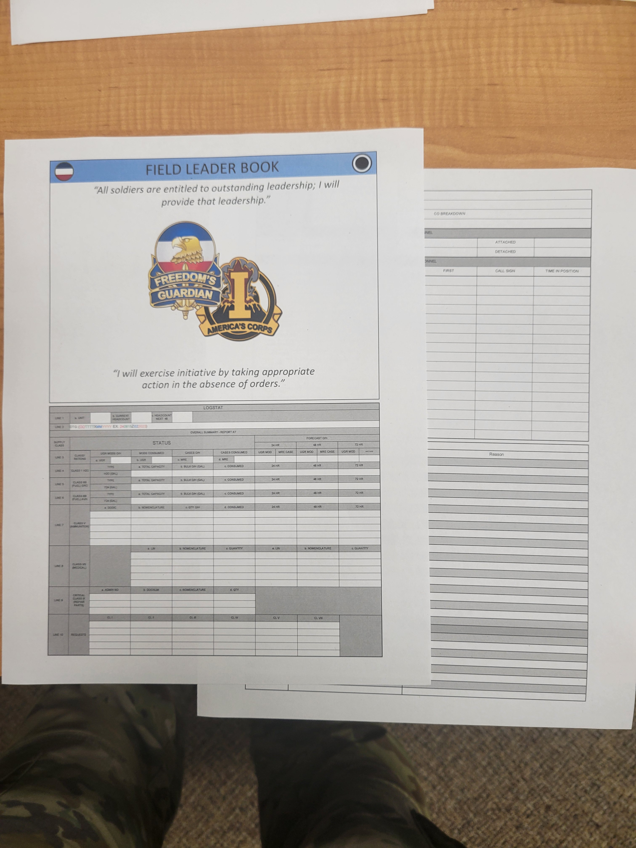
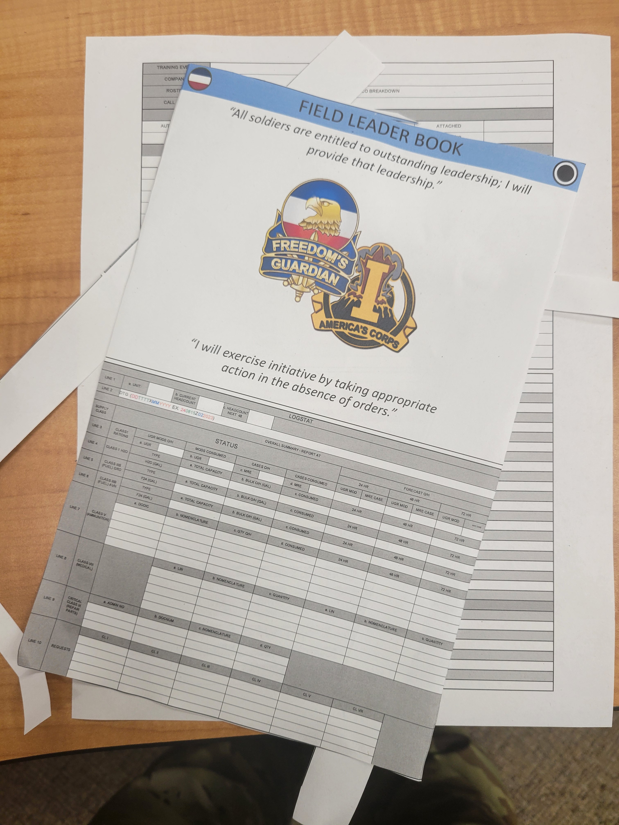
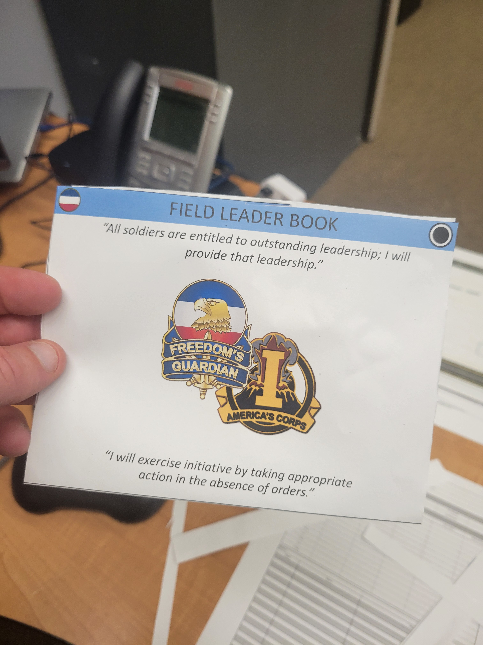
NCO Field Leader Guide Construction Methods
Flight Book Production
From the main print menu, select "Printer Properties.
Inside the Printer Properties, change the number of pages per sheet to TWO.
Click "OK" and return to the main printer menu. Ensure you're printing in color, IF POSSIBLE, and print.
DO NOT print front and back!
Scroll through the deck and "hide" any slides you don't need. Go to "File," click "Print."
Within the MAIN "print" menu, click "Full Page Slides" and ensure the boxes next to "Frame Slides" and "Scale to Fit Paper" are both CHECKED.
Go retrieve your pages
Find a large paper cutter if possible. (I recommend you check your 3 shop.)
Trim your pages along the black border line. TOP, BOTTOM, and SIDES ONLY.
Do NOT separate the two pages.
If using a large paper cutter, limit the number of pages you cut simultaneously as the pages WILL twist under the blade and you WILL cut into your documents.
Once pages are trimmed, carefully fold within the blank space between the two remaining borders. (Bottom of top page and top of bottom page.)
What you are left with are front and back pages that flip as you turn the pages of your flight binder.
Apply a small amount of scotch tape between the top and bottom pages to retain the fold during acetation.

Slide 4
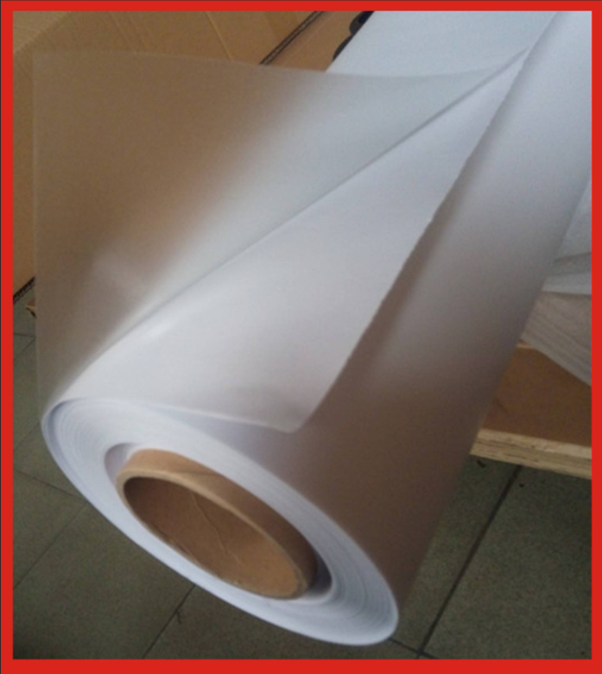
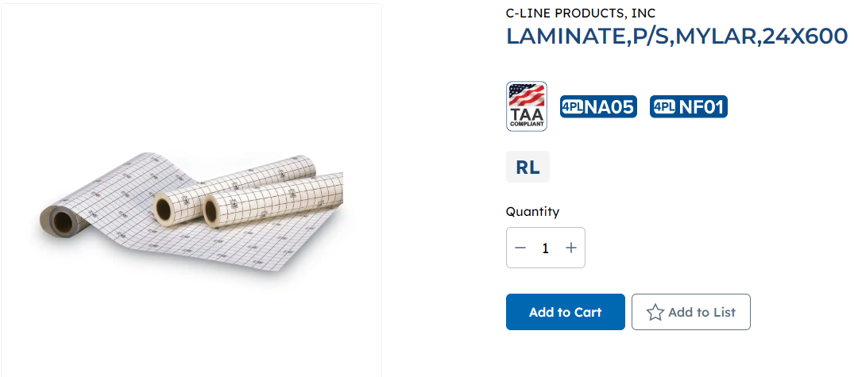
NCO Field Leader Guide Construction Methods
Tactical Leader Book Build Option 2:
Print and acetate pages individually
Lamination comes in many sizes and thicknesses.
Lamination machines can be purchased through GPC or lamination can be completed en masse, similar to laminating maps
Flight Book Production: (Continued on next page. Visualization on next page)
Print according to the instructions on the next page.
Trim your pages along the black border line. TOP, BOTTOM, and SIDES ONLY.
Do NOT separate the two pages.
Once pages are trimmed, carefully fold within the blank space between the two remaining borders. (Bottom of top page and top of bottom page.)
What you are left with are front and back pages that flip as you turn the pages of your flight binder.
Use a small amount of rolled scotch tape to hold the fold you just left.
Acetate the pages as you would a map, trim the excess acetate, leave a decent border to help retain the seal. (you may find taping the edges to even further reinforce seal retention.
Use 100 mph along the SPINE edge at a minimum, then hole punch along the spine.
You MUST firm up the front and back covers if you plan to write ANYWHERE in your book.. MRE cardboard can be cut and trimmed to fit, covered in acetate OR 100MPH tape, poke holes aligned with the holes in the pages, and tie together with 550 cord, tied with a square knot and two overhands. Only use the overhands if you WON'T be disassembling between field problems.
A DEMONSTRATION VIDEO WILL BE PRODUCED!
Lamination and Acetate rolls:
These choices are almost always available in supply rooms, but large rolls CAN be expensive when purchasing in large numbers. Depending on size purchased, each platoon could require 3-4 rolls, just to complete their books, not including any maps needing waterproofed.
These types of laminant can waterproof NUMEROUS pages at a time, but bubbles, wrinkling, and damage to sheets are common. This type of lamination requires practice to become proficient, whereas the machine can be done by anyone with a GT score higher than the average speed limit.
The most obvious benefit is that pages can be laminated ANYWHERE at almost any time.
Laminator and lamination pouches:
Laminators vary widely in cost based on size and level of automation
Laminator shown requires power and uses the pouches shown. These laminators can obviously be used in the rear, but also in any CP with 120 power available (power conditioners can be mounted in vics when purchased through maintenance channels. This lamination method, while tedious, produces very durable and professional weather/waterproof documents, but are impractical for widespread use as the machines have a limited lifespan when ran all day.
Other, larger laminators, CAN be purchased, but are expensive and lack mobility.
All are available through BSC with GPC purchases.
Cost Estimate
Cost for lamenation is difficult to estimate as cost per roll varies wildly depending upon the mil thickness chosen and the Width/Length or the roll(s) ordered.
Going with the pouch/machine method, while time intensive, is more durable AND professional in appearance, but comes at a greater cost.
On the upside, the supply rooms of most formations, already have OR are familiar with purchasing acetate.
The major downside is not only durability, but frequent updates/changes and wear and tear will cause the costs to climb as more and more acetate will be gone through regularly, on top of the acetate purchase for maps and normal products.
Notes:
How to Laminate
Instructions for laminating card….the product you made here with small changes we discussed.
Paste the card.
At bottom say there will be a video too.

Slide 5
NCO Field Leader Guide
Standardized Contents
Roles and Responsibilities of the TL/SL/PSG/1SG/SGM/CSM (Ranger Handbook 1-2 – 1-5) (Doctrine- RHB stops at PSG)
Common to all; Custom
Status Card- Custom
PLT/CO Battle Roster- Custom
CL VIII Tracker- Custom- Scalable
Basic Hand and Arm signals- GTA 17-02-019 / USAIS PAMPHLET 350-6- 071-COM-0608-Use Visual Signaling Techniques
Knots (Ranger Handbook 9-6 – 9-19) Custom
Counter UAS; Custom; ATP 3-01.81 Chapters 3 and 4
Range Card Example/Sketch Example: NOT A GTA (?) DA 5517 (basic)(Ref: ATP 3-21.8)
Fighting Positions (Individual-Crew Served): Custom GTAs 05-08-001 (Survivability POSNs), 07-06-001 (Fighting POSN Constr.), 07-04-006 (Building the DEF for the Comp/Tm)
Heat/Cold Chart; GTA 20-01-001 (Cold Weather Smart Card Custom) TC 21-3 Soldier's handbook for Indiv Ops and survival in CW Areas, TR 350-29 Prev of HEAT and COLD Weather Injuries
Risk estimates distances for unguided mortars and cannon artillery (REDS) Ranger Handbook CUSTOM; TC 3-21.76; IT 071-620-0078 Plan REDs at Company Level includes the charts
Counter UAS; Custom; ATP 3-01.81 Chapters 3 and 4
HLZ establishment; Custom GTA 31-02-001 Special Forces Air Operations; EXCEPTIONAL one pager in source material
Range Card Example /Sector sketch example- NOT A GTA (?) DA 5517 (basic)(Ref: ATP 3-21.8)
Fighting Positions (Individual-Crew Served); Custom GTAs 05-08-001 (Survivability POSNs), 07-06-001 (Fighting POSN Constr.), 07-04-006 (Building the DEF for the Comp/Tm)
Heat/Cold Chart; GTA 20-01-001 (Cold Weather Smart Card Custom) TC 21-3 Soldier's handbook for Indiv Ops and survival in CW Areas, TR 350-29 Prev of HEAT and COLD Weather Injuries
OPORD format for; CUSTOM (Usable up to Company)
Mortar Capabilities and emplacement/Mortar Firing Point
MEDEVAC/CASEVAC Platform Capabilities (?)

Slide 6
Roles and Responsibilities of the Team Leader
TEAM LEADER
The TL controls the movement of the fire team, and the rate and placement of fire. To do this, the TL leads from the front and uses the proper commands and signals. The TL maintains accountability of Soldiers, weapons, and equipment, and ensures the Soldiers maintain unit standards in all areas and are knowledgeable of their tasks and the operation.
The TL leads by example and has specific duties and responsibilities during mission planning and execution. The TL takes specific action when orders are issued. This includes the—
Warning order (WARNORD):
Assists in control of the squad.
Monitors squad during issuance of the order.
OPORD preparation:
Posts changes to schedule.
Posts and updates team duties on warning order board.
Submits ammunition and supply requests.
Picks up ammunition and supplies.
Distributes ammunition and special equipment.
Performs all tasks given in the SLs special instruction paragraph.
OPORD issuance and rehearsal:
Monitors squad during issuance of the order.
Assists SL during rehearsals.
Takes actions necessary to facilitate movement.
Enforces rear security.
Establishes, supervises, and maintains security at all times.
Performs other tasks as the SL requires, and helps in every possible way, particularly in control and security.
Actions
In the objective rally point, the TL assists in the occupation of the ORP and helps supervise, establish, and maintain security. The TL also—
Supervises the final preparation of Soldiers, weapons, and equipment in the ORP according to the SLs guidance.
Assists in control of personnel departing and entering the ORP.
Reorganizes perimeter after the reconnaissance party departs.
Maintains communication with higher HQ.
Upon return of the reconnaissance party, helps reorganize personnel, redistribute ammunition and equipment, and ensures that accountability of all personnel and equipment is maintained.
Disseminates priority intelligence requirements (PIRs) to the team.
Performs additional tasks assigned by the SL.
Actions on the objective, the TL ensures special equipment has been prepared and maintains positive control of the fire team during the execution of the mission. The TL also controls the movement and maneuver of individual fire team members and assists in positioning key weapon systems during and after the assault on the objective.
Actions in the PB, the TL—
Inspects the perimeter to ensure team has interlocking sectors of fire and prepares the team sector sketch.
Enforces the priority of work and ensures it is properly accomplished.
Helps reorganize personnel, redistribute ammunition and equipment upon return of the reconnaissance party, and ensures accountability of all personnel and equipment is maintained.
Disseminates the PIR to the team.
Performs additional tasks assigned by the SL and assists in every way possible.

Slide 7
Roles and Responsibilities of the Squad Leader
SQUAD LEADER
The SL is responsible for what the squad does or fails to do. He is a tactical leader who leads by example. In addition to completing casualty feeder cards and reviewing the casualty reports completed by squad members, the SL—
Directs the maintenance of the squad's weapons and equipment.
Inspects the condition of Rangers' weapons, clothing, and equipment.
Keeps the PL and PSG informed on status of the squad.
Submits liquids, ammunition, casualties, and equipment (LACE) report to PSG.
Actions
During actions throughout the mission, the SL obtains status reports from team leaders and submits them to the PL and PSG, makes recommendations to the PL or PSG when problems are observed, and delegate’s priority tasks to team leaders and supervises their accomplishment according to the SLs guidance.
The squad leader uses initiative in the absence of orders, follows the PLs plan, and makes recommendations. During movement and halts, the SL—
Ensures heavy equipment is rotated among members and difficult duties are shared.
Notifies the PL of the status of the squad.
Maintains proper movement techniques while monitoring route, pace, and azimuth.
Ensures the squad maintains security throughout the movement and at halts.
Prevents breaks in contact.
Ensures subordinate leaders are disseminating information, assigning sectors of fire, and checking personnel.
During actions on the objective, The SL ensures special equipment has been prepared for actions at the objective, and maintains positive control of the squad during the execution of the mission. The SL also positions key weapons systems during and after assault on the objective, obtains status reports from team leaders, ensures ammunition is redistributed, and reports the status to the PL.
When performing actions in the patrol base, the SL—
Ensures the PB is occupied according to the plan.
Ensures that the sector of the PB is covered by interlocking fires, and makes final adjustments, if necessary
Sends out listening posts (LPs) or observation posts (OPs) in front of the assigned sector. (METT-TC dependent).
Ensures priorities of work are being accomplished, and reports accomplished priorities to the PL and PSG.
Adheres to time schedule.
Ensures personnel know alert and evacuation plans and locations of key leaders, OPs, and the alternate PB.

Slide 8
Roles and Responsibilities of the Weapons Squad Leader
WEAPONS SQUAD LEADER
The weapons squad leader (WSL) is responsible for all that the weapons squad does or fails to do. The duties are the same as those of the SL. The WSL also controls the machine guns in support of the patrol's mission and advises the PL on employment of the squad.
The weapons squad leader also—
Supervises machine gun teams to ensure they follow priorities of work.
Inspects machine gun teams for correct range cards, fighting positions, and understanding of fire plan.
Supervises maintenance of machine guns, ensuring that maintenance is performed correctly, deficiencies are corrected and reported, and that the performance of maintenance does not violate the security plan.
Assists the PL in planning.
Positions at halts and danger areas any machine guns not attached to squads, according to the patrol SOP.
Rotates loads. Machine gunners normally get tired first.
Submits LACE report to PSG.
Designates sectors of fire, principal direction of fire, and secondary sectors of fire for all guns.
Gives fire commands to achieve maximum effectiveness of firepower.
The WSL—
Shifts fires.
Corrects windage or elevation to increase accuracy.
Alternates firing guns.
Controls rates of fire and fire distribution.
Knows locations of assault and security elements and prevents fratricide.
Reports to the PL.

Slide 9
Roles and Responsibilities of the Platoon Sergeant
PLATOON SERGEANT
The PSG is the senior noncommissioned officer (NCO) in the patrol and second in succession of command. The PSG helps and advises the PL, leads the patrol in the leader's absence, supervises the patrol's administration, logistics, and maintenance, and prepares and issues paragraph 4 of the operation order (OPORD). The PSG also—
Organizes and controls the patrol command post (CP) according to the unit standard operating procedure (SOP); PLs guidance; and mission, enemy, terrain and weather, troops and support available-time available, and civil considerations (METT-TC) factors.
Receives SLs requests for rations, water, and ammunition. Works with the company first sergeant (1SG) or executive officer (XO) to request resupply. Directs the routing of supplies and mail.
Supervises and directs the patrol medic and patrol aid-litter teams in moving casualties to the rear.
Maintains patrol status of personnel, weapons, and equipment; consolidates and forwards the patrol’s casualty reports (DA Form 1156, Casualty Feeder Card) and receives and orients replacements.
Monitors the morale, discipline, and health of patrol members.
Supervises task-organized elements of patrol. This includes the—
Quartering parties.
Security forces during withdrawals.
Support elements during raids or attacks.
Security patrols during night attacks.
Coordinates and supervises patrol resupply operations.
Ensures that supplies are distributed according to the patrol leader’s guidance and direction.
Ensures that ammunition, supplies, and loads are properly and evenly distributed (a critical task during consolidation and reorganization).
Ensures the CASEVAC plan is complete and executed properly.
Ensures that the patrol adheres to the PLs time schedule.
Assists the PL in supervising and spot-checking all assigned tasks and corrects unsatisfactory actions.
Actions
During movement and halts, the PSG takes the actions necessary to facilitate movement; supervises rear security during movement; establishes, supervises, and maintains security during halts; performs additional tasks as required by the PL and assists in every way possible. The PSG also focuses on security and control of the patrol.
At danger areas, the PSG directs positioning of nearside security (usually conducted by the trail squad or team) and maintains accountability of personnel.
During actions on the objective, the PSG—
Assists with objective rally point (ORP) occupation.
Supervises, establishes, and maintains security at the ORP.
Supervises the final preparation of Soldiers, weapons, and equipment in the ORP according to the PLs guidance.
Assists the patrol leader in control and security.
Supervises the consolidation and reorganization of ammunition and equipment.
Establishes marks, supervises the planned casualty collection point (CCP), and ensures that the personnel status including wounded in action (WIA) or killed in action (KIA) is accurately reported to higher HQ.
Performs additional tasks assigned by the PL and reports status.
During actions in the patrol base (PB), the PSG assists in PB occupation and establishing and adjusting the perimeter. The PSG enforces security in the PB, keeps movement and noise to a minimum, supervises and enforces camouflage, assigns sectors of fire, ensures designated personnel remain alert and equipment is maintained to high state of readiness.
The PSG requisitions supplies, water, and ammunition, and supervises the distribution. He supervises the priority of work and ensures its accomplishment, and performs additional tasks assigned by the PL. When creating a security plan, the PSG ensures—
Crew-served weapons have interlocking sectors of fire.
Claymore mines are emplaced to cover dead space.
Range cards and sector sketches are complete. The security plan also includes—
Alert plan.
Evacuation plan.
Withdrawal plan.
Alternate PB.
Maintenance plan.
Hygiene plan.
Messing plan.
Water plan.
Rest plan.

Slide 10
SQUAD STATUS CARD (SIDE 1)
INPUT SERIAL NUMBER, NOMENCLATURE and LAST PMCS DATE IN BOXES BELOW
 | NAME (LAST, FIRST, MI) | BATTLE ROSTER # | BLOOD TYPE | HW/CW INJURIES | ALLERGIES | TRANS TYPE and BUMPER NUMBER | SERIAL | CHALK
SL
ATL
AR
GR
RM
BTL
AR
GR
RM
LIQUID ON HAND: (FULL QTS.): CL I: meals/water | AMMO ON HAND: (FULL MAGS/DRUMS)(POUCHES): CL V: ammo
CASUALTIES: Battle Roster #s MIST: CL VIII: medical supplies needed | EQUIPMENT: IX: repair parts

Slide 11
SQUAD STATUS CARD (Side 2)
INPUT SERIAL NUMBER, and NOMENCLATURE IN BOXES BELOW
 | PRIMARY WPN | LASER | OPTIC | ALT WPN (GUSTAV/320/M17/DRONE BUSTER) | RADIO | NIGHT VISION | THERMALS | CLU
SL
ATL
AR
GR
RM
BTL
AR
GR
RM
VC
DRVR
SPECIAL EQUIPMENT: | SPECIALTY TEAMS: A&L: EPW SEARCH: BREACH:

Slide 12
NCO FIELD LEADER GUIDE TERMS OF REFERENCE
8 Troop Leading Procedures
Receive the Mission
Issue The Warning Order
Make Tentative Plan
Start Necessary Movements
Conduct Reconnaissance
Complete the Plan
Issue the Complete Plan
Supervise
Subsequent Orders
Rehearsals
PCCs and Equipment Prep
Execution
OAKOC (Continuous)
O- Observation and Fields of Fire
A- Avenues of Approach
K- Key Terrain
O- Obstacles and Movement
C- Cover and Concealment
3 Forms of Movement
Traveling
Traveling Over watch
Bounding Over watch
Reconnaissance
Map
Imagery
UAS
Area
Zone
Route
5 Paragraphs Of An OPORD
Situation
Mission
Execution
Sustainment
Command and Control
PB
ORP
OBJ
METT-TC (Continuous)
M- Mission
E- Enemy (Strength, Disposition, and Location)
T- Time (Available and Required)
T- Terrain (To, On, and Around OBJ)
T- Troops Available
C- Civilian Activity (To, On, and Around OBJ)
LACE
L- Liquid (Qts)
A- Ammo (Mags/Drums)
C- Casualties (Type)
E- Equipment (Shoot, See, Speak)
Types of Rehearsals Quality to Quick
Full Dress RXL (Ideal)
Reduced Force RXL / TEWT
Terrain Model RXL (Desired Min.)
Sketch Map RXL
Map RXL (Used AFTER Leader’s Recon when making minor adjustments)
Radio / Technical RXL
5-Point Contingency Plan(GOTWA)
G- Where You Are Going
O- Others You Are Taking
T- Time You Will Return
W- What To Do If You Don’t Return
A- Actions On Contact (For you and ME)
5 Principles Of Patrolling (Continuous)
Planning
Reconnaissance
Security
Control
Common Sense
7 Danger Areas
Open Areas
Road and Trails
Streams
Villages
Enemy Positions
Minefields
Wire Obstacles

Slide 13
NCO FIELD LEADER GUIDE TERMS OF REFERENCE
EA DEVELOPMENT:
IDENTIFY ALL LIKELY ENEMY AVENUES OF APPROACH
DETERMINE LIKELY ENEMY SCHEME OF MANEUVER
DETERMINE WHERE TO KILL THE ENEMY (Mass Effects)
PLAN AND INTEGRATE OBSTACLES
EMPLACE WEAPON SYSTEMS
PLAN AND INTEGRATE INDIRECT FIRES
REHEARSE THE EXECUTION OF OPERATIONS IN THE ENGAGEMENT AREA
Terms:
5/25 meter check- Five meter and 25-meter search.
1/3 - 2/3 rule- Of the available time allotted for troop-leading procedures (planning), the leader uses 1/3 of the time, allowing the subordinate 2/3 of the time for their actions.
5-Cs- Confirm, clear, call, cordon, and control.
5-Ss- Secure, search, segregate, safeguard, and speed.
5-Ws- Who, what where, when, and why.
STANO- Surveillance, target acquisition, and night observation/optics.
Priorities of Work- Other than security, POWs are determined by the leadership, based on the needs of the element. Minimum products due before 2-5 can be executed: Minimum Security (33+%, SQD and PLT Sector Sketches, Exfil Plan w/ Black and Gold, and Alert Plan. (Centralized or Decentralized execution?)
Security (Always #1) (PL/PSG Confirm Sector Sketches through perimeter inspection) At a MINIMUM:
Position Key Weapon Systems
Emplace elements with interlocking sectors of fire
Confirm Positions
Make decision to camouflage, scratch, or dig (Duration)
Emplace mines (as needed)(must be overwatched)
Employ R&S patrols as needed
Maintenance
Weapons
ONE MG is down at a time for maintenance. (If a gun is down, the PLT is up)
When a SAW is down, the rest of the SQD is UP
NVGs
Commo
Ensure battery will sustain the shifts or replace with fresh
Next day’s SOI is prepped
DO NOT update ALL PLT-SQD radios at the same time
Vehicles
PMCS Complete and 5988s returned
Personal Hygiene (Do NOT violate Security percentage)
Location? (Away from the line)
Chow Plan (Do NOT violate Security percentage)
Location? (Away from the line)
Rest Plan (Do NOT violate Security percentage)
Location? (Away from the line)
ACRONYMS:
CCIR- commander’s critical intelligence requirements
EPW- enemy prisoner of war
PIR- priority intelligence requirement
R&S- reconnaissance and surveillance
SLLS- stop, look, listen, and smell
LOA- limit of advance
EA Dev Questions:
After identifying likely avenues of approach and scheme of maneuver, have you considered how YOU would fight to and through your kill box? Including where you would transition from movement to maneuver?
After determining where to place your primary and alternate kill boxes, have you ensured your obstacles SUPPORT those kill boxes? Would you have time to adjust your plan prior to committing to the kill box if YOU saw YOUR obstacles?
After confirming obstacle effects, have you confirmed prioritization of your key weapon systems and their placement/observation? Can they reach the back edge of your kill box(es)? Do your TRPs cut off escape routes, shape maneuver, delay penetration, and support the massing of DF weapon systems?
When and how are you rehearsing execution? Have you confirmed your plan, engagement, and disengagement criteria are understood at the lowest level?
Where are your trains? Resupply plan? Casualty plan? Egress Routes rehearsed?
Priorities Of Work Questions:
Is the security plan disseminated to the lowest? How did you confirm?
What decisions informed the PRIORITIES? When was the last time your team ate? Slept? Changed socks?
When and how are you ensuring vehicle Maintenance is completed and 5988s are turned in?
When was the last time your weapons were field stripped, cleaned, and lubed? How many rounds through your most used/critical weapons?
Batteries fresh in critical equipment? Optics/lasers/NVGs/Radios? When does the fill need updated? Will it occur during the rest plan?
Where is the slit trench in relation to planning and rest/hygiene?

Slide 14
INDIVIDUAL AND CREW WEAPONS TABLES
INDIVIDUAL/CREW SERVED WEAPONS
WEAPON | MAX EFF. RNG AREA/POINT |  | MAX RANGE | MIN SAFE DISTANCE | RATE OF FIRE SUS/RAP/CYC |  |  |  | BASIC LOAD | TRACER BURN OUT | BURST RADIUS
M9 | NA | 50m | 1800m | 40 DEGREES WAIVER TO 15 | NA |  |  |  | 45 rounds | NA | NA
M17 | NA | 50m | 1800m | " | NA |  |  |  | 45 rounds | NA | NA
M4 | 600m | 500m | 3600m | " | 12-15 RPM | 45 RPM |  | 90 RPM | 210 rounds | 900m | NA
M16A2 | 800m | 550m | 3600m | " | 12-15 RPM | 45 RPM |  | 90 RPM | 210 rounds | 900m | NA
M203 | 350m | 150m | 400m | " 130m training 31m combat | 5-7 rounds aimed |  | 15-17 RPM area supp |  | 36 rounds | NA | 5m kill 15m wound
M320 | 350m | 150m | 400m | " 130m training 31m combat | 5-7 rounds aimed |  | 15-17 RPM area supp |  | 36 rounds | NA | 5m kill 15m wound
M249 | 800m 1000m on tripod | 600m 800m on tripod | 3600m | " 15 DEG WAIVER AVAILABLE FOR TRIPOD ONLY | 50rpm 3-5 rds / 4-6s | 100rpm 8-10 rds / 2-3s |  | 650-850rpm Barrel every min | 1000 rounds | 900m | NA
M240 | 800m 1100m on tripod | 600m 800m on tripod | 3725m | " 15 DEG WAIVER AVAILABLE FOR TRIPOD ONLY | 100rd 6-9 rd / 4-6 sec | 200rd 10-13 / 2-3sec |  | 650-950 Barrel every min | 600 rounds | 900m | NA
M24 | 1000m | 800m | 3725m | " | 20 rounds per minute |  |  |  | 100 rounds | 900m | NA
SR-25 (SAAS) | 1000m | 800m | 3725m | " | Maximum of 40-50 rounds per minute |  |  |  | 100 rounds | 900m | NA
M82A1 | 1830m | 1250m | 6800m | " | Suppressive fire NOT recommended (health risk) |  |  |  | 50 rounds | 900m | NA
M2 | 1830m | NA | 6800m | " | <40 RPM 5-7 rd / 5-7 sec | >40 RPM 5-7 rd / 3-5 sec |  | 400-600 rpm | 400 rounds minimum | 900m | NA
MK19 | 2212m | 1500m | 2212m | " 310m training 75m combat | 40 rpm | 60 rpm |  | 325-375 rpm | ~ 400 rounds 8 cans | NA | 5m kill 15m wound
M67 (FRAG) | How far can you accurately throw? |  |  | 150m | How fast can you pull pins? |  |  |  | 2 | Trace THIS! | 5m kill 15m wound

Slide 15
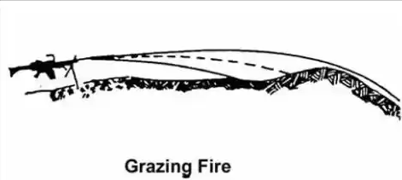
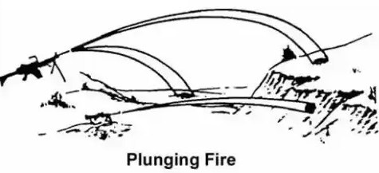
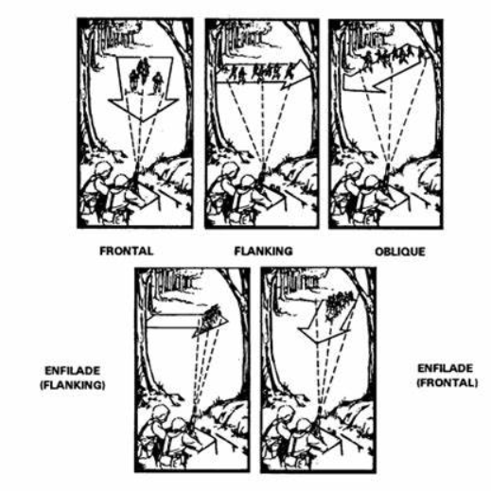
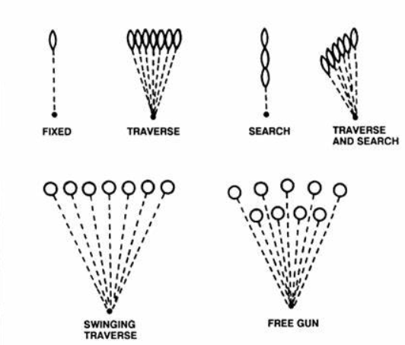
Machine Gun Classes of Fire and Terms of Reference
WITH RESPECT TO TERRAIN
GRAZING FIRE | 1 METER HIGH x 600M OUT | OVER FLAT OR UNIFORMLY SLOPED TERRAIN
PLUNGING FIRE | DIRECT FIRE, FROM SUPERIOR ELEVATION | RESULTS IN PROJECTILES STRIKING TARGET FROM A HIGH ANGLE
WITH RESPECT TO TARGET
FRONTAL | LONG AXIS OF THE BEATEN ZONE AT A RIGHT ANGLE TO THE LONG AXIS OF THE TARGET
FLANKING | FIRE DELIVERED TO THE FLANK OF THE TARGET
OBLIQUE | FIRE DIRECTED AT ANY ANGLE OTHER THAN DIRECTLY TOWARD OR PERPENDICULAR TO THE GUN
ENFILADING | FIRE WHERE THE LONG AXIS OF THE BEATEN ZONE COINCIDES WITH THE LONG AXIS OF THE TARGET
WITH RESPECT TO THE GUN
TRAVERSE | FLANK TO FLANK
SEARCH | TARGETS IN DEPTH- UP/DOWN
TRAVERSE AND SEARCH | IN DEPTH/FLANK TO FLANK | TRIPOD- UP/DOWN, FLANK/FLANK
FIXED | ONE SINGULAR POINT | TRIPOD
FREE GUN | TOTAL FREEDOM ON TRIPOD | NOT LOCKED IN
TERMS OF REFERENCE
MAX ORDINATE | HIGHEST POINT ABOVE THE LINE OF SIGHT TO WHICH A PRJOECTILE RISES DURING ITS FLIGHT (2/3 TRAVEL DISTANCE)
CONE OF FIRE | THE GROUP OF TRAJECTORIES RESULTING FROM A BURST OF FIRE ON A VERTICAL PLANE
BEATEN ZONE | THE PATTERN FORMED WHEN THE CONE OF FIRE STRIKES THE GROUND. OVAL OR CIGAR SHAPED.
MAX ORDINATE

Slide 16
Anti-Tank/Bunker Munitions References
WEAPON |  | MAX RANGE | MAX EFF RANGE | ARMING DISTANCE / MIN RANGE | MSD | BACK-BLAST
M72A1, LAW |  | 1000m | 350m (sighted) | 75m | 250m | 45 degrees X 40m
AT-4 |  | 2100m | 300m | 50m | 250m | 100m
M3 RAAWS (GUSTAAV)
 | HEAT | 2700m | 700m | 5-8m | 50m | 90 degrees X 40m pri 60m sec
 | HEDP | 2800m | 1000m | 20-70m | 150m | "
 | HE | 2900m | 1000m | 20-70m | 250m | "
 | SMOKE | 2900m | 1300m | 20-70m | 50m | "
 | ILLUMINATION | 3100m | 1700m | 500m | 300m | "
 | TRAINING PRACTICE |  | 700m | NA | 50m | "
JAVELIN |  | NA | 2000m (depending on lot) | 35m | 500m | 60 degrees X 25m pri 100m sec

Slide 17
SALUTE Report
Size Size of the enemy unit (Number OR Element size, i.e. Platoon, Company, etc.)
Activity Activity Observed: Digging, patrolling, etc
Location Location of observed enemy (center mass) and key Weapon systems / C2 nodes
Uniform Include uniform items Including patches, symbols on equipment, and any identifying features of element (mine rollers/blade)
Time DDTTTTMMYYYY Time of observation and report | OBS: REP Sent:
Equipment Key equipment observed and orientation

Slide 18
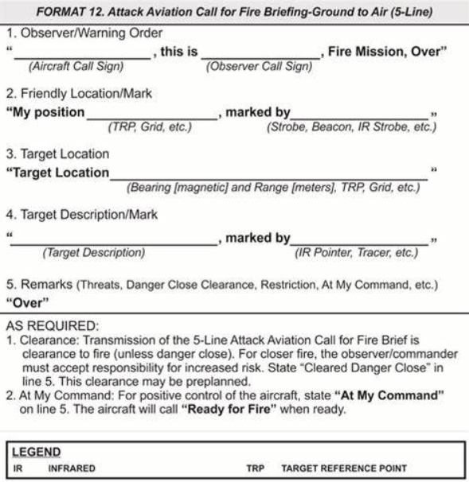
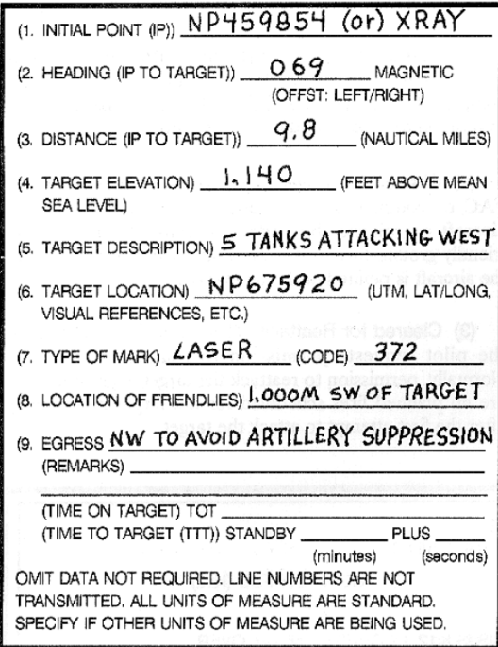
AVIATION SUPPORT REQUEST/BRIEF
Close Air Support Brief Script

Slide 19
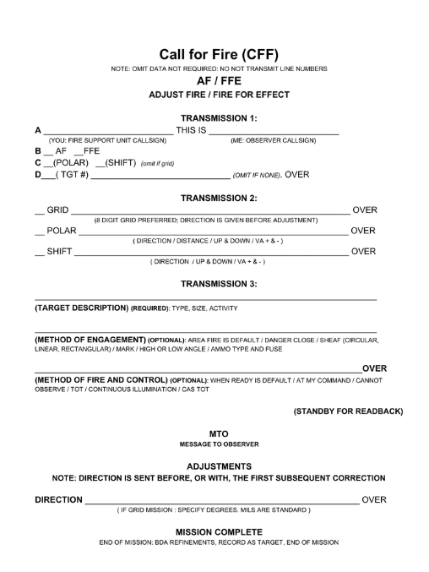
CALL FOR FIRE SCRIPT
Call For Fire Notes/Instructions:
Prior to calling for fire, determine the mission type.
ADJUST (AF)/Fire For Effect (FFE)
POLAR
GRID
Target Number
Adjust fire (AF) causes the support element to deliver a single round at a time, until the impact is on target. Unless desired effect is achieved, AF missions end with a FFE and then assessed BDA or affect achieved (suppressed, destroyed, etc.)
Fire for effect (FFE) Once calibrated upon the desired target or bracketed area, a call for "fire for effect" is made – requesting several batteries or the battalion to fire one or more rounds, with the goal of saturating the target area with shell fragments.
POLAR is a method of engagement which relies on the FDC knowing the location of the observer, then receives the distance, direction, and description of the target.(If in an OP, ensuring your location is transmitted to your supporting FDC is critical, as polar missions are the fastest to transmit.)
GRID, IF the mission is AF, this is the target grid and will be followed by subsequent adjustments. IF the mission is POLAR, the grid is YOUR grid, and you MUST STATE “MY GRID IS…” if they don’t already have it and are already expecting a POLAR mission
Target number is used when firing a PRE-PLANNED target. IF the TARGET is in the preplanned location, it can simply be fired as, “Fire target AB0003, BMP in the open.” If NEAR the preplanned target area, the fire mission is “Adjust fire, target AB0003, direction and +/-, BMP in the open.”

Slide 20
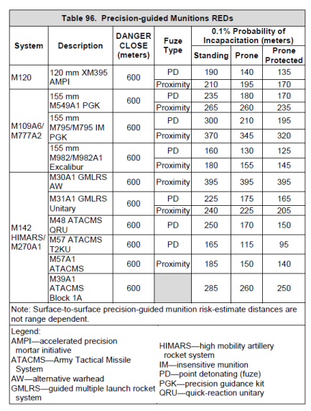
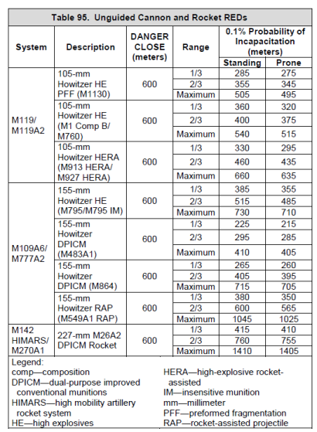
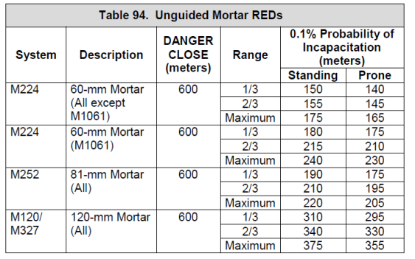
IINDIRECT FIRE RISK ESTIMATE DISTANCES (REDS)

Slide 21
#4
#5
#6

Slide 22
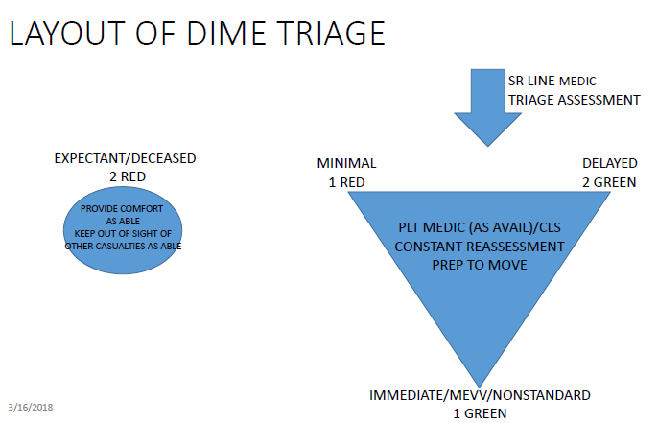
TREATMENT AND TRIAGE
Triage
Types of Bleeding
Capillary (Scratch)
Venous ( Dark Red Blood, Deep Cut)
Arterial ( Bright Red, squirting Blood)
MARCH PAWS Sequence
MARCH- DURING LIFE-THREATENING
M- MASSSIVE BLEEDING #1 Priority
A- Airway
R- Respiration (Breathing)
C- Circulation
H- Hypothermia/Head Injuries
AFTER MARCH- PAWS
Reassess MARCH
P- Pain
A- Antibiotics
W- Wounds
S- Splinting
Tourniquet (TQ)
High And Tight
Never Place On A Joint (Go above the joint if possible)
Never Remove It
Mark forehead / chest / limb with “T” and TIME put on
Patient Flow
Fractures
Open Fractures- TQ, splint and bandage as it lies
Closed Fracture- Splint as it lies
Signs and Symptoms of Shock
Confusion
Loss of Pain
Shivering
Cool Clammy Skin
Rapid Heart Rate
Rapid Shallow Breathing
Blueish Color in Lips, Skin and Nails
AVPU- Used to assess the casualty responsiveness. It is done while moving to the casualty during care under fire and reassessed during tactical field care.
A- Alert and Conscious
V- Responds to Verbal Commands
P- Responds to Pain
U- Unresponsive
Patient Flow
Types of Burns
Thermal
Chemical
Laser
Electrical
Patient Pickup

Slide 23
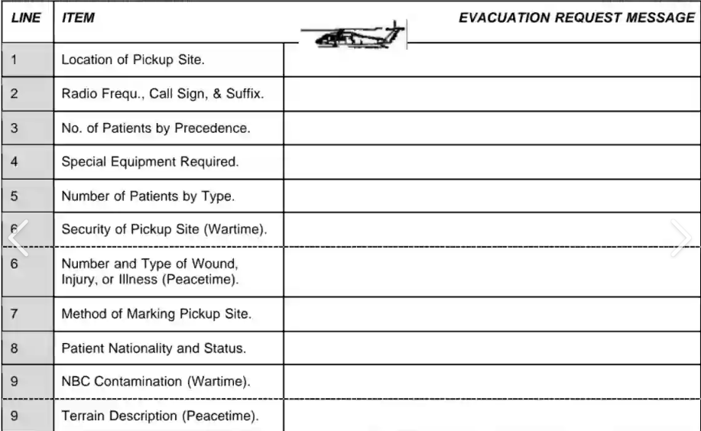
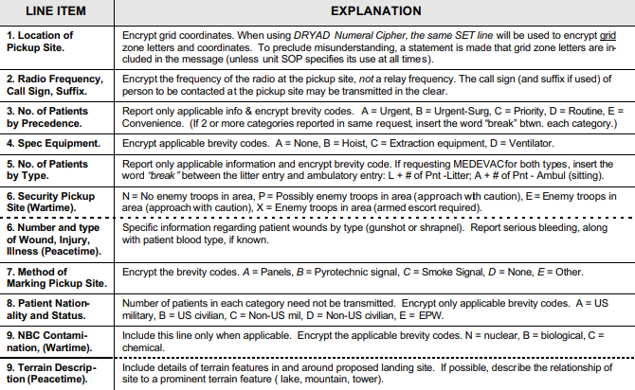
9 LINE MEDEICAL EVACTUATION REQUEST (GTA 08-01-004)

Slide 24
CLASS VIII Tracker
ITEM (IFAK, WALK, Litter, SKEDCO, Aid Bag, etc.) | Quantity | Location (Individual, Bumper Number, etc.) | Shortages or Status

Slide 25
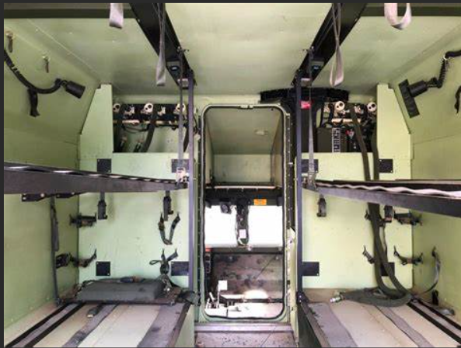
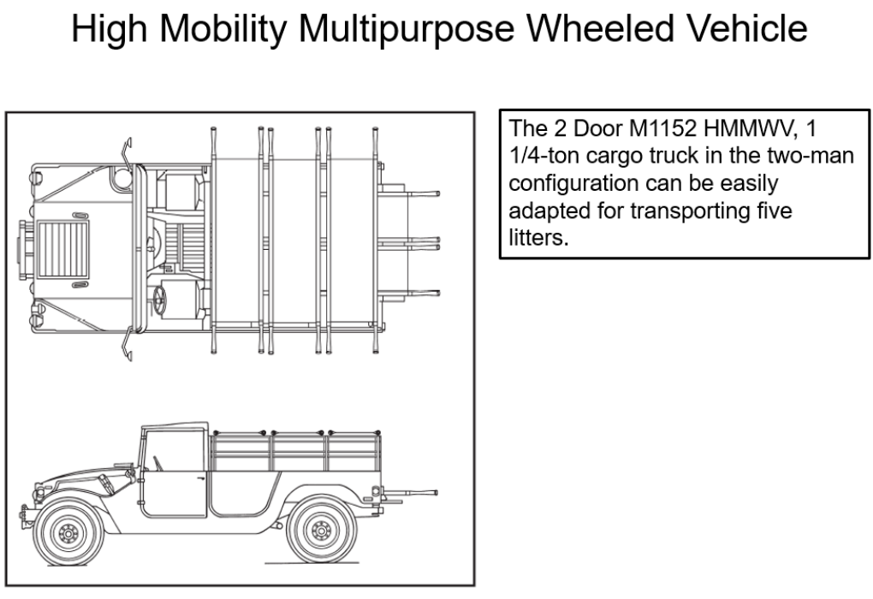
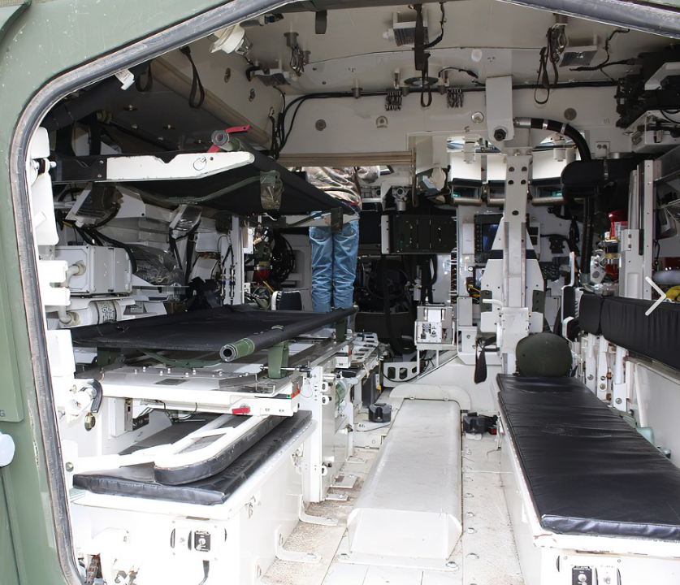
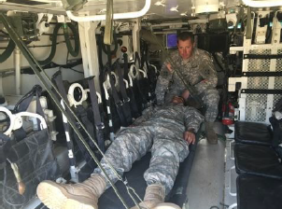
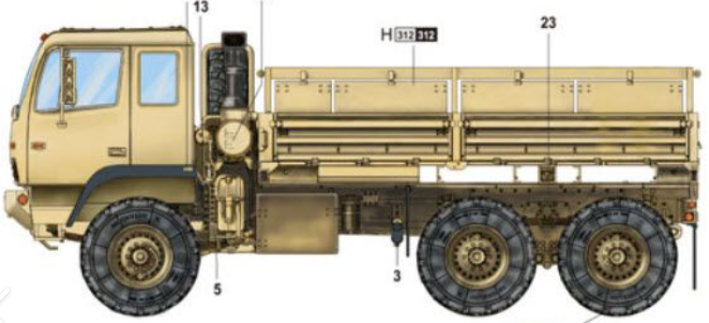
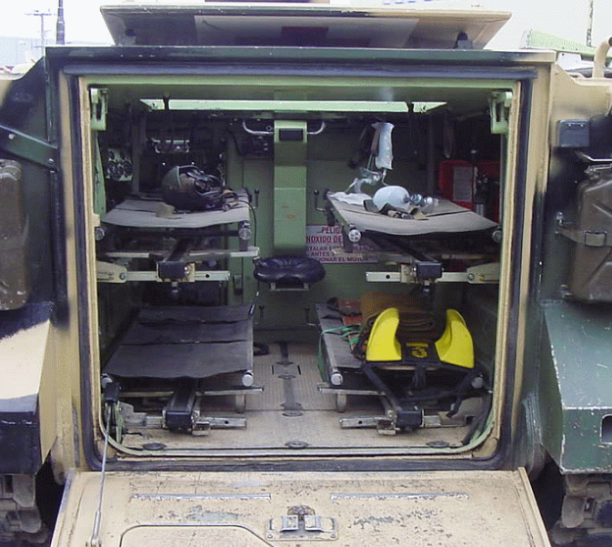
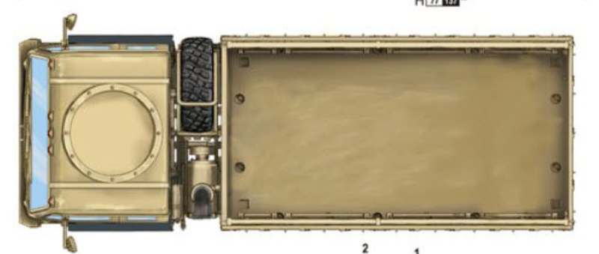
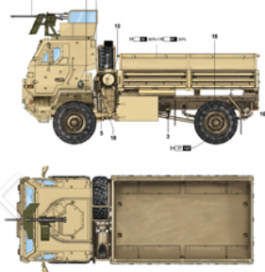
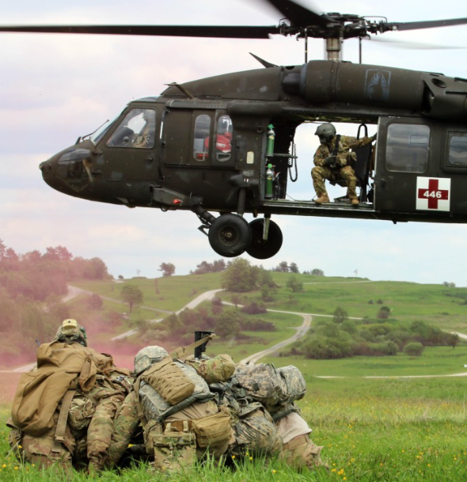
MEDEVAC (Left) AND CASEVAC (Right) PLATFORM CAPABILITIES
FLA/M997 HMMWV-
Senior Medic
Jump Medic
VC
4 litter or
2 litter, 4 ambulatory or,
8 ambulatory
DRVR/TC
Up to 5 Litters or,
8 ambulatory or,
2 litters (across top) 2 ambulatory or,
1 litter (across top) 4 ambulatory.
Requires 4 straps per litter
MEVV/Stryker
Senior Medic
Jump Medic
VC
4 litter or
2 litter, 4 ambulatory or,
8 ambulatory
ICVV/Stryker
DRVR/VC/Gunner
Up to 2 Litters or,
8 ambulatory or,
1 litter 4 ambulatory or,
Requires 2 straps per litter
3 Axle LMTV
DRVR/VC/(Gunner possible)
Up to 12 Litters (8 cross seats, 4 on floor) or,
16 ambulatory or,
any combination thereof,
Requires minimum of 2 straps per litter AND a seat down on each side for each litter
MEDEVAC- Dedicated medic and medical equipment
AMEV/M113
Senior Medic
Jump Medic
VC
4 litter or
2 litter, 4 ambulatory or,
8 ambulatory
CASEVAC- No organic MEDIC or equipment
Air MEDEVAC UH-60/CH-47
Both platforms depend upon setup
UH 60 w/MEDEVAC Kit (-1Lw/hoist)
High Cap: 6L/1A, 3L/4A, 0L/7A
Combat config: 4L/1A, 2L4A, 0L/7A
CH-47 w/MEDEVAC Kit
24 Litter patients, or 31 ambulatory or a combination of both
2 Axle LMTV
DRVR/VC/Gunner possible
Up to 8 Litters (6 cross seats, 2 on floor) or,
12 ambulatory or,
any combination thereof,
Requires minimum of 2 straps per litter AND a seat down on each side for each litter

Slide 26
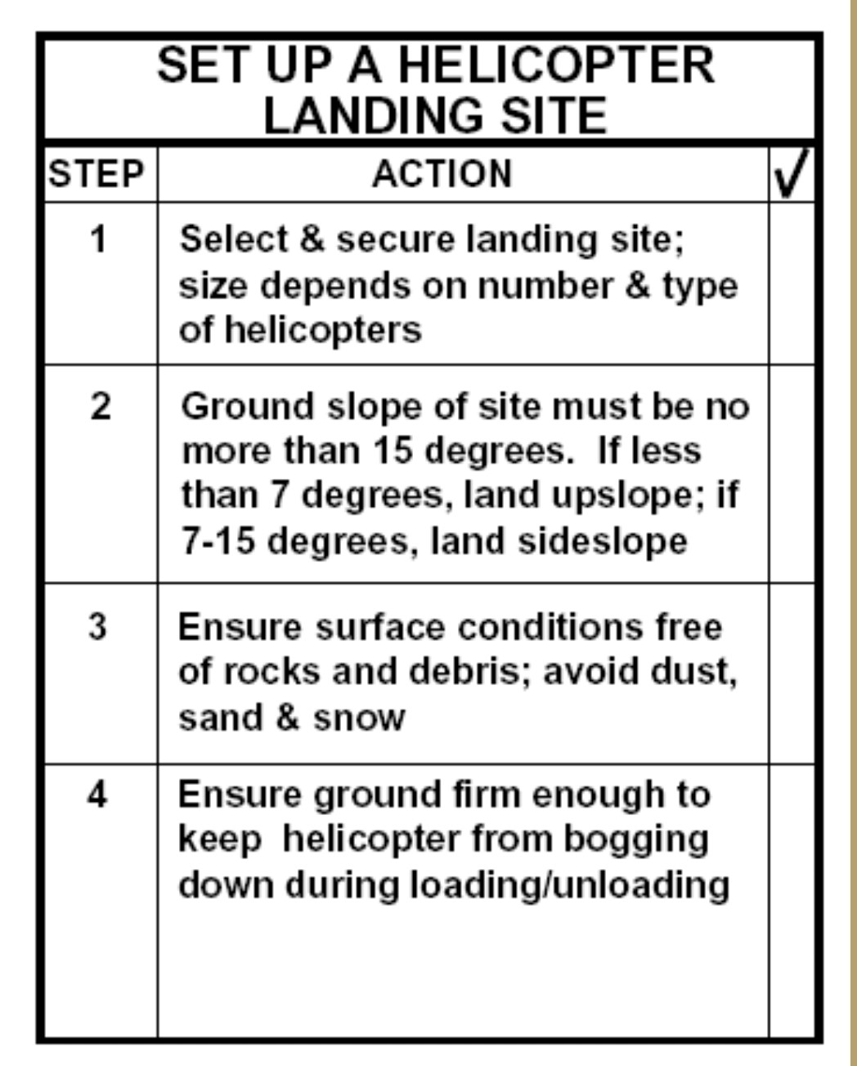
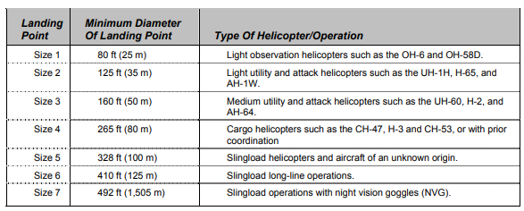
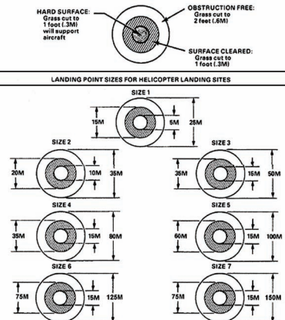
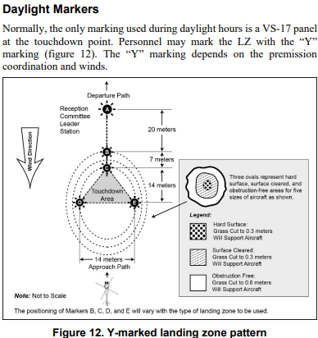
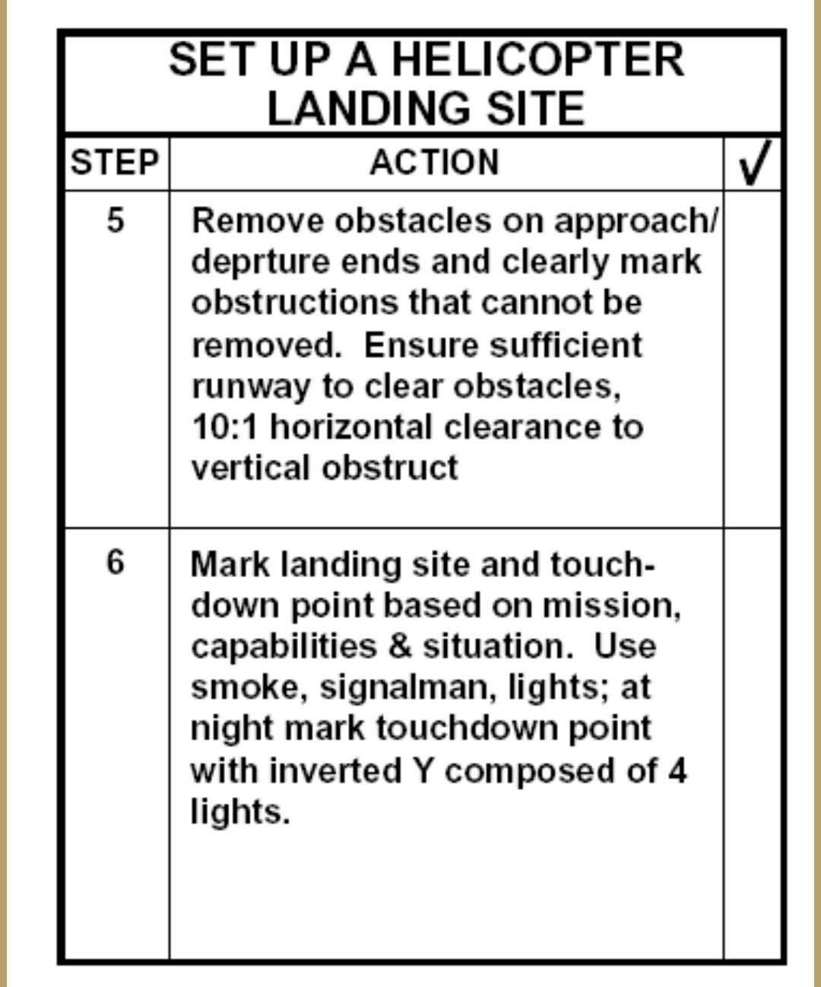
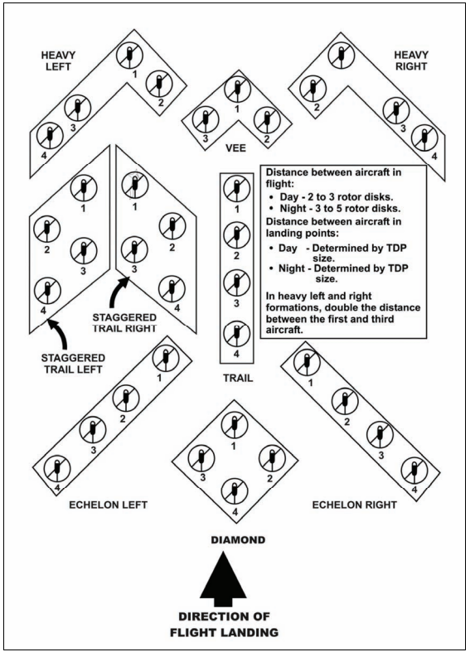
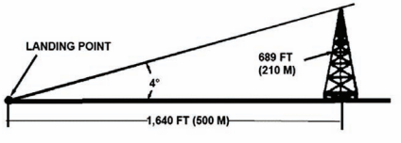
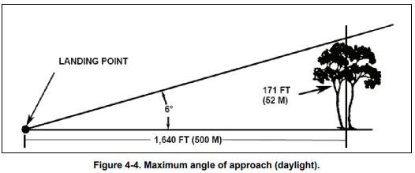
Helicopter Landing Zone (HLZ) Setup
MAX APPROACH ANGLE NIGHT FOR EVERY 1 METER TALL (OBSTACLE) IT REQUIRES 14 METERS OFFSET.
MAX APPROACH ANGLE DAY FOR EVERY 1 METER TALL (OBSTACLE) IT REQUIRES 10 METERS OFFSET.

Slide 27
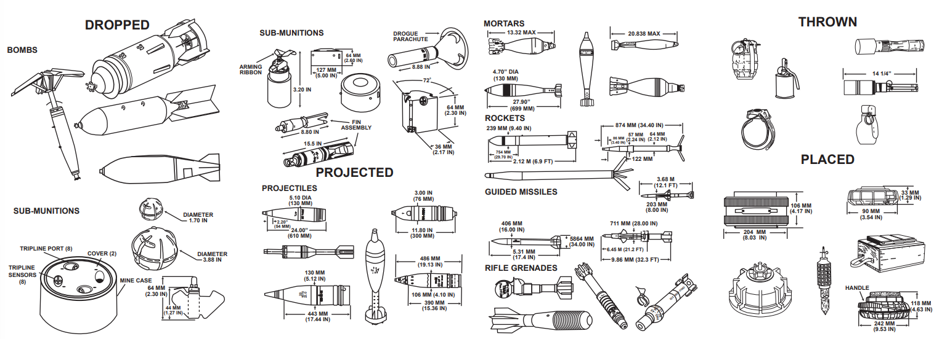
UXO SPOT REPORT (GTA 09-12-001)
LINE 1 | DATE/TIME GROUP DISCOVERED
LINE 2 | REPORTING ACTIVITY (UIC) LOCATION (8 DIGIT GRID OF UXO)
LINE 3 | CONTACT METHOD: FREQ/CALLSIGN, TELEPHONE NUMBER
LINE 4 | TYPE OF MUNITION (DROPPED, PROJECTED, PLACED, OR THROWN)
LINE 5 | CBRN CONTAMINATION
LINE 6 | RESOURCES THREATENED
LINE 7 | IMPACT ON MISSION
LINE 8 | PROTECTIVE MEASURES TAKEN
LINE 9 | RECOMMENDED PRIORITY (IMMEDIATE, INDIRECT, MINOR, OR NO THREAT)

Slide 28
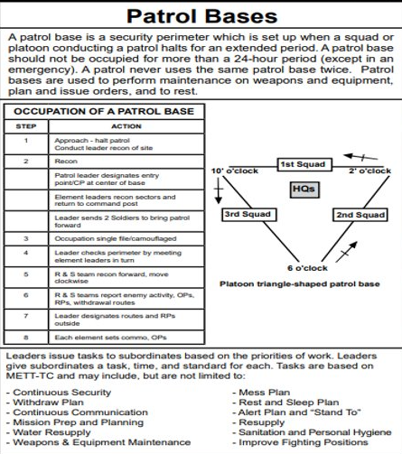
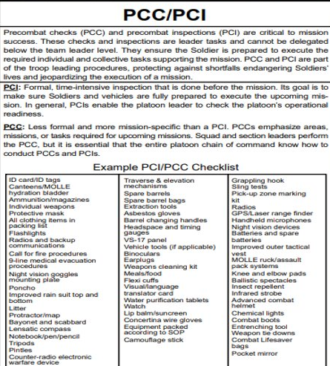
SUSTAINMENT FUNDAMENTALS
Common Classes of Supply
Class I- Food, rations, and water. ​
Class III- Petroleum, oils, and lubricants.
Class IV- Construction materials ​
Class V- Ammunition. ​
Class VII- Major end items. ​
Class VIII- Medical supplies, minimal amounts. ​
Class IX- Repair parts.
Characteristics of a Patrol Base / ORP
Able to communicate with higher Headquarters
Easily defendable for short periods of time
Away from natural lines of drift
Away from high-speed avenues of approach
Provides cover and concealment from both ground and air
Provides little to no tactical advantage to the enemy
Multiple ingress and egress routes
No recent signs of activity
Near a fresh water source (if possible)

Slide 29
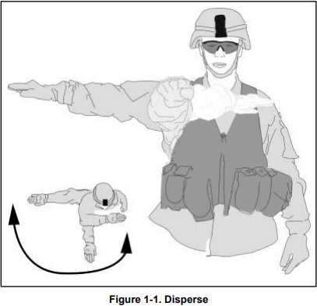
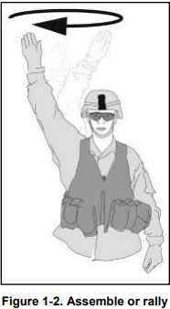
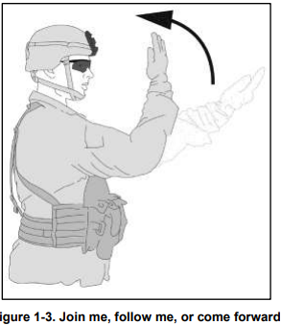
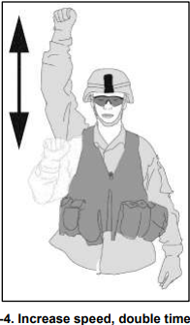
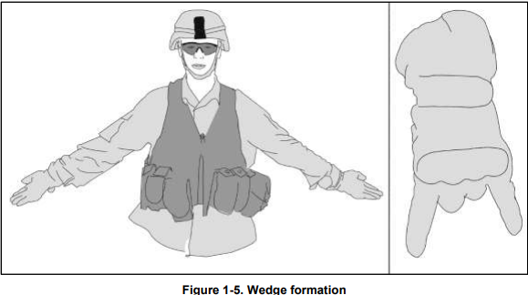
Hand and Arm Signals

Slide 30
Hand and Arm Signals

Slide 31
Standard Knots
Running or working end is the loose (or working) end of the rope.
Standing end is the static, stationary, or nonworking end of the rope.
Bight. Formed by placing the running end alongside the standing end, creating an open eyelet of rope.
Loop. Formed by placing the running end across the standing end, creating a closed eyelet.
Overhand knot. Formed by inserting the running end through the eyelet formed.
Half hitch. An overhand knot tied around an object with the pigtail pulled perpendicular to the standing end.
Pigtail. The pigtail is the portion of the running end of the rope between the safety knot and the end of the rope.
Turn. Formed by passing the running end of a rope 360 degrees around an object.
Round turn. A round turn wraps around an object one and one-half times. A round turn is used to distribute the load over a small diameter anchor (three inches or less). It may also be used around larger diameter anchors to reduce the tension on the knot or provide added friction.
Dress is the proper arrangement of all the knot parts, removing unnecessary kinks, twists, and slack so that all rope parts of the knot make contact.
The bowline (see figure 9-17) is used to tie the end of a rope around an anchor. It may also be used to tie a single fixed loop in the end of a rope. Bring the working end of the rope around the anchor from right to left (as the climber faces the anchor). Form an overhand loop in the standing part of the rope (on the climber’s right) toward the anchor. Reach through the loop and pull up a bight. Place the working end of the rope (on the climber’s left) through the bight and bring it back onto itself. Now dress the knot down. Form an overhand knot with the tail from the bight.
A square knot joins two ropes of equal diameter (see figure 9-6). Two interlocking bites, running ends exit on same side of the standing portion of rope. Each tail is secured with an overhand knot on the standing end. When dressing the knot, leave at least a four-inch tail on the working end.
A round turn with two half hitches is a constant tension anchor knot (see figure 9-7). The rope forms a complete turnaround the anchor point (where the name “round turn” comes from), with both ropes parallel and touching, but not crossing. Both half hitches are tightly dressed against the round turn, with the locking bar on top. When dressing the knot, leave at least a four-inch tail on the working end.
The rerouted figure-eight knot is an anchor knot that also attaches a climber to a climbing rope. Form a figure eight in the rope and pass the working end around an anchor. Reroute the end back through to form a double figure eight. (See figure 9-12.) Tie the knot with no twists. When dressing the knot, leave at least a four-inch tail on the working end.

Slide 32
Standard Knots
The Munter hitch is one of the most often used belays, the Munter hitch (see figure 9-14) requires very little equipment. The rope is routed through a locking pear-shaped carabiner, then back on itself. The belayer controls the rate of descent by manipulating the working end back on itself with his brake hand.
The rappel seat (see figure 9-11) is a rope harness used in rappelling and climbing. It can be tied for use with the left or right hand
(1) Leg straps do not cross and are tightly centered on buttocks
(2) Leg straps form locking half hitches on rope around waist. Square knot is properly tied on right hip
(3) and finished with two overhand knots
(4) Carabiner properly inserted around all ropes with opening gate opening up and away
(5) Carabiner will not come in contact with square knot or overhand knot. Rappel seat is tight enough not to allow a fist to be inserted between the rappeller’s body and the harness.
The Munter mule knot (see figure 9-15 on page 9-) is a knot that allows the user to stop movement of the rope through a Munter hitch. The Munter mule knot is tied so it can be easily released tension with the pull of a rope, allowing a smooth and controlled release. It is vital knot for many rope systems.
Start by tying a Munter hitch (ABOVE) in the rope, ensuring it is in the loaded position. Maintaining tension, create two loops in the brake strand on either side, and behind the main strand. Pass one loop through the other on top of the main strand, and carefully pull it tight while maintaining tension. Secure the knot by tying an overhand knot with the bight of rope protruding from the knot and include the main strand in the knot.
To make a double figure-eight knot, use a figure-eight loop knot (see figure 9-8) to form a fixed loop in the end of the rope. It can be tied at the end of the rope or anywhere along the length of the rope. Figure-eight loop knots are formed by two ropes parallel to each other in the shape of a figure eight, with no twists are in the figure eight. Fixed loops are large enough to insert a carabiner. When dressing the knot, leave at least a four-inch tail on the working end.

Slide 33
Counter UAS
PASSIVE MEASURES
Passive measures improve survivability by reducing the likelihood of detection and targeting of friendly assets and mitigating the potential effects of an air attack. Passive air defense measures are the first line of defense against air threats. While this book is focused on C-UASs, these measures can apply for all counter-air operations. All units employ passive defense measures to protect themselves from detection, observation, and attack. These measures include—
Camouflage and concealment.
Deception.
Dispersion.
Displacement.
Hardening and protective construction.
Aiming Points
Aiming points used to engage threat UAVs are different but may be used on a variety of different threats. An example of this technique would apply if enemy helicopters were detected and the decision was made to engage it should be engaged as a group 5 rotary wing UAV. The rules for selecting aiming points are simple, easily learned, and retained.
Air Guard Checklist
Before assuming duty as an air guard, leaders perform precombat inspection to ensure the designated air guard has the correct equipment and has been briefed on the current threat. The air guard checklist includes, but is not limited to—
Understanding on types and characteristics of threat UAS.
Understanding of current UAS trends.
Specific data on local air threats and named areas of interest.
Detection equipment (such as binoculars, night vision devices, thermal weapon sights).
C-UAS equipment available.
Secure radio operations and frequencies to send out early warning.
Unit call signs to request support.
Military map of area.
Orientation techniques (location, heading, speed, and line-of-sight).
Range card.
Engaging With Machine Guns
The machine gun is effective against slow-moving UAVs. To sustain the volume of fire and kill a target, a continuous burst of 20-to-25 rounds fired using a tracer on target method, allowing the gunner to adjust rounds on target.
Vehicle's machine guns are useful weapons against UAVs. They can be fired quickly unleashing a high-volume of fire. Ensure that the area is clear of friendly personnel. Use the following guidelines when using crew served weapons:
When targets are hovering or inbound, aim high with the machine gun and fire a continuous burst, adjusting onto target by observing the travel and impact of tracers remembering, tracers may appear to be striking the target when they are actually going under it.
If engaging a moving target, track along its flight path using a lead of 50 meters or half a football field. Fire a continuous burst, forcing the target to fly through the cone of fire.
When coordinated effectively, the aircraft will fly through the unit's cone of fire. Vehicle commanders must not try to track high-speed aircraft because they fly too fast. When enemy aircraft fly directly at vehicles, vehicle commanders are responsible for engaging them with controlled machine gun bursts of 50-to-100 rounds. Select an aiming point slightly above the nose to position the UAV in the cone of fire.
Because of the speed of some types of UAVs, the best technique to use against them is to fire all automatic weapons in continuous bursts. If the UAVs are inbound, aim slightly above the nose or fuselage and fire. If the UAV is crossing, use a lead of 200 meters (two football fields) and fire letting the UAV fly through the cone of fire from the machine guns. Do not try to track or traverse your fire for group 3 and above UAVs since they fly too fast.
The horizontal scan is viewed from the horizon, the air guard should search using eye movements across the sky while working upward to approximately 20 degrees. As in vertical scanning, the air guard should continue the search and scan technique to 20 degrees below the horizon to detect low flying air threats.
The vertical scan is the technique used to optimize a Soldier’s vision for finding air threats. By using upward eye movements toward the sky, then downward to the horizon and continuing across the terrain the air guard should scan using the same pattern to approximately 20 degrees above and below the horizon to account for all air threats.
Drone Busters operate strictly by line of sight, and it requires the operator to maintain eyes on the target throughout the engagement. If there is loss of line of sight during the engagement, the threat my regain control of the UAV. Drone Buster is designed to disrupt remote controlled and GPS guided UASs. Key considerations for this system include:
Range: 400m. Power source: 1x BB2847 rechargeable battery.
Battery life: Continuous jamming: approximately 1 hour. Continuous detect: approximately 4-6 hours. Complete battery discharge: approximately 10 days. Weight: 2.5 lbs
The SMART SHOOTER is a sight that mounts to existing individual weapon systems and enables the operator to defeat UAS threats. Compatible with existing military rifles and can be mounted on any rail on a weapon system. When the Smart Shooter is employed, it will only fire when the sight is aligned to hit the target, this includes the required “lead” on a moving target. Key considerations for this system include: Range: 120m. Power source: Rechargeable smart Lith-I battery. Battery life: 72 hours or up to 3,600 assisted shots. Weight: 2 pounds and 1 ounce

Slide 34
Range Card Preparation

Slide 35
Sector Sketch Preparation

Slide 36
Survivability Positions

Slide 37
Survivability Positions

Slide 38
Mortar and Artillery Capabilities and Mortar Firing Points
~4 ft
~5 ft
~4 ft
~6 ft
Colored lines indicate INTERNAL dimensions
~4.5 ft
~3.5 ft
~4 ft
~6 ft
60mm fighting position
81mm fighting position
5ft
3ft
7ft & 7ft
8ft
16 ft
8ft

Slide 39
Cold Weather Card

Slide 40
Cold Weather Card

Slide 41
Hot Weather Work/Rest and Water Consumption Card

Slide 42
Hot Weather Work/Rest and Water Consumption Card

Slide 43
WARNO
SITUATION | ENEMY |  | WHO
 |  |  | WHAT
 |  |  | WHERE
 | FRIENDLY (Higher’ s Mission) |  | WHO
 |  |  | WHAT
 |  |  | WHERE
 |  |  | WHY
 | ATTCH-DETACH
MISSION | WHO
 | WHAT
 | WHERE
 | WHEN
 | WHY
EXECUTION | CONCEPT OF THE OPERATION |  | REF: CONCEPT SKETCH
 | TASK TO MANUVER UNITS
 | COORDINATING INSTRUCTIONS |  | PACKING LIST |  | WORN: |  | RUCK:
 |  |  | TIMELINE
 |  |  | SUBORDINATE GUIDANCE (NON-TAC)

Slide 44
WARNO CONT…
SERVICE & SUPPORT | SPECIAL EQUIP | WHO | EQUIPMENT
 | AMMO | WPN | QTY & REMARKS
 | TRANSPORTATION
COMMAND & SIGNAL

Slide 45
REVERSE PLANNING MISSION TIMELINE (1/3 – 2/3)
OBJECTIVE NAME: NLT TIME ON TARGET: NLT EXFIL:
EVENT | TIME
NLT EXFIL
MOVE TO EXFIL
TOT
INFIL
WU / SP
LOAD
RAMP BRIEF
FINAL COMMEX
FMC
EVENT | TIME

Slide 46
CONCEPT SKETCH
MISSION:

Slide 47
2 HIGHER MISSION:
2 HIGHER INTENT:
Expanded Purpose:
Key Tasks:
Endstate:
Terrain: | Enemy: | Civil:
HIGHER MISSION:
HIGHER INTENT:
Expanded Purpose:
Key Tasks:
Endstate:
Terrain: | Enemy: | Civil:
HIGHER MISSION, INTENT, & CONCEPT

Slide 48
MISSION:
EXPANDED PURPOSE:
KEY TASKS:
END STATE (TERRAIN): | (ENEMY): | (CIVIL):
MISSION

Slide 49
BACK BRIEF | PHASE | TRIGGER | EFFECT | CRITICAL TASKS
The purpose of this operation is to: We will accomplish this by conducting (FOM or DEF tech): Decisive to this operation is (DO accomplishes): It is decisive because: We will accept tactical risk by: We will mitigate this through: Task/Purpose: DO/SO DO: T: SO2 T: P: P: SO1: T: SO3 T: P: P:
Attachments: Task, Purpose, and Duration | END STATE (TERRAIN): | (ENEMY): | (CIVIL):

Slide 50
CONCEPT SKETCH
MISSION:

Slide 51
SUSTAINMENT
CLI/Water:________________________________________________________________________
Ration cycle: CL II, III, & IV:___________________________________________________________________
Request through PSG NLT:___________________________________________________________________
CL IX:____________________________________________________________________________________
BN Aid Station vic:_________________________________________________________________________
BN AXP vic:_______________________________________________________________________________
CO CCP vic:_______________________________________________________________________________
PLT CCP vic:_______________________________________________________________________________
CL V:_____________________________________________________________________________________
SP with UBL, additional requirements covered in TASK ORG and SOM
CL VII:____________________________________________________________________________________
Mortuary Affairs:___________________________________________________________________________
EPWs:____________________________________________________________________________________
CLVIII:____________________________________________________________________________________
Maintenance:______________________________________________________________________________
Morale:___________________________________________________________________________________

Slide 52
COMMAND AND CONTROL
COMMAND:
Succession of Command: _____________________________________________________________________________________________________________________
BN TOC vic:_______________________________________________________________________________________________________________________________
CO CP vic:________________________________________________________________________________________________________________________________
PLT CP vic:________________________________________________________________________________________________________________________________
SIGNAL:
SOI index:_______________________________________________ SOI Changes throughout:_____________________________________________________________
JBCP Chat Rooms:___________________________________________________________________________________________________________________________
FIREs NET:_________________________________________________________________________________________________________________________________
Attachment NETs:___________________________________________________________________________________________________________________________
Notes:

