Slide 1
Barracks Inspections
POC: MSG Irizarry, Geraldo

Slide 2
Purpose
Purpose
Soldiers have the inherent right to live in a safe, secure, functional, and clean barracks room. Leaders and Soldiers will work together to ensure a healthy living condition for all Mountain Soldiers.
Each Soldier has the individual responsibility to follow the policies and guidelines established for the barracks and will be held accountable for their actions; good or bad.
Each Leader has a responsibility to inspect and correct the barracks to ensure a safe, secure, clean, and functional living environment and has the authority to enforce the standard.

Slide 3
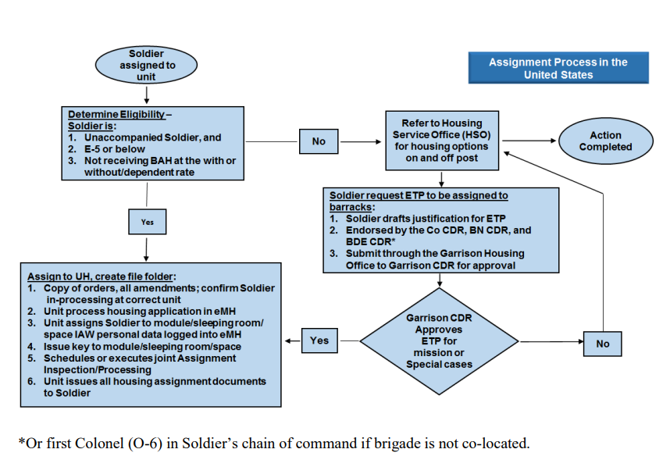
Who Is Authorized a Barracks Room
Soldiers in the ranks of Private (E-1) thorough Sergeant (E-5)
A single Soldier is someone who would be entitled allowance at the “without dependent” rate
The flow chart below outlines the processes in determining the appropriate steps to assigning barracks rooms

Slide 4
Soldier Responsibilities
Following established rules of conduct and joint occupancy of living quarters
General house keeping, such as cleanliness of rooms, closets, kitchenette, latrines, appliances, shared space, and common areas
Actively promote energy conservation; secure all windows and doors
Positive control of room key
Report incidents of vandalism and neglect to C/B/T CQ NCO
Responsible for visitors’ actions and negligence
Report all maintenance requirements through ARMA and report to first line supervisor
All trash is to be removed and discarded in a dumpster or recycling container. If dumpster is full, contact LeMay to empty dumpster again. This service is on a pre-paid contract. No unit funds needed. LeMay phone number is on the front of every dumpster. If problem persists, call DPW@ (253) 967-3803 / 1781
Do not put trash on ground around dumpster.​

Slide 5
Leader Responsibilities
Address maintenance and repair issues through ArMA and the facility manager
Understand key control and issuance
Conduct inspections IAW inspection type (Formal, General, Health and Welfare) and IAW CBT SOP
Properly clear room and report status to facility manager after Soldier moves rooms
Maintain good order and discipline by enforcing appropriate retraining for infractions
Maintain an up-to-date door label IAW unit SOP
Ensure facility manager has accurate accountability for Soldier to room (EMH)

Slide 6
Barracks Inspection Flow Chart
1.
Soldier and Leader Responsibility
2.
Inspect
3.
Repair and Upkeep
4.
Notify unit 1SG & Barracks Manager
IAW with C/B/T SOPs
*Emergency Service Orders are called into (253) 967-4713/3131
Notes:
-Work Orders for Appliances MUST include the bar code number

Slide 7
General Inspection
What to look for..
This is a “snapshot” inspection and should be conducted every business day.
Verify the Soldier is living in a healthy environment i.e. No left-over food, piles of trash, etc.
Look for broken equipment and mold build up. Use the ArMA app to place a work order. Inform your Barracks Manager and display the work order number IAW unit SOP.
If contraband is found, and can’t be dealt with at the lowest level, immediately have the SM exit the room, contact your supervisor and then the MPs. Do not touch the suspected contraband. If it can be handled at the lowest level, like inappropriate pictures, flags etc. have the individual dispose of said items.

Slide 8
Formal Inspection
What is it?
A formal inspection conducted by the command and announced on the training schedule.
This inspection is usually done by the Commander and/or 1SG.
Everything needs to be very clean, dress right dress, and all items up to standard. Think “white glove” inspection.

Slide 9
Clearing Room
How to Clear a Room:
When clearing a room, after everything has been moved out, verify the equipment that is supposed to be in there is still there.
Clean said room as if you are preparing for a formal inspection.
Have the Barracks manager verify that the room is clean, and that the SM has been moved.
Ensure that the move has been annotated.

Slide 10
Cleaning Standard
The term “clean” is defined as: Free of dirt , dust, lint, stains, streaks, film, grease, mildew, food, fingerprints, cleaning material, mineral deposits, and all foreign matter.
Generally clean vs clean.

Slide 11
Cleaning and Inspecting Standards
Walls, Ceiling, Doors, Door locks, and Base Boards: Must be cleaned with care to ensure surfaces are not damaged. Heating/cooling vents will be clean.
Furniture: Cleaned and light coat of wood polish applied. Upholstered furniture will be cleaned as follows: mattress box spring, sofa, and chair will be brushed and vacuumed.
Floors: Floor cleaning includes sweeping, vacuuming and mopping. Only vinyl tile will be waxed, buffed and stripped. Only hot water and a clean mop should be used to clean floors. Floor cleaning should include cleaning door and thresholds.
Blinds, Windows, Screens, and Drapes: Care will be taken to prevent damaging during the cleaning process. Accessible glass, frames, casings, seals, ledges and adjacent wall will be clean and dry.
Closets: Closets, including floors, walls, hanger rods, shelves, built in drawers, and doors will be cleaned.
Light Fixture: Light fixtures will be cleaned.
Bathroom: Bathtubs, shower walls, and sinks will be cleaned. Fiberglass tubs, shower stalls, and sinks will not be cleaned with an abrasive cleaner. Toilet bowls and seats will be cleaned. Mirrors, medicine cabinets, and vanities, to include interior and exterior surfaces, shelves, and tracks, will be cleaned.
Kitchen Equipment: Refrigerator and freezer inner and outer surfaces will be cleaned and free of debris. Microwave interior and exterior surfaces will be cleaned.
Bedroom: Clean all surfaces including inside/under furniture drawers. Clean windowsills, frame and glass. Dispose of trash

Slide 12
Health and Wellness
What does this entail?
This is a memo driven inspection. They are looking for specific items laid out by a memorandum.
This type of inspection is to ensure a safe environment for all, and the overall good order and discipline of the barracks.
If something is identified as suspected contraband, the NCO will order the Soldier to stand by outside of the room and notify the chain of command. The chain of command will call the MPs as necessary.
NCOs should not touch or disturb suspected contraband.

Slide 13
Additional Information
Visitation: Soldiers may have visitors of either sex in their barracks rooms from 1700 to 2400 daily on days prior to a duty day and from 0800 to 2400 daily prior to non-duty day. Visitors are prohibited during hours 0001 to 1700 on duty days and 0001 to 0759 on on-duty days
Room/Common Area Standards: Soldiers may arrange and decorate their rooms within the limits of good taste. Commanders can prohibit the display in barracks of symbols, flags, posters, or other material relating to extremist groups or activities in the order to ensure good order and discipline. Nothing will be displayed that is inappropriate.
Furniture: Soldiers may have non-government furniture, microwave ovens, telephones, civilian blankets, and other comforts.
Alcohol: Soldiers who are 21 years of age or older may possess or drink alcohol in the barracks within the prescribed limits. Consumption and possession by those under 21 is prohibited by law.
Hot Plates: Hot plates, crockpots, rice cookers, and Air Fryers. ANYTHING THAT CREATES A FLAME or REQUIRES OIL is PROHIBITED.
All pets are prohibited

