Slide 1
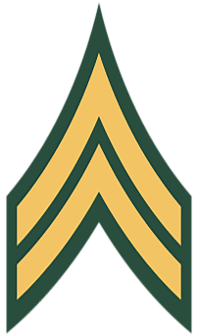
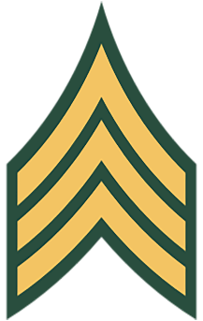
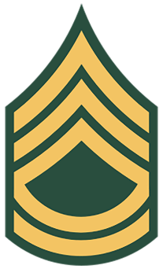
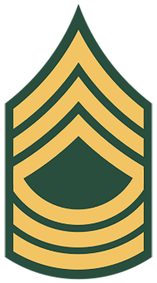
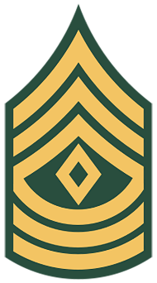
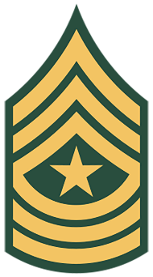
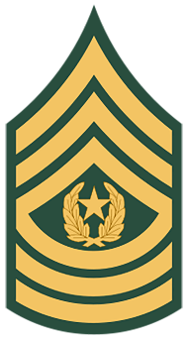
General Military Authority of the
Non Commissioned Officer

Slide 2
Agenda
AR 600-20 ( Army Command Policy) Chapter 4 Military Discipline and Conduct
4-1. Military discipline
4-2. Obedience to orders
4-3. Military courtesy
4-4. Soldier conduct
4-5. Maintenance of order
4-6. Exercising military authority
Professional Confrontation

Slide 3
4-1. Military Discipline
Military discipline is instilled through positive leadership, reinforcing the regulatory standards for personnel, and the training readiness standards for individual and collective tasks, together, resulting in a mental attitude about proper conduct and obedience to lawful military authority. (Following Orders)
Further Defined: Non Commissioned Officers obey, understand, and enforce (Be, Know, Do) the orders of the Officers appointed over us.

Slide 4
4-2. Obedience to Orders
All personnel in the Army are required to strictly obey and promptly execute the legal orders of their lawful seniors. (Following Orders)
Enlisted Oath: I, _____, do solemnly swear (or affirm) that I will support and defend the Constitution of the United States against all enemies, foreign and domestic; that I will bear true faith and allegiance to the same; and that I will obey the orders of the President of the United States and the orders of the officers appointed over me, according to regulations and the Uniform Code of Military Justice. So help me God.“
Further Defined: All Enlisted Soldiers are under the custody of the U.S. Army until separated with or without honors.
Example: A legally appointed Officer signed AR 670-1 and it is our duty to Obey those orders prescribed in said regulation.

Slide 5
4-3. Military Courtesy
Courtesy among members of the Armed Forces is vital to maintaining military discipline. Respect to seniors will be extended at all times (see AR 600–25).
Further Defined: Members is ALL Armed Forces. Respect is extended by body posture when address by or speaking to seniors. A Senior is any member outranking you in grade or by position regardless of thoughts, feelings, and emotions.

Slide 6
4-4. Soldier Conduct
Commanders and leaders (NCO’s) in the Army, whether on or off-duty or in a leave status, will Ensure all Soldiers present a neat, military appearance. Take appropriate action, consistent with Army regulations, in any case where a Soldier’s conduct violates good order and military discipline.
Further Defined: As a Non Commissioned Officer you are charged with the responsibility to correct all Soldiers to include Officers who violate good order and military discipline.

Slide 7
4-5. Maintenance of Order
Officers, WOs, NCOs, and petty officers of the Armed Forces are authorized and directed to quell all quarrels, frays, and disorders among persons subject to military law and to apprehend participants.
Those exercising this authority should do so with judgment and tact. Personnel so apprehended will be returned to the jurisdiction of their respective Service as soon as practical. Confinement of females will be according to AR 190–47.
Further Defined: Armed Forces members who commit offenses punishable under the UCMJ will be apprehended and placed under the custody of the NCO maintaining order if warranted .

Slide 8
4-6. Exercising Military Authority
One of the most effective nonpunitive corrective measures is extra training or instruction. If Soldiers have training deficiencies, they will be required to take extra training or instruction in subjects related to the shortcoming.
(1)The training or instruction given to a Soldier to correct deficiencies must be appropriately tailored to curing the deficiency. It must be oriented to improving the Soldier’s performance in their problem area. Brief physical exercises are an acceptable form of corrective training for minor acts of indiscipline (for example, requiring the Soldier to do push-ups for arriving late to formation), so long as it does not violate the Army’s policies prohibiting hazing, bullying, and unlawful punishment.
(2) Corrective measures may be taken after normal duty hours. Such measures assume the nature of training or instruction, not punishment. Corrective training should continue only until the training deficiency is overcome. Authority to use it is part of the inherent powers of command.
(3) Care should be taken at all levels of command to ensure that training and instruction are not used in an oppressive manner to evade the procedural safeguards inherent to the imposition of nonjudicial punishment. Deficiencies satisfactorily corrected by means of training and instruction will not be noted in the official records of the Soldiers concerned.
Further Defined: (1.) “Brief” is five to seven minutes (2.) deficiencies found during Corrective measures can extend the “only until” window (3.) Closing the assessment on the DA FORM 4856 allows the Leader to document additional training or instruction for painting a picture for Commanders.
Example: If a Soldier appears in an improper uniform, they are required to correct it immediately. ALL SOLDIERS

Slide 9
Professional Confrontation
Interpersonal skill is one of the most important skills for professional success, and one of the biggest obstacles to that success and a great source of headache in the Army, is interpersonal conflict. When differences between Leaders and subordinates are not managed well what results is poor climate, undisciplined culture, weaponized Army programs, complaining, and interpersonal conflict.
All Non Commissioned Officer must stay inside the left / right limits of dignity and respect when exercising general military authority with all Soldiers.
Mastering the art of professional confrontation allows the Non commissioned Officer to keep the stress between the Soldier and the Standard NOT the NCO. By BEing the example “Smartness in Appearance”, KNOWing the regulations “The Stress”, and DOing one's charge “Maintaining Order” at a minimum Soldiers will comply with Army regulations.

Slide 10
Professional Confrontation cont. Identifying an Infraction and Preparation
1. Preparation:
a. Identify: (What is the Violation?) (What is the Regulation?)
b. Gather thoughts: (During this phase know the correction will go three ways.)
• Soldier corrects the deficiency ( Engagement Over )
• Soldier is disrespectful while correcting the deficiency ( Prepare for verbal altercation) (Direct Orders are applied “At-Ease”)
• Soldier blows you off (Proceed with Direct Action leading up to Soldier Apprehension)

Slide 11
Professional Confrontation cont. On the Spot Correction Execution
2. Execution Example: Correct Way
“PVT Doe”
Always address the Soldier by their Rank, by doing so it forces them to address you by your Rank and establishes a professional tone.
b. “I'm SGT Baxter 3/10 BCT
Always state your Rank, Name, and Unit, by doing so the Soldier has zero excuses to not render proper customs and courtesies
c. “Earrings are NOT authorized bring PRT, field, or training events.”
Monitor how the Soldier is receiving the information, this is where the Soldier is deciding to comply or defy.
d. “PVT Doe remove the earrings immediately”
A Lawful order is issued, and all Soldiers are required to obey and fix the infraction immediately.
e. “Carry On PVT Doe”
“Carry On” lets the Soldier know the on the spot correction is over and to move out smartly.

Slide 12
Professional Confrontation cont. On the Spot Correction Execution
3. Execution Example: Incorrect Way
“Doe”
Just saying the last name without rank makes it personal putting the stress between the NCO and the Soldier
b. “Why the F!@# do you have earrings on!!!”
The use of inappropriate language WILL be used to undermine your authority or position of power.
c. “If 1SG sees you with those on……….”
Non Commissioned Officers speak with one voice.
d. “Take that Sh!@ off”
Could be perceived as a personal attack on ones choice of jewelry.

Slide 13
Common MCM Article Violations during Professional Confrontations
Article 91—Insubordinate conduct toward noncommissioned officer
strikes or assaults a warrant officer, noncommissioned officer, or petty officer, while that officer is in the execution of his/her office
Willfully disobeys the lawful order of a warrant officer, noncommissioned officer, or petty officer
Treats with contempt or is disrespectful in language or deportment toward a warrant officer, noncommissioned officer, or petty officer while that officer is in the execution of his office; shall be punished as a court-martial may direct.
Article 92—Failure to obey order or regulation
violates or fails to obey any lawful general order or regulation
having knowledge of any other lawful order issued by a member of the armed forces, which it is his duty to obey, fails to obey the order
Is derelict in the performance of his duties; shall be punished as a court-martial may direct.

Slide 14
Common Article Violations during Professional Confrontations
Article 95—Resistance, flight, breach of arrest, and escape
Any person subject to this chapter who—
Resists apprehension;
Flees from apprehension;
Breaks arrest; or
Escapes from custody or confinement; shall be punished as a court-martial may direct.
Article 134—(Disorderly conduct, drunkenness)
Disorderly conduct is conduct of such a nature as to affect the peace and quiet of persons who may witness it and who may be disturbed or provoked to resentment thereby. It includes conduct that endangers public morals or outrages public decency and any disturbance of an outrages contentious or turbulent character.

Slide 15
PE

Slide 16
Questions?

