Slide 1
Army Maintenance Application (ArMA) Repair & Upkeep (R&U) Work Orders (WO)
UH Branch
Housing Division
Version Number
As of DD MMM YYYY

Slide 2
Unaccompanied Soldier Housing POCs
*Emergency Service Orders are called into 253-967-3131 or https://www.ArmyMaintenance.com
**Then notify Barracks Manager and First Line Supervisor**
Mr. Hernandez, Ron; UH Branch, ABMP Branch Chief
Ronald.j.hernandez6.civ@army.mil
253-966-3217 (Desk) 253-592-5039 (Gov Mobile)
Mr. Perilli, Richard; FMO Team
Richard.r.perilli.civ@army.mil (Contact for All Questions)
253-982-2824 (Desk) N/A (Gov mobile)
MSG Irizarry, Geraldo; DPW NCOIC/ UH NCO
Geraldo.irizarry.mil@army.mil (Contact for All Questions)
(253)-906-8172 (GOV Cell) 907-360-6875 (mobile)

Slide 3
Priority 1 / Emergency Work Orders
Emergency Service Orders are called into 253-967-3131
Priority 1 - Emergencies
Priority 1—Emergencies: Work required to correct an emergency condition that is detrimental to the
mission or reduces operational effectiveness, directly impacts health or safety, can cause significant
damage to a facility or infrastructure or compromise security. P1s response time is one hour and
must be mitigated or downgraded within 24 hours of notification. Emergency work can include but is
not limited to:
Gas, oil, and steam leaks
Building floods
No water, hot water or steam in medical, barracks or dining facilities
Sewage backing up into building
Total power outage in a building
Downed high voltage power line
No heat or air conditioning whole barracks
Loss of heat during periods of cold weather (entire or major portion of a facility)
Broken electrical components that could cause fire or shock
Roof leaks or water leaks posing a significant danger to personnel or property

Slide 4
Emergency Work Order Flow Chart
*Emergency Work Orders (Priority 1) must be submitted by phone 253-967-3131.
SM informs first line supervisor & Barracks Manager of deficiency
DPW team will respond as quickly as possible but might be 1-2 hours depending on availability
SM identifies deficiency
SM calls emergency WO line. Provides all required information
Inform 1SG, DPW NCOIC & UPH to receive additional assets and assistance
If issue is harmful to Soldiers, call 911 and evacuate the building.
If broken water pipe is causing flood, call 911 to request Fire Department to shut off water to the building. All Soldiers in barracks must work together to stop flow of water and to protect as many rooms and property as possible.
**Emergency WOs must also be reported to Barracks Manager, 1SG, DPW NCOIC & OHP.
Provide the following info when reporting an Emergency WO:
Problem location (BLDG/ROOM/ETC)
Description of the problem
POC name and phone number (POC must be available on site and responsive to telephonic contact from DPW)
*Do NOT submit more than 1 work order. Submitting multiple WOs slows the system down. Contact UPH & BDE Barracks Managers to get quicker results and additional assets.

Slide 5
Agenda (cont)
ArMA – how to access the 3 aspects of ArMA - Create a case - Subscribe to reports - Use Portal to see current status on a case

Slide 6
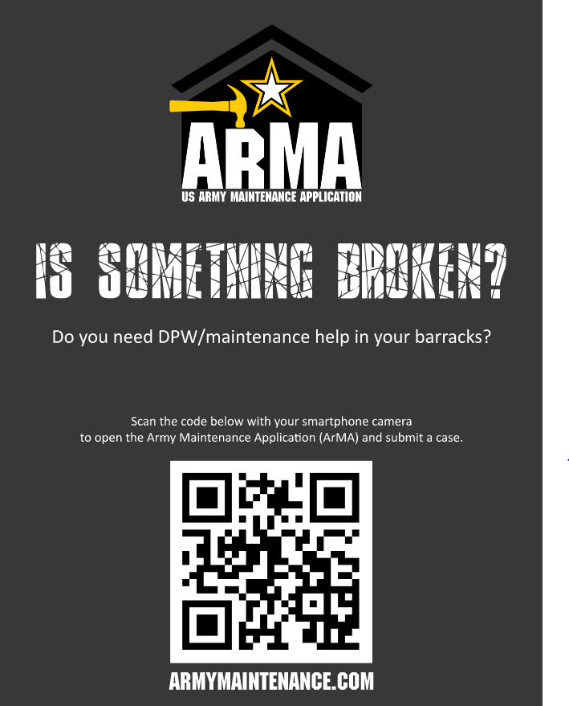
Army Maintenance Application (ArMA)
https://www.ArmyMaintenance.com
ArMA
Army
Maintenance
Application
Used for Barracks,
COFs, Motorpools,
HQ Offices
Any Facility of JBLM
Except On Post Housing

Slide 7
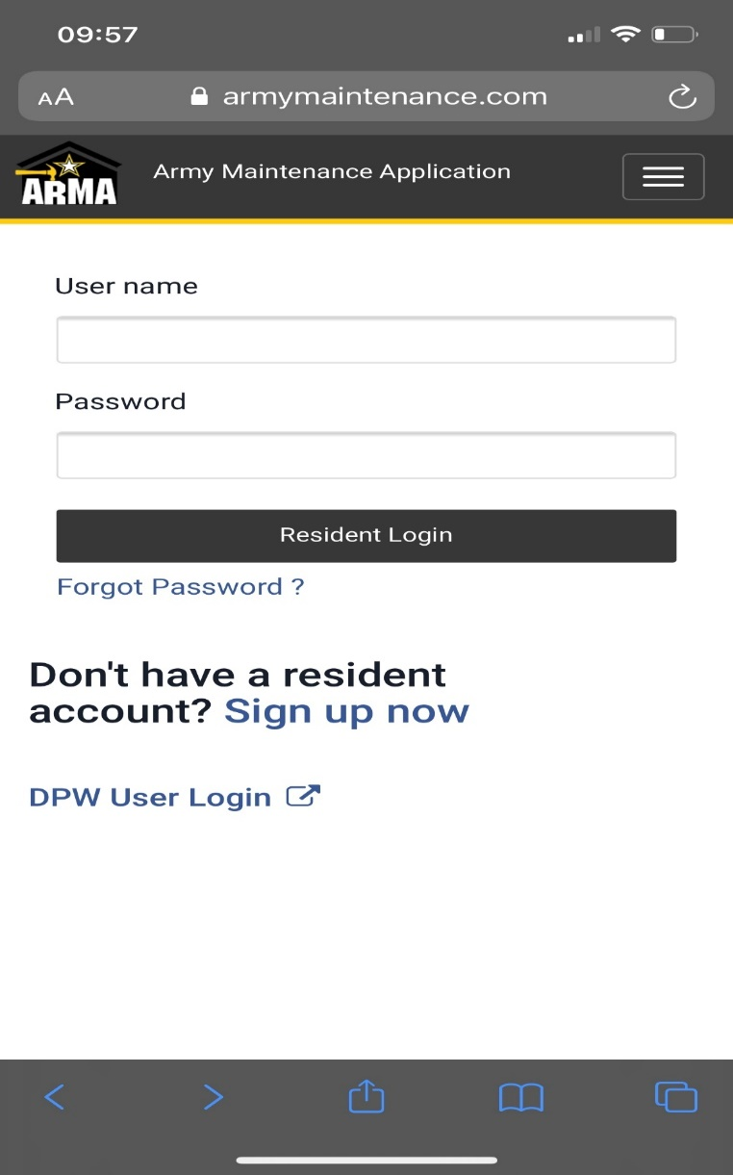
ArMA - Creating ArMA Account
Step 1
Step 2
Email can be military or civilian.
Sponsor Email must be @army.mil and must be confirmed within 30 days.

Slide 8
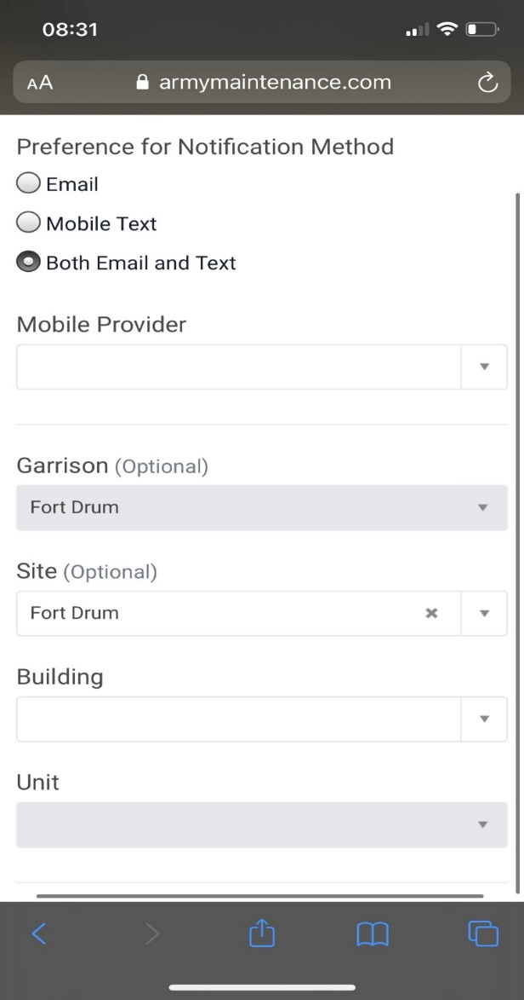
Creating ArMA Account
Step 3
Recommend using both
text & email
Both should read JBLM as this will allow Soldier to easily find their associated BLDG and unit in the next two fields
BLDG the Soldier lives in
Units are listed at the BN level

Slide 9
Types of Work Orders
IDENTIFY PROBLEM AREA
AND SEVERITY
DETERMINE TYPE OF WORK ORDER NEEDED
ArMA Work Order (WO)
Emergency WO
Repair & Upkeep
(R&U)
Soldier/FMO
Routine Work Order
Pest Control
Mold WO
Key Replacement
Appliance Replacement
Furniture Replacement
Any deficiency which
would present an
immediate danger to
personnel or equipment.
Examples Include:
Flooding, sewage back up. Loss of heat in winter months.
Loss of A/C
during summer
months.
Exposed electrical wiring.
Loss of electricity.
To be utilized for the replacement of routine maintenance or expendable items such as light bulbs, blinds, showerheads, towel racks, bathtub or sink drain plugs, etc.
SM’s must utilize ArMA to place work orders
(Refer to Routine WO flowchart).
ArMA Portal Homepage - Army Maintenance
Application
If pests such as mice, rats, roaches, or any other insects are present on any interior portion of the barracks, submit WO in ArMA.
Any presence of mold on the interior or exterior of the barracks building or barracks room.
(See mold flow chart)
Any loss of barracks keys.
Contact S4.
(Refer to key control doc below)
Any deficiency resulting in inoperable, broken, or damaged appliance such as washer, dryer, microwave, or fridge.
(See Appliance Replacement Flow Chart)
Any deficiency resulting in inoperable, broken, or damaged furniture such as
chair, desk, bed frame, mattress, dresser, and etc.
(See Barracks Furniture Replacement Flow Chart)

Slide 10
Routine Work Order Flowchart
1.
Identify deficiency & submit WO in ArMA
Inform first line supervisor
& Barracks Manager
SM fills out WO placard and places placard on broken item
Barracks Manager tracks work order
SM removes and disposes of work Order placard
2.
5.
SM reports completion to Barracks Manager
& first ^{l}ine supervisor
4.
DPW conducts work and corrects deficiency
3.
Notes:
-Work orders for appliances MUST include the bar code number
- Do NOT submit more than 1 work order per issue. Submitting multiple WOs for the same issue slows the process down.
*Emergency Service Orders are called into 253-967-3131

Slide 11
Submitting ArMA Work Order
Step 1
Step 2
Sign in using account that was created
To create a case or request a work order select Maintenance Support

Slide 12
Appliance Repair Tracking Form
Highly recommend for use in common laundry rooms

Slide 13
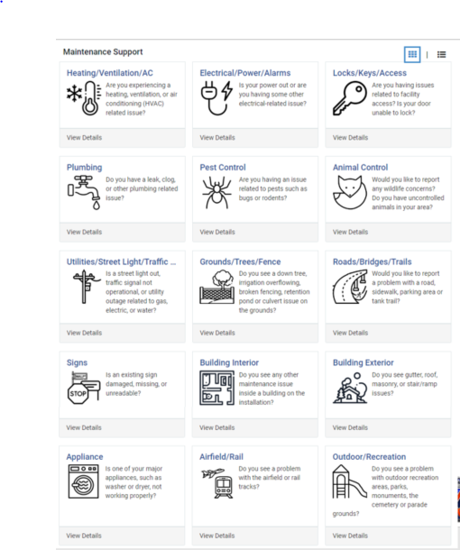
Submitting ArMA Work Order
Step 3
Browse maintenance catalog and select the area that you need assistance with such as electrical

Slide 14
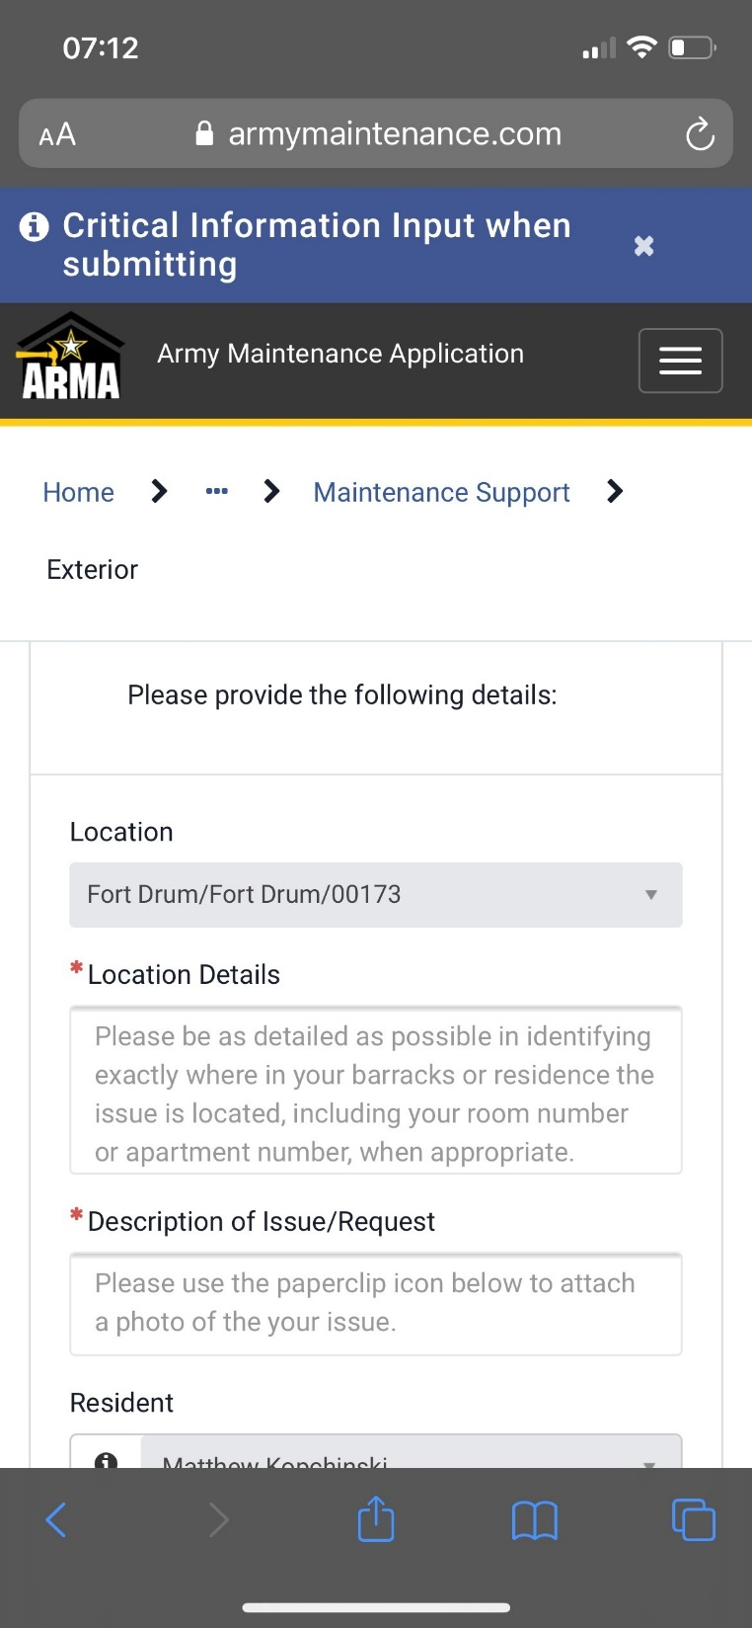
Submitting ArMA Work Order
Step 4
Select the building
A detailed description of the issue is required, and photos are highly encouraged
Room number

Slide 15
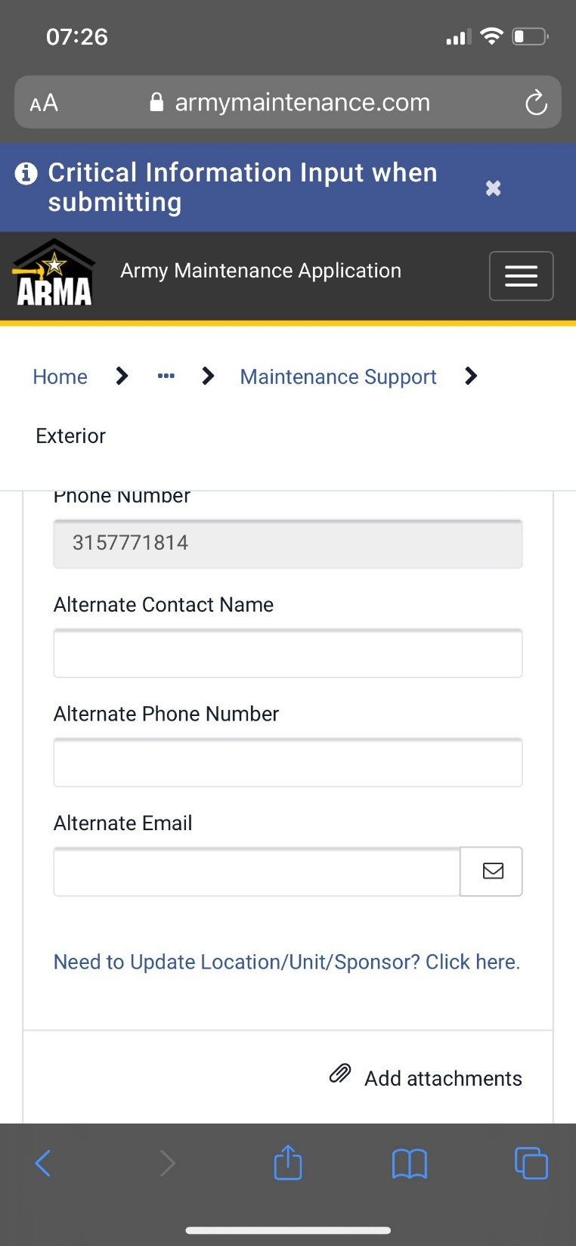
Submitting ArMA Work Order
Step 5
Alternate POC:
Barracks Manager or 1st line supervisor
In the event a Soldier moves to another BLDG or changes BN’s the Soldier will need to go here to update their profile
Add ATTACHMENT. Pictures get WO completed faster. (Recommended)

Slide 16
ArMA - How to Get Weekly Status Report
Army Maintenance Order Portal links
ArMA Homepage for Barracks: https://www.armymaintenance.com
ArMA Unit Report Email subscription: https://www.armymaintenance.com/subscribe
Link above is where leaders can subscribe to weekly reports for their barracks.

Slide 17
ArMA - How to Get Weekly Status Report
Example of an open DMO Priority 3 and status when pulling weekly reports.

Slide 18
ArMA - How to Get Weekly Status Report
Location i.e. bathroom kitchen, etc.
Description of issue in your room. Also have an alternate POC i.e. First Line or PSG.

Slide 19
How To Make Your Washers/Dyers Last
Wait till the cycle finishes before you open the washer (wait till you hear the door latch release). Opening the washer door before the release renders the washer inoperable until repaired.
Do not use too much soap! It is recommended that you use ¼ cup liquid soap only.
Do not overload the washers & dryers (rule of thumb is halfway up). Overloading appliances beyond what they are designed causes the drivetrain to fail prematurely.
Check/clean the dryer filter before and after each use. Clothes will dry faster, and it will be more energy efficient, and it reduces chance of dryer duct fires. At no time do not try and fix or repair washers and dryers, this task requires a certified technician.

Slide 20
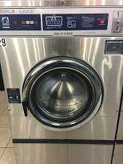
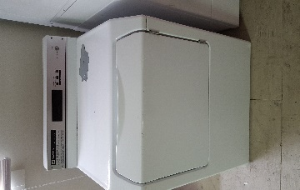
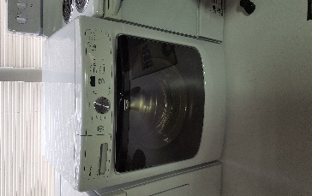
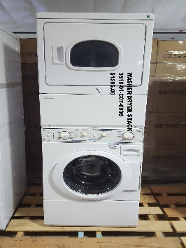
How To Make Your Washers/Dyers Last
Washing/drying TA-50 Gear is not authorized in machines deployed throughout the barracks. The only exception are the very large silver industrial washers.
Standard Washer Clothes of all types No TA-50 Items
Standard Dryer Clothes of all types No TA-50 Items
Stack Washer/Dryer Clothes of all types No TA-50 Items
Industrial Washer Clothes of all types Yes for TA-50 Items

