Slide 1
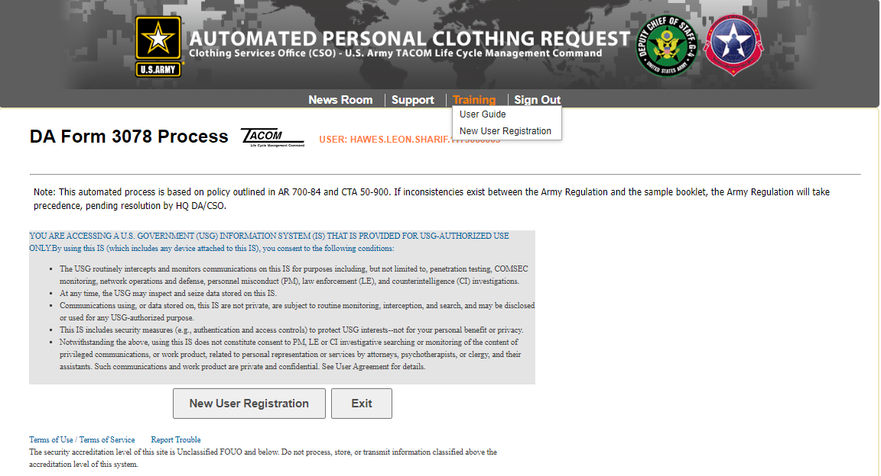

Slide 2
ATTENTION SUPPLY SERGEANTS
As of 7 May 2018, the Army Clothing Store (AMCS) will no longer accept paper copy of DA Form 3078 for Personal Clothing Requests. Units must use the Automated Personal Clothing Request (APCR) system in accordance with AR 700-84, para 1-6p.
Go to Https://DA3078.Natick.Army.Mil to register both the Commander (Approving Officer) and Supply Rep at a minimum.
Choose the DoD Certificate (Not the email cert.)
Complete the System Access Request
UIC and DoDAAC must match for all personnel within unit requesting access
Upload DA Form 7000 signed by Commander
Upload Commander’s Assumption of Command (1 per Unit)
System Access Request will be reviewed/approved by the Clothing Services Office

Slide 3
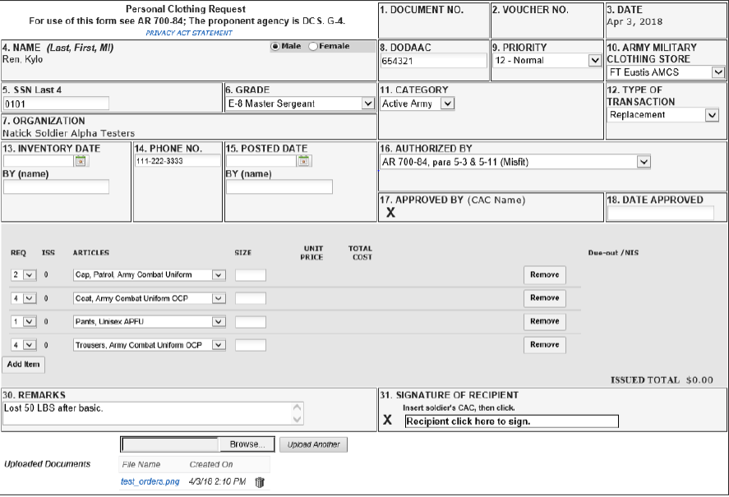
Example Personal Clothing Request
Military Clothing and Sales (MCS)
Office Contacts:
JBLM MCS Senior Manager
Ron Terry
(253) 964-3966
terryr@aafes.com
JBLM MCS Manager
Teresa Topasna
(253) 964-3966
topasnate@aafes.com
JBLM Military Clothing CSO
Stacie Acevedo
(410) 436-9334
stacie.m.acevedo.civ@army.mil

