Slide 1

DoD Food Analysis and Diagnostic Laboratory (FADL)
Pet Travel Across Borders: A Guide to FAVN Requests
Public Health Command, West
2024

Slide 2
Rabies Alert
For all dogs imported into the United States, including U.S.-origin dogs returning to the US:
“The Centers for Disease Control and Prevention (CDC) is the primary government authority for dogs imported into the United States. Contact the CDC at 800-232-4636 or go to CDC-INFO for questions related to CDC’s updated dog import requirements for dogs entering or returning to the United States. Pet owners and accredited veterinarians with questions on how to complete the CDC “Certification of U.S.-Issued Rabies Vaccination” form may refer to this resource or contact CDC.
For questions on how to access VEHCS, visit Using the Veterinary Export Health Certification System (VEHCS).
APHIS may also have specific requirements for dogs entering the United States. These requirements are different and separate from the CDC import requirements for dogs.”
Reference: https://www.aphis.usda.gov

Slide 3
Pet Travel Guidance
Please read the travel guidance to understand what is required for pet travel. Each country is different and has its own guidelines.
USDA Pet Travel Guidance for Pets Traveling to Another Country From the US
  https://www.aphis.usda.gov/pet-travel/us-to-another-country-export/pet-travel-guidance-pets-traveling-another-country-united
    In Spanish (En Español): https://ww.aphis.usda.gov/pet-travel/us-to-another-country/guia-de-viaje-para-mascotas-que-vajan-otro-pais-desde

Slide 4
Find a USDA-Accredited Veterinarian
A USDA-accredited veterinarian can help you learn about your destination country's entry requirements for pets, including required vaccinations, tests, or treatments.
Schedule an appointment with your Military Veterinary Treatment Facility (VTF) or civilian veterinary clinic.
Veterinary clinic will guide pet travel process

Slide 5
Information For Travel
Pet information (e.g., breed, species, age, color, etc.)
Destination country
If applicable, countries where your pet will stop (for customs clearance or upon leaving the airport or seaport) on the way to the destination country.
Additional destinations may require additional FAVN documentation
Departure date
Other documentation required by vet clinic
Veterinary clinic will guide pet travel process

Slide 6
FAVN Requirement
Ensure FAVN testing is done well in advance to ensure pet has a passing titer to avoid pets being quarantined at your expense
Pets traveling to rabies-free countries will require vaccinations, microchips and FAVN testing
FAVN documentation is required and hand-carried by the client or digitally sent by the FADL NAF FAVN office. This is determined by each quarantine station
Veterinary clinic will guide pet travel process

Slide 7
Requesting FAVN Testing
Schedule appointment with military or civilian vet
Ensure all information on FAVN request form is correct before leaving appointment
Payment can be made at military VTF or by credit card payment form for civilian clinics
Allow enough time before departure to test pets for FAVN to avoid any setbacks in case pet fails or departure is short notice
FAVN testing cannot be expedited
Veterinary clinic will guide pet travel process

Slide 8
FAVN Form Instructions
Please follow instructions on the following slides
Do not leave any blanks
Veterinarian signature should be in BLUE ink, the document can be rejected by these countries: Japan, Korea, Guam
Address must be updated for mail/FedEx delivery. Returned mail cannot be tracked and additional re-issue fees will be charged
FAVN fee is $70 per pet. Additional destination documents are $10 per document
FedEx fee is $25 for standard overnight (Cannot deliver to APO/FPO address)
Military VTF will auto generate FAVN form, civilian clinics can use automated fill in form or handwrite (please make legible)
Turnaround time is 4-6 weeks, FAVN testing cannot be expedited
Veterinary clinic will guide pet travel process

Slide 9
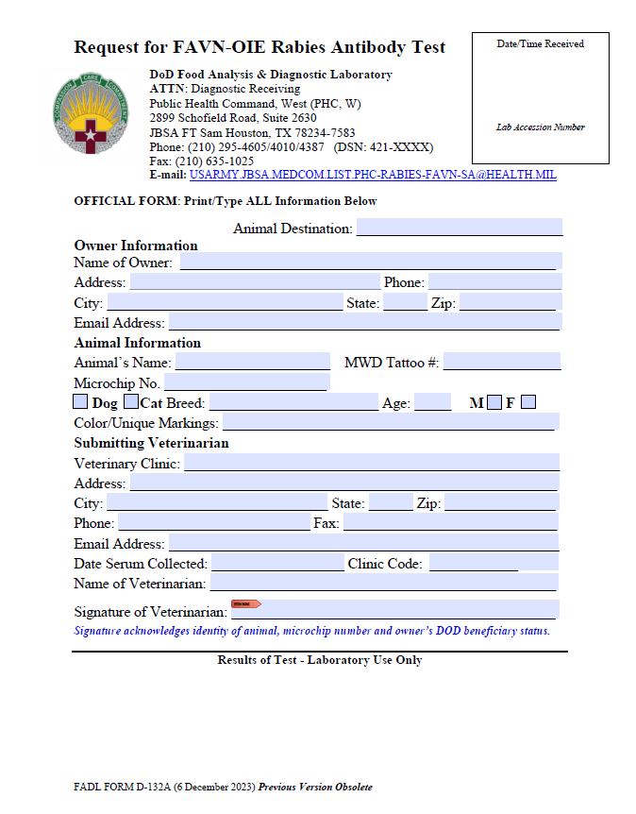
Request for FAVN-OIE Rabies Antibody Test
Notes:
FADL Form D-132A

Slide 10
Request for FAVN-OIE Rabies Antibody Test
Owner Information Checklist
Owner(s) name-LISTED and CORRECT
Address-LISTED and CORRECT
  Address is valid for the next 6-8 weeks (use another address if leaving current address)
  VERFIFY how envelope should be addressed if using a friend or family’s address (see next slide)
Phone Number – LISTED and CORRECT
Email - LISTED and CORRECT
OWNER’S INITIALS off to the side is okay if it is small
This is an official document DO NOT make any stray marks
Notes:
FADL Form D-132A

Slide 11
Request for FAVN-OIE Rabies Antibody Test
If a Client is using a Friend/Family’s Address
Please include a note
stating how to address the envelope
Example 1
Client’s Name
In C/O John Doe
123 ABC St.
ABC Town, AB 12345
Example 2
Client’s Name
ATTN: John Doe
123 ABC St.
ABC Town, AB 12345
Example 3
(Client’s) Friend/Family’s Name
123 ABC St.
ABC Town, AB 12345
WE DO NOT FEDEX TO APO/FPO ADDRESSES
Notes:
FADL Form D-132A

Slide 12
Request for FAVN-OIE Rabies Antibody Test
DO’s | DON’Ts
Animal Information: Microchip Number(s) is ACCURATE 15 Digits AVID 9 Digits | INACCURATE MICROCHIP 14 or 16 NUMBERS NO MICROCHIP = INVALID FAVN
ACCEPTABLE FORMATS:
Spaced out in three’s: 123 456 789 123 466
All Together: 123456789123456
Avid Microchip Number:
123*456*789
Breed: KOREA/JAPAN/GUAM Must Be Specific | Do NOT Put Mixed Tabby Shepherd Mix
Color: ACCURATE color | Do NOT Put Mixed Tabby *must put SPECIFIC color
To be filled out by veterinarian
Notes:
FADL Form D-132A

Slide 13
Request for FAVN-OIE Rabies Antibody Test
Please have the client(s)
CONFIRM all ANIMAL INFORMATION is CORRECT
Animal Information Checklist
Pet’s Name LISTED and CORRECT
Microchip Number LISTED and CORRECT (list all microchips)
Breed LISTED and CORRECT
Age LISTED and CORRECT
Sex LISTED and CORRECT
Color/Unique Marking LISTED and CORRECT
To be filled out by Veterinarian
Notes:
FADL Form D-132A

Slide 14
Request for FAVN-OIE Rabies Antibody Test
DO’s | DON’Ts
Submitting Veterinarian: FILL OUT ALL THE BOXES | LEAVE BLANKS
PLEASE WRITE IN CLINIC CODE
Civilian clinics do not require a code
PLEASE SIGN FAVN IN BLUE INK
(digital signatures are not accepted)
To be filled out by Veterinarian
Notes:
FADL Form D-132A

Slide 15
Request for FAVN-OIE Rabies Antibody Test
CLINIC:
PLEASE ENSURE ALL INFORMATION IS LISTED AND CORRECT
Submitting Veterinarian Checklist
Clinic Name LISTED
Address is LISTED and CORRECT
Phone/Email is LISTED and CORRECT
Date Serum Collected is LISTED and CORRECT
  REDRAWS- Must be the NEW Date
Name of Veterinarian is LISTED and CORRECT
Signature is in BLUE INK (no digital signature)
Notes:
FADL Form D-132A

Slide 16
Request for FAVN-OIE Rabies Antibody Test
DO’s | DON’Ts
Sending a Note Write message on a: Post-It Separate paper Send an email and ATTACH email to sample | DO NOT WRITE ANY WHERE OUTSIDE THE DESIGNATED BOXES *This is an OFFICIAL DOCUMENT Any unauthorized writing can cause the FAVN to be INVALID in certain Countries
Any documentation errors found on the FAVN form will need to be resubmitted by the referring clinic as corrections can only be made by the originator.
A $10 re-issue fee will be charged for corrections once the FAVN is resulted
Notes:
FADL Form D-132A

Slide 17
Credit Card Payment Form Instructions
Credit Card Payment form is for civilian veterinary clinic use only (military VTFs will charge point of sale at time of service)
Please fill out all information
AMEX is not accepted
Lab Accession Number will be filled out by FADL NAF office
Send payment form with sample in a separate Ziplock bag

Slide 18
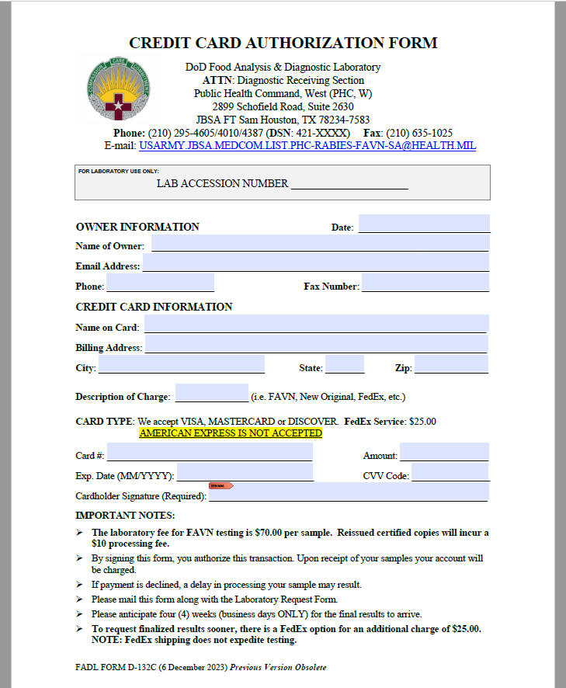
CREDIT CARD AUTHORIZATION FORM
Notes:
FADL Form D-132C

Slide 19
Requesting FAVN Information
Please have clinic email our office: usarmy.jbsa.phc-west.list.phc-w-rabies-favn-sa@health.mil
Pet(s) name
Owner’s Name
MICROCHIP NUMBER(S)
Submitted Date
Destination
When their Health Certificate Appointment is (If scheduled) When is the LAST DAY they are going to be receiving mail at the location listed on their FAVN Document?
*If health certificate is within 10 days going to Korea or Japan and the client has not paid for FedEx
Please Charge the Client $25 FedEx fee by Credit Card payment form (civilian clinic) or point of sale at military VTF
Email a copy of the invoice or the credit card payment form to the FADL with the LAST DAY they are going to be receiving mail at the location
Please be advised:
Our FedEx Pick Up Time is 1200 CST
FedEx requests sent on FRIDAY will be delivered the following MONDAY
WE CANNOT FedEx for SATURDAY Delivery
*All requests are subject to availability (if the result released/time of day request is submitted)
Notes:
FADL Form D-132C

Slide 20

Shipping Samples

Slide 21
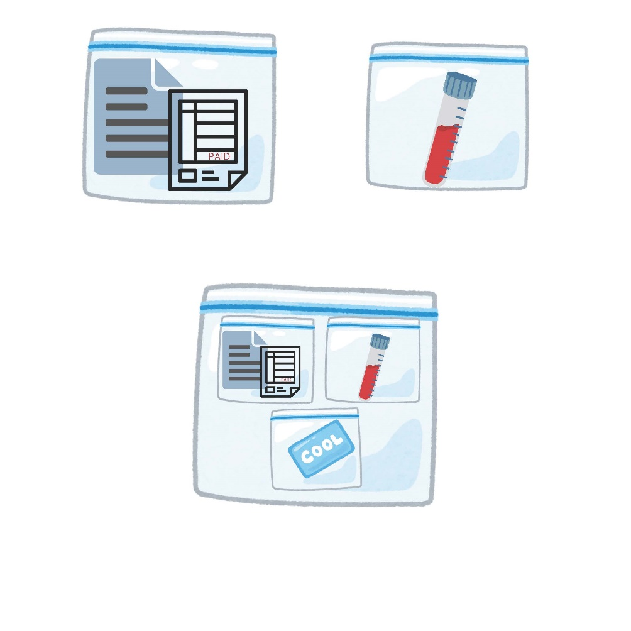
Diagnostic Section: Sample Shipment
Sample Shipment Checklist
Request Form is COMPLETE (no empty lines)
INVOICE and RECIEPT with a ZERO balance (military VTF)
Credit Card Payment form civilian clinic
Serum Sample (no gross hemolysis or lipemia) 1.0–1.5 mL and LABELED with the CORRECT PET’s name and microchip Number
Serum sample is in a SEPARATE Ziplock bag
Paperwork and Serum Sample is in a Ziplock bag
  Multiple pets in one family can be in the sample bag
Ice pack in a SEPARATE Ziplock bag
Please see FADL Form D-132B under documents on our website for shipping instructions and additional information

Slide 22
Diagnostic Section: Contact Information
DISTRO LIST EMAIL:
usarmy.jbsa.phc-west.list.phc-w-rabies-favn-sa@health.mil
Quality Assurance Specialist
Office: 210-295-4387
Operations Assistants (POA)
Office: 210-635-1025
Office: 210-295-4605
Office: 210-295-4004
Animal Health Technician (MWD/GOA/Non-GOA)
Office: 210-221-3323
Chief of Diagnostics
Office: 210-295-6154

