Slide 1
Community and Leaders Information Forum (CLIF)

Slide 2
        OPENING REMARKS

Slide 3
Agenda
        Community Recognition
        Health Clinic – Healthcare
        DENTAC Italy - Dental Care
        DHR – Command Sponsorship, UK Travel Requirements
        FMWR – Valentines Bazaar, Del Din Pool Opening, VAT, AER
        PAO – FAQ capability on USAG Italy Webpage
        DES – Italian Road Code Changes
        DPW – Housing Maintenance Information
        CR2C – OHA Survey

Slide 4
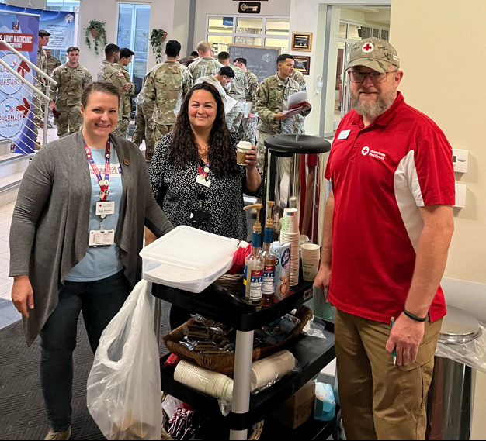
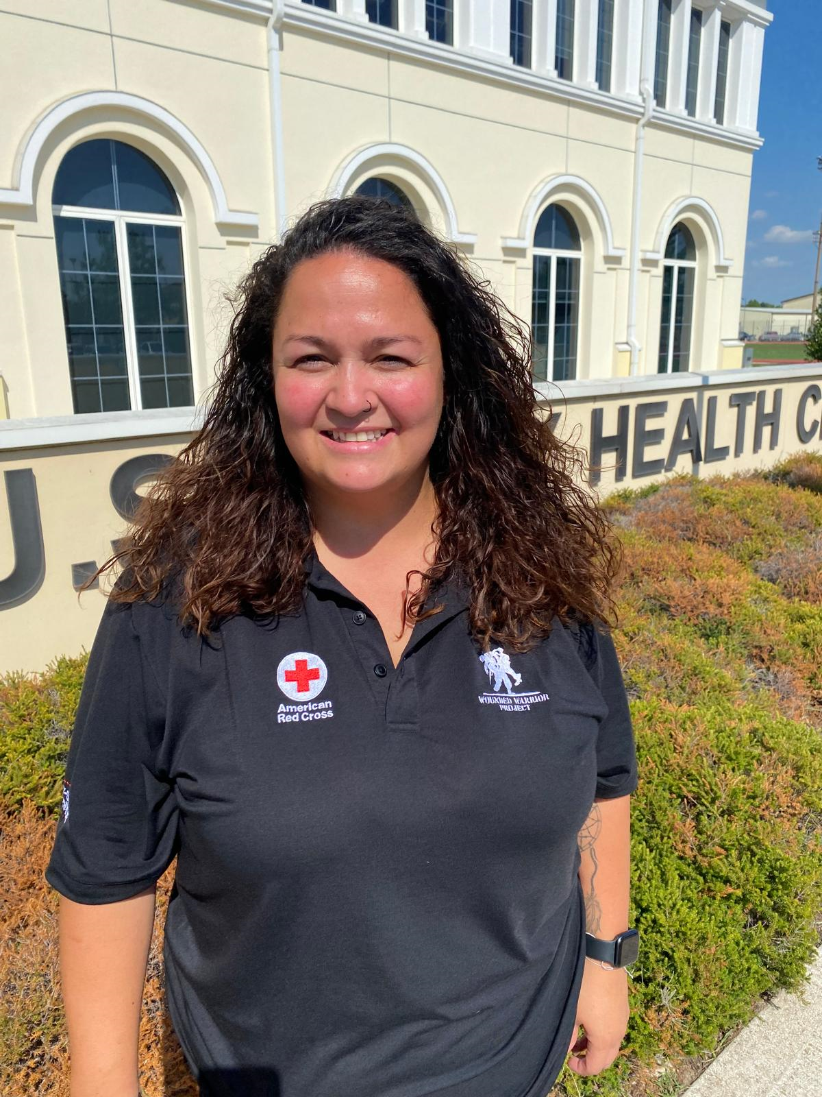
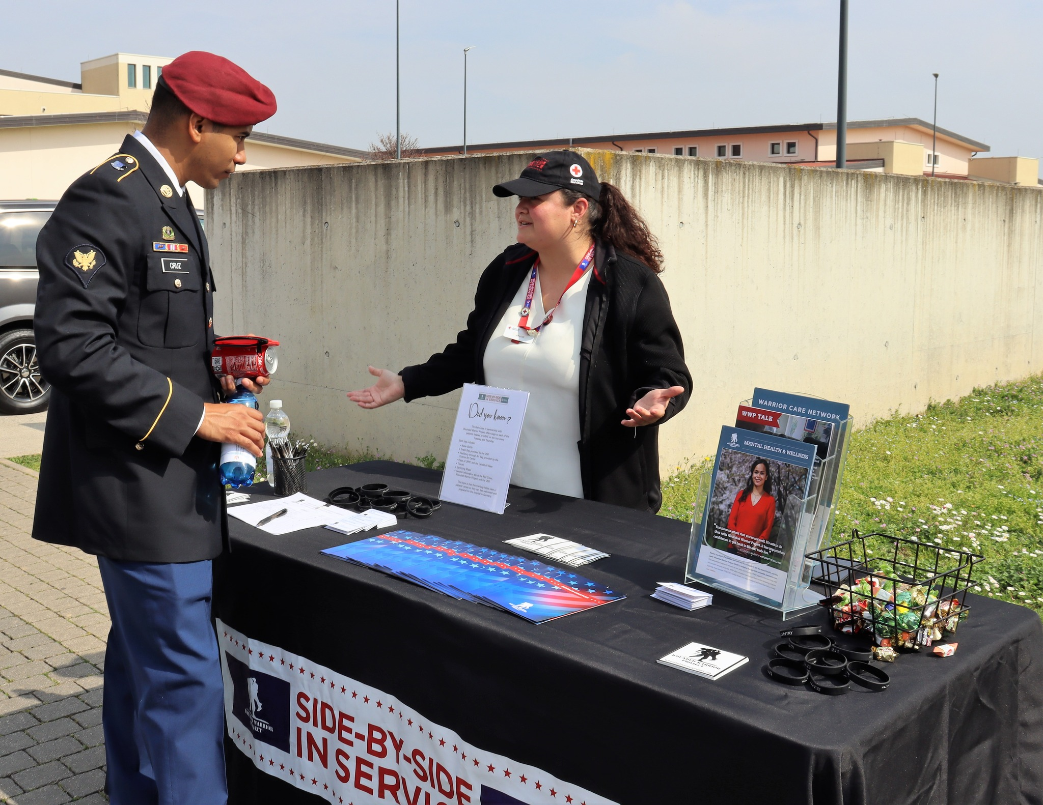
USAHC-V, Community Service Recognition
Angie Olivera,
Mrs. Angie Olivera began volunteering with the American Red Cross in partnership with the Wounded Warrior Project in April 2022 and has since volunteered nearly 1,400 hours, averaging 500 hours a year; bringing priceless support and joy to clinical teams on both Caserma Ederle and Del Din.
Most of these volunteer hours are during the evenings and weekends all while raising three children and supporting her active-duty husband.
Angie has helped coordinate and support countless events and initiatives including our Organizational Resiliency Day; Halloween, Thanksgiving, and Christmas holiday events; monthly “coffee cart;” flu drives; and more.
A favorite quote that guides Angie is from Robert Powell: "Leave the world a little better than you found it." This sentiment perfectly reflects her passion for making a positive impact wherever she goes; for wherever there is a morale event or “morale fire mission,” there is Angie!
Notes:
Red Cross in partnership with the Wounded Warrior Project focuses on providing critical mental health support and resiliency programs, enhancing the well-being of our soldiers and their professional care providers.

Slide 5
C/1-503rd IN (ABN), Community Service Recognition
Angie Olivera,
Mrs. Angie Olivera is an active member of the community and volunteers a significant amount of her time in various ways.
Mrs. Olivera serves as a Project Facilitator and Coordinator for the VMC Wounded Warrior Foundation. Since the Wounded Warrior Foundation is tied into the Ederle Clinic, Angie supports the clinic by volunteering her time to leading multiple activities such as resiliency puzzles, scavenger hunts around Vicenza, and cooking classes.
Angie volunteers her time at every Battalion and Company SFRG event - fundraising, baking treats for our Paratroopers, handing out snacks before a long training rotation, or donating old uniforms, cooking equipment, and other basic house essentials to make the living conditions in the barracks more enjoyable. Her dedication and love for paratroopers extends past March or Die Company, dedicating her time to both Gamble and Dog Company SFRG’s, helping to build company kitchens and hangout spaces in the barracks to better the lives of paratroopers and their families. Additionally, Angie fills the role of a Meal Coordinator for the Battalion Care Team Member, coordinating and resourcing meals for families who need extra help.
Lastly, and most importantly, Angie is a mother to three school aged children. She gives back to the community/DoDEA through her volunteer efforts for field days, class trips, and other school functions.

Slide 6
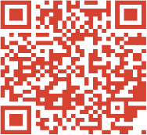
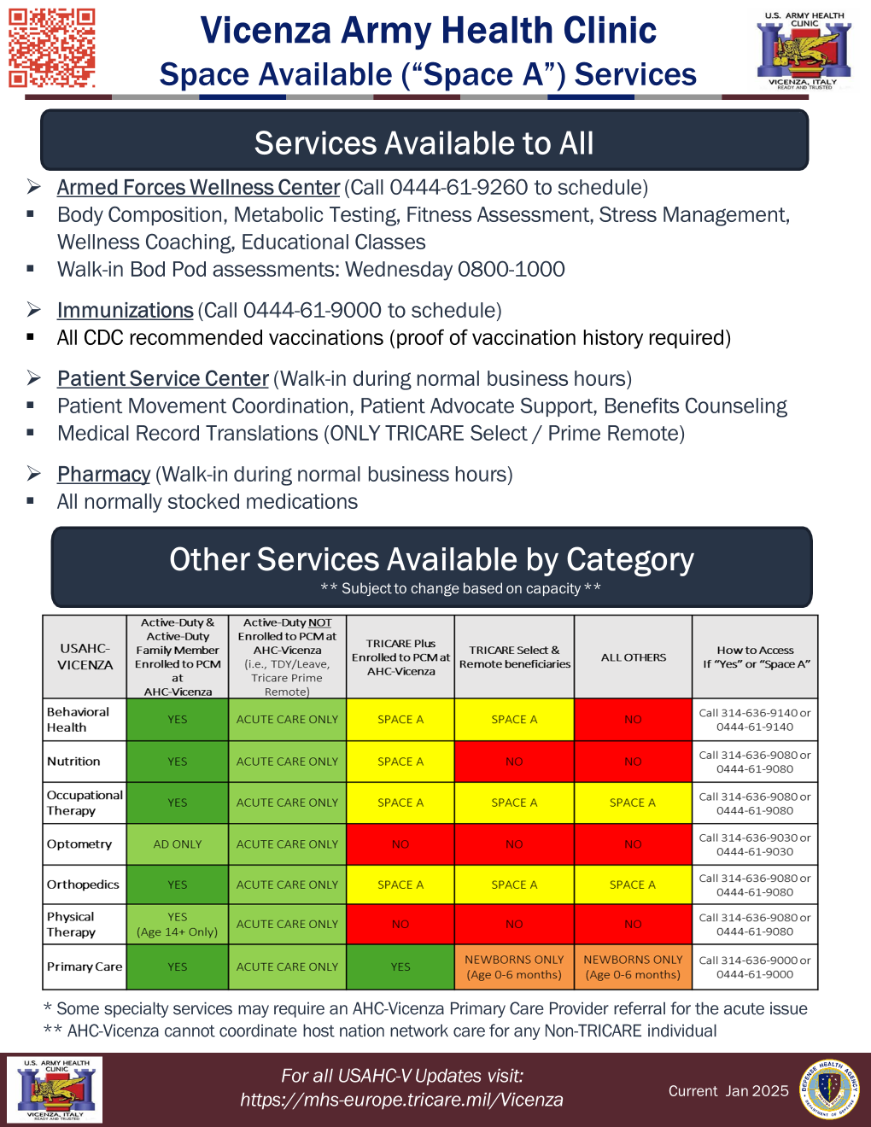
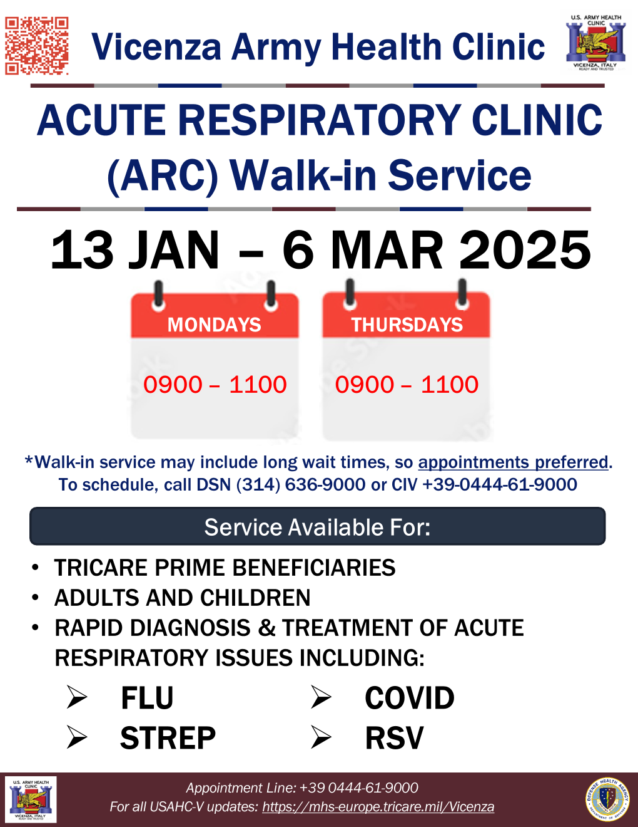
Health Clinic
Appointment Line: 0444 61 9000
https://mhs-europe.tricare.mil/Vicenza
https://www.facebook.com/VicenzaArmyHealth/
Closures
Annual Federal Holidays
Training: 1st & 3rd Thurs PM
Current Seasonal Services
Flu Vaccine Walk-ins
- NOW until February 7th
- Monday afternoons, Wednesday/Thursday mornings
Acute Respiratory Care (ARC) Walk-in
- NOW until March 6th
- Mondays & Thursdays 0900-1100
Patient Information Flyers
NEW: Space Available Services
Cold & Flu Season Guidance
Other Updates & Reminders
COVID Vaccine: Thursday mornings Walk-ins
Pharmacy Self-Care Over the Counter medications
Notes:
“Free COVID tests: How and when to order them--Americans are able to order free COVID-19 test kits from the federal government to be delivered to their homes. The program, offered through the U.S. Health and Human Services (HHS) agency, will offer up to four nasal swab tests per U.S. household when it opens at COVIDTests.gov. The tests will be able to detect the dominant variants that are circulating, according to the CDC.”
https://www.covid.gov/tools-and-resources/resources/tests
Metabolic Pathways
- To align with rapidly evolving current best practices, we are incorporating a medical component to our current comprehensive lifestyle services (nutrition, activity, and BH).
- Patients who fail to meet treatment goals after 6 months of lifestyle intervention may be offered medical (pharmaceutical / surgical treatment options).

Slide 7

DENTAC- Italy
American Dental Association National Children’s Dental Health Month = FEBRUARY!
  Dental screenings to be conducted at elementary school.
  These will take place during normal school hours, and nothing required from parent to schedule.
  If there are dental issues identified, the school nurse will contact parent to share any findings.
For Appt. 636-9210, 0444-61-9210, or https://my.mhsgenesis.health.mil/
Emergency on-call/after-hours contact +39 334-600-8029
“…promote the benefits of good oral health to children, their caregivers, teachers and many others.”

Slide 8

MWR – Del Din Pool Reopening!
MWR is happy to share that the Del Din Pool will be reopening!
Date: Monday, February 3
Time: 06:00-14:00
Location: Del Din Fitness Center
What to Expect:
  Indoor Pool
  Locker Rooms
  Diving Platforms
  PT hours of operation
  Open swim hours of operation
  Space for unit trainings

Slide 9

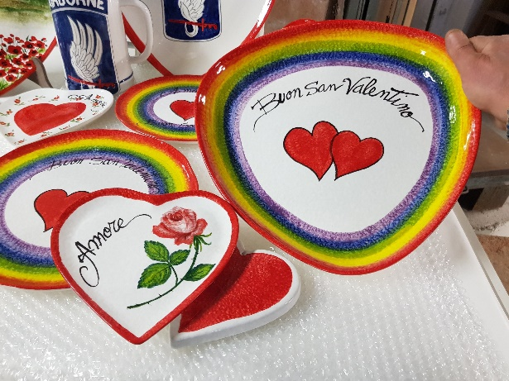
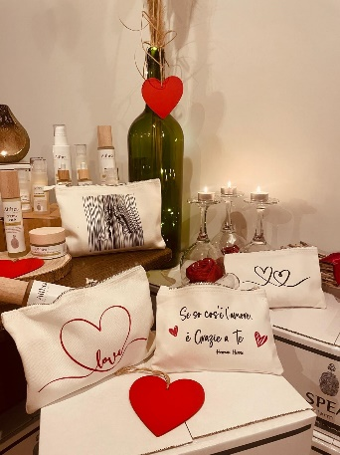
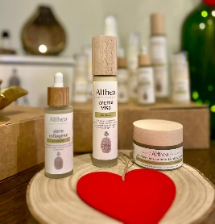

MWR – Valentine’s Bazaar
Valentine’s Bazaar:
Dates/Times:
  Friday, February 7
  from 13:00-19:30
  Saturday, February 8
  from 10:00-19:30
  Sunday, February 9
  from 12:00-17:30
Location: Upstairs in the Arena Bowling Center
What to Expect:
  Valentine’s-themed products
  25+ Vendors
  6+ new vendors
    Leather goods
    Scented oils and perfumes
    Baked goods
    Local cheeses
    Sculptures & lava rock jewelry
  Wine Clinics
  Outdoor Recreation booth to promote wine certification courses
  Other Products You Can Expect:
    Jewelry
    Wine, beer, and spirits
    Chocolates and baked goods
    Cheese and regional foods
    Soaps and Textiles

Slide 10
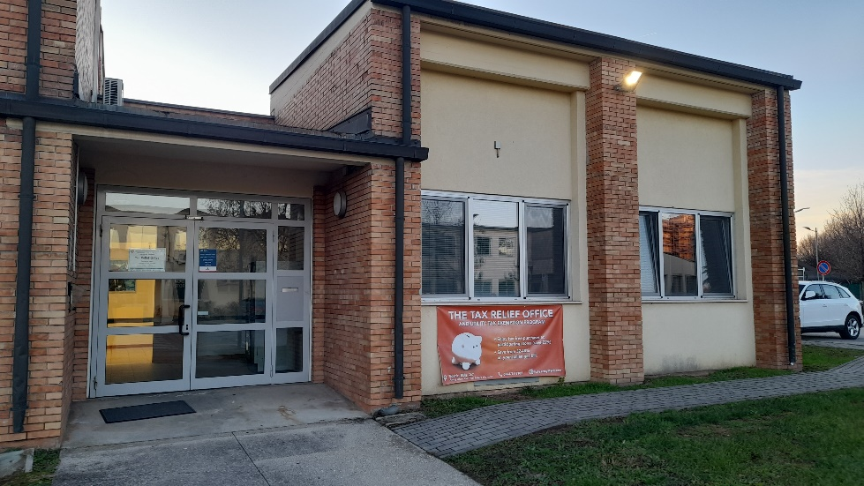
MWR – Tax Relief (UTEP) Changes
Tax/IVA-Free Purchases:
Enjoy saving 22% off any purchase over €150 in the Veneto and Tuscany!
Tax/IVA-free purchases can be performed at most stores.
Steps:
  Get an estimate (preventivo)
  If unsure, bring your estimate by Tax Relief if you’d like us to check what you’re buying and if all data was filled in correctly
  Get an Italian cashiers check for the total cost without tax/IVA
  Bring the check and estimate to Tax Relief
  You’ll receive a sealed envelope with the check, estimate, and important documents.
  Return to the store, provide the sealed envelope, and purchase your product(s)
For more information on the process, visit our website: Italy.armyMWR.com
Beginning in January:
Two payment options for paying service fees
  Annual
    $264 per year
    Cost-savings and fixed price for the year
  Bi-Monthly
    $60 (every two months)
    Lower up-front costs
    Added flexibility

Slide 11


ARMY EMERGENCY RELIEF CAMPAIGN
Campaign Dates: 1 MARCH through 16 JUNE
  OPORD forthcoming.
Goals: The Annual Campaign’s purpose is to fully inform 100 percent of all active-duty and retired Soldiers and their Family members (including spouse and children of deceased Soldiers) about the types of financial assistance available from AER and provide the opportunity for Soldiers to donate (USAG Italy – $10,000).
Needs:
  Every company-level unit will appoint an AER campaign representative (SSG or above) who will work with the installation’s campaign coordination team.
  Endorse/publicize the campaign through usual campaign activities, memorandums, digital platforms, and/or other communication.
  Provide Soldiers the opportunity to make voluntary donations.

Slide 12
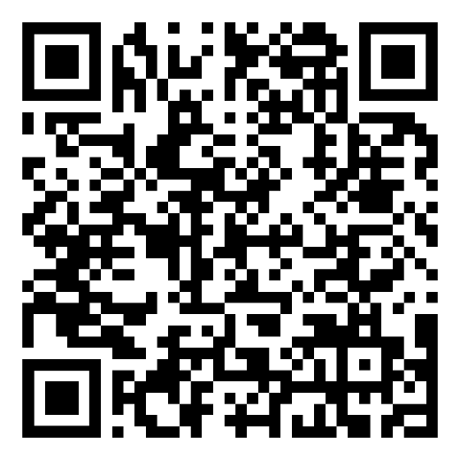
ARMY EMERGENCY RELIEF CAMPAIGN
Unit Representative Training (4 options):
  12 FEB | 0930 or 1330
  19 FEB | 0930 or 1330
*Each training is located at the Ederle ACS and will last approximately 1 hour.
Scan the QR code for Unit Representative Training sign-up:
Campaign Kick-off and Outreach Events:
Information forthcoming.

Slide 13
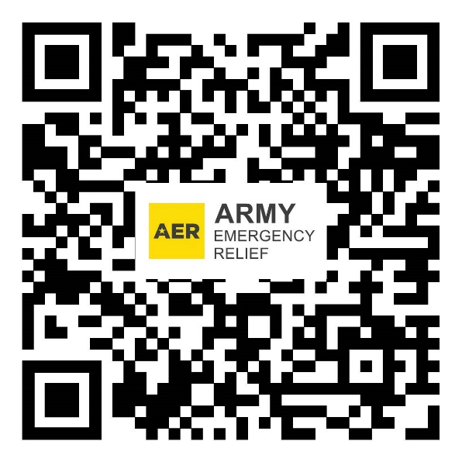
ARMY EMERGENCY RELIEF CAMPAIGN
Scan the QR code to learn more and donate Army Emergency Relief:
References and Resources:
AR 600-29 (Fundraising within the Army)
AR 930-4 (Service Organizations – Army Emergence Relief

Slide 14
Directorate of Emergency Services
Provost Marshal Office
Reference: USAG Italy Parking Policy, signed April 2024
Parking is limited across the installations. Main points to remember:
Handicap spaces. Must display a PMO issued handicap placard.
Long term parking. Long term parking is arranged through the PMO, located on Ederle (center parking lot East of Building 28) and Del Din (parking garages levels 4/5).
Timed parking spaces. Should only be used for short duration (15min/30min/2hr)
Del Din. The only authorized parking areas are in the two parking garages and time restricted parking spaces (not to exceed indicated time). Parking by the barracks is not authorized!
Vehicles parked and unattended for 5 days will be treated as abandoned and towed to a secure facility (space permitting).
One parking ticket = 1 point assessed on AFI license.
Handicap space violation = 3 points assessed
Any person assessed 6 or more points for parking violations within 12 consecutive months may have their AFI driving privileges suspended for 30-90 days.
Notes:
SPRUILL TYRELL J ,119, 173 BSB
JAMESON CAMERON J, 77, 1-503
PENA QUINTON L, 72, 54 BEB
CRUZ VELAZQUEZ JOSE DOROTEO, 68, 2-503
MUENZLER NICHOLAS B, 63, 2-503 T
HOMAS KYRON J, 61, 173 BSB
HUDSON DEON J, 59, 2-503
HALL JOSHUA T, 56, 7ATC-TSAE
HAMRY CONNOR E, 54, 1-503
KIENDREBEOGO HANNIEL, 52, 173 BSB
BAUTISTA ROGELIO A, 5,1 1-503
STONE JACKSON S, 51, 2-503
SNEAD DAVID, 42, 54 BEB

Slide 15
Italian Rode Code Updates
SOURCES:
Agenzia GAMMA 08 Dic. 2024 Normative
https://www.agenziagammariccione.it/nuovo-codice-della-strada-2024-sintesi-delle-modifiche-in-vigore-dal-14-dicembre/
I FOCUS DEL SOLE 24 ORE 13.12.2024 “Nuovo Codice della Stada. Le modifiche subito in vigore”. Inserto al giornale.
The new Italian Road Code, introduced by Law No. 177 of 25 November 2024, came into force on 14 December 2024, although some specific aspects will be further defined by future implementing ministerial decrees.
This means that NOT all changes will come into force starting 14 December as, for full operation, they require the indispensable implementing decrees of the Ministry of Infrastructure and Transport and the other competent ministries.

Slide 16
Driving Under the Influence of Alcohol (Art.186)
Those found driving with a blood alcohol level of more than 0.8 grams per liter (US BAC .08) will only be able to drive with a blood alcohol level of 0 for at least two years.
The prefect can also impose the obligation to drive a car with an Ignition Interlock Device installed (breathalyzer installed on the car that prevents vehicle from starting if blood alcohol level exceeds 0 grams)
Blood alcohol level between 0,0 g/l and 0,5g/l US BAC .05 |  |  | Administrative procedure: N/A
Blood alcohol level between 0,5 g/l and 0,8g/l US BAC .05 - .08 |  |  | 500€ to 2000 € fee; 3 to 6 months driver’s license suspension
Blood alcohol level between 0.8 g/l and 1.5 g/l US BAC .08 - .15 | Code 68 on driver’s license | 2 yrs with 0.0 g/l blood alcohol level while driving | 800€ to 3.200 € fee; 6 months to 1 year driver’s license suspension Penal procedure: up to 6 months detention
Blood alcohol level over 1.5 g/l US BAC .05 | Code 69 on driver’s license | 3 yrs with 0.0 g/l blood alcohol level while driving permitted only with Alcolock Ignition Interlock Device installed in the car | 1500€ to 6000 € fee; 1 to 2 years driver’s license suspension Administrative seizure of the vehicle on spot; Vehicle’s confiscation (at end of penal proceeding) Penal procedure: 6 months to 1 year detention

Slide 17
New Italian Road Code 2024
Driving under the Influence of Drugs (Art. 187)
It is not necessary to demonstrate the state of psychophysical alteration while driving, a positive test is sufficient.
In the event that the driver tests positive, the license will be revoked, and, in any case, the holder will not be able to obtain a new license before three years from the date of revocation.
Withdrawal of driving license in case of drink-driving is always envisaged when the driver, with alcohol level superior to 1,5 g/l (US BAC .15) or under drug influence, has caused a car accident.
Use of cell phone while driving (Art.173)
Fine: from 250 to 1000 euros
License suspension: The use of mobile phones while driving is included among the serious violations that provide for the automatic short suspension (i.e. without the intervention of the prefect) of the license at the first violation for drivers with less than 20 points on the license based on the following:
– 7 days of suspension if you have between 10 and 19 points,
– 15 days of suspension from one to nine points.
The duration of the suspension will double in the event of an accident.

Slide 18
New Italian Road Code 2024
Speed cameras and other devices
Speeding in residential and urban areas. In the event of violation of speed limits of more than 10 km/h and no more than 40 km/h within a built-up area at least twice within a year: a fine of 220 euros and suspension of the license from 15 to 30 days.
Citation for dangerous and concurrent violations:
Dangerous violations, use of cameras allowed. On motorways and main extra-urban roads, the police forces will be able to ascertain some particularly dangerous violations using normal cameras and the related photographic or filmed documentation.
Automatic detection of multiple violations at the same time. The devices for the automatic detection of violations will be able to ascertain two or even more violations at the same time for example speeding and passing through red light.
Electric Scooters
Helmet required for all ages.
In addition, scooters will only be able to circulate on urban roads with a speed limit of no more than 50 km/h (no longer on cycle paths). Prohibition of parking on sidewalks (except for exceptions specifically indicated).
Adhesive identification mark (Targhino, version of license plate) and insurance will be required in the future – pending implementation by Italian government.
Notes:
(prohibition of circulation of certain vehicles, reversal of the direction of travel, circulation on prohibited lanes, improper occupation of acceleration or deceleration lanes, failure to use position lights during parking or stopping, violation of the rules on toll collection)

Slide 19
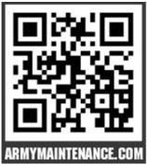
Housing - Maintenance Requests
Residents of Government Controlled Quarters
  Submit requests in ArMA (ArmyMaintenance.com)
    If unable to use ArMA call the Total Maintenance Contractor (TMC) – IGOM
      0444-71-2515
Residents of Private Rental Properties
  Submit requests to your Landlord or POC (Agency)
  Private Rental Liaison Support if Housing support needed/wanted
    0444-71-2720/21
*Contact numbers and more information can be found on our webpage:
https://home.army.mil/italy/about/Garrison/directorate-public-works-1/housing

Slide 20
Maintenance Requests - Emergency After Hours
Examples of Emergency Maintenance Requests:
  Electrical (power failure, exposed/smoldering wires, lights flashing, garage door inoperative)
  Plumbing (broken/leaking water line, sewage flooding, no hot water, )
    Heating (no heating, furnace overheating, furnace making loud noises, fumes from furnace)
    Air Conditioning (No A/C in the entire house, gas leaking, any safety hazard)
  Appliances (range leaking gas, any electrical shorts, any safety hazards, refrigerator not working)
  Structural (broken/unsecure exterior door, broken glass/window, lock-out, roof leaks)
Residents of Government Controlled Quarters
  Call the Total Maintenance Contractor (TMC) – IGOM
    0444-71-2515
Residents of Private Rental Properties
  Submit requests to your Landlord or POC (Agency)
  Private Rental Liaison Support if Housing support needed/wanted
    0444-71-2720/21
*Contact numbers and more information can be found on our webpage:
https://home.army.mil/italy/about/Garrison/directorate-public-works-1/housing

Slide 21

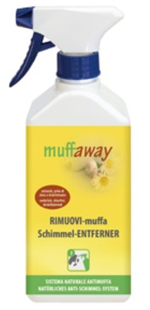

Mold Prevention
Mold thrives in conditions of:
Humidity Poor Ventilation Poor Lighting
Everyday Mold Prevention Tips:
Open your windows and cross ventilate your home for up to 30 minutes daily (also in winter times). Especially in restrooms after shower or bath
Open your shutters and blinds to allow natural daylight into the house
Clean showers and tubs weekly so that mildew cannot grow on soap scum and moisture
Wipe down water condensation that runs down window frames
Clean your house regularly
Watch for condensation and wet spots, or leaky plumbing
Mold Removal:
Mold can be removed from hard surfaces with household products, soap and water, or a bleach solution of no more than 1 cup of bleach in 1 gallon of water. ​
Contact the appropriate agency (GCQ Work Order Desk or the Property Owner - Private Rentals) right away to address these issues.

Slide 22
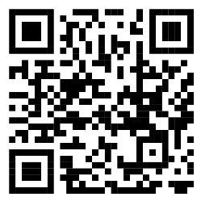





Take the OHA Utility Expenses Survey now!
Common Access Card not required to access survey
2025 OHA Utility and Move-In Expenses Survey
Who
What
Where
When
Why
Service members or their spouses should take the survey if:
You have been stationed in Italy for at least 3 months
You reside in privately leased quarters
You receive an Overseas Housing Allowance (OHA)
Survey conducted on behalf of DoD, designed to collect utility/recurring maintenance and move-in expense data incurred by service members stationed overseas who reside in private housing
Scan the QR code above or visit this link:
https://www.travel.dod.mil/Allowances/Overseas-Housing-Allowance/OHA-Data-Collection-Surveys/
OPEN NOW
January 1 – March 31, 2025
Utility Survey conducted annually
Move-In Expenses Survey conducted once every three years in combined survey
You play a critical role!
Data will determine the Utility/Recurring Maintenance and Move-In Housing Allowances paid to service members in Italy

Slide 23
Next CLIF
26 February 25
1030-1130
GOLDEN LION, CASERMA EDERLE

