Slide 1
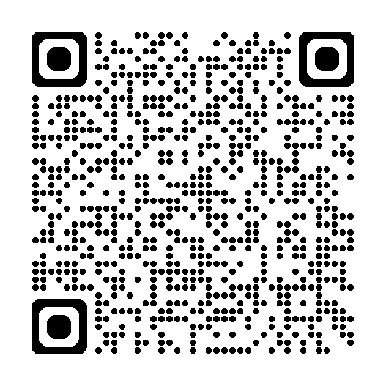
YEAR IN REVIEW
OCPA needs your help in telling the Army story!
Submit your best work for a chance to be featured on Army.mil and across @USArmy social media platforms in the 2024 Army Year in Review!
Took a great photo? Wrote a newsworthy article? Submit it!
Every December, OCPA’s Digital Media Division assembles the best photos and articles into the Year in Review campaign. This year, DMD is expanding the curation process, opening submissions to all Army public affairs and visual information personnel, including enlisted, officer, civilian and contractors. Comprehensive guidance is available in an EXORD.
Photos submitted must be uploaded and released to the public through the DVIDS content management system. Photo submissions will be accepted exclusively via the Army Year in Review tool in DVIDS as a portfolio — no photos will be accepted via email, Teams, etc.
Articles will cover contributions to the Army mission in 2024. Features, hard news and compilation-style recaps are accepted. Please submit articles via email to ocpadmd.yearinreview@army.mil with the subject: 2024 Year in Review Submission — [Organization Abbreviation].
^{CRITERIA}
Photos
Photographed within 2024
Work of the highest quality
Limit 5 (five) photos per person
Submitted through DVIDS
Submitted by 04 NOV 2024
Follows visual information guidance in AR 670-1/DA PAM 670-1, AR 360-1, DODI 5040.02, etc.
Showcases the full breadth of the Army mission and the team that accomplishes that mission
Articles
Covers notable achievements, the Army making a difference, innovation, improvements to quality of life, stories of valor
Released in CORE content management system
Submitted via email to ocpadmd.yearinreview@army.mil
^{TIMELINE}
2024 — U.S. Army personnel take quality photos, write news stories; content uploaded to DVIDS/CORE
SEPT — EXORD released; internal awareness campaign begins; photo submissions open on DVIDS, articles submitted via email
04 NOV — Submissions closed; internal awareness campaign ends; OCPA begins selection process
02 DEC — Year in Review site launched; @USArmy social media campaign begins
Toolkit QR Code
Help OCPA get the word out!
To encourage maximum participation, teams across the Army are asked to support distributing information about the Year in Review. DMD has provided a messaging toolkit to assist in efforts, which includes a link to the EXORD, an informational one-pager, social-style graphic, PowerPoint slide and guides on how to use DVIDS for submission.

