Slide 1
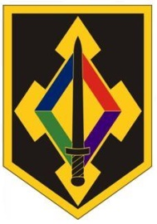
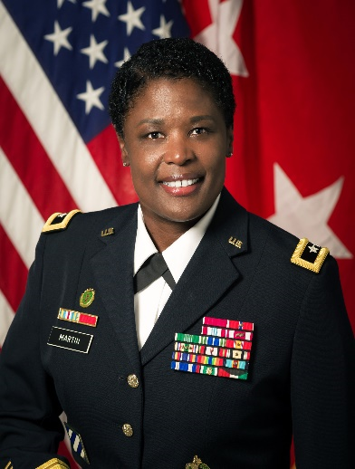
Major General Donna W. Martin
Commanding General
U.S. Army Maneuver Support Center of Excellence
Fort Leonard Wood, Missouri 65473
Major General Donna W. Martin is a native of Yorktown, Virginia. She graduated from Old Dominion University with a Bachelor of Science in Criminal Justice. She was commissioned a second lieutenant in the Military Police Corps in 1988. Major General Martin earned a Master’s degree in Strategic Studies from the United States Army War College in Carlisle Barracks, Pennsylvania.
Major General Martin has served in every staff position from Battalion to Combatant Command (USPACOM). In 2006, Major General Martin was selected to command the 385th Military Police
Battalion (Dragoons) at Fort Stewart, Georgia. The Battalion Headquarters deployed to Afghanistan from 2006-2008 providing command and control to seven Military Police units and a National Guard Field Artillery Battery. After command, Major General Martin remained at Fort Stewart to serve as the Inspector General of the 3rd Infantry Division and deployed to Iraq in October 2009.
Major General Martin has commanded twice at brigade level. She commanded the 202d Military Police Group (Criminal Investigation Division) at Kaiserslautern, Germany, from July 2011 until May 2013. In June 2013, she assumed command of the Rear Detachment of the 18th Military Police Brigade. In June 2014, Major General Martin reported for duty as the Chief of Investigations, HQDA Inspector General Agency. From March 2015 until June 2017, Major General Martin assumed duties as the Deputy Commanding General, United States Army Recruiting Command at Fort Knox, Kentucky. From June 2017 to August 2018, Major General Martin also served as the Chief of the Military Police Corps Regiment and Commandant of the Military Police School. In August 2018, Major General Martin assumed command of the Maneuver Support Center of Excellence and Fort Leonard Wood, Missouri.
Major General Martin’s military awards include: Legion of Merit with 1 Bronze Oak Leaf Cluster; Bronze Star Medal with 1 Bronze Oak Leaf Cluster; Defense Meritorious Service Medal; Meritorious Service Medal with 4 Bronze Oak Leaf Cluster; Army Commendation Medal with 4 Bronze Oak Leaf Cluster; and an Army Achievement Medal.
Major General Martin has been married for over 25 years. She and her husband, Chris, are the proud parents to their son, Christopher, who is a recent graduate of the University of Virginia.

